Slide 1
The Source of Temptation
April 16

Slide 2
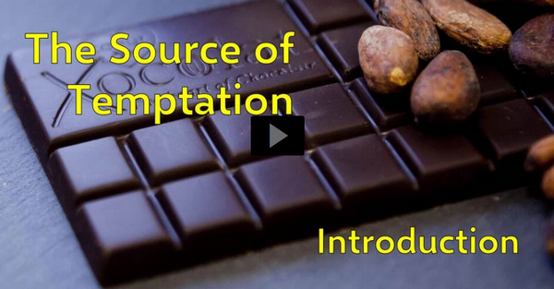
Video Introduction
View Video

Slide 3
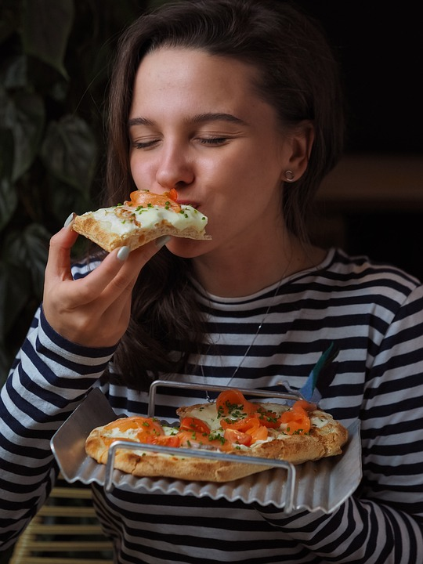
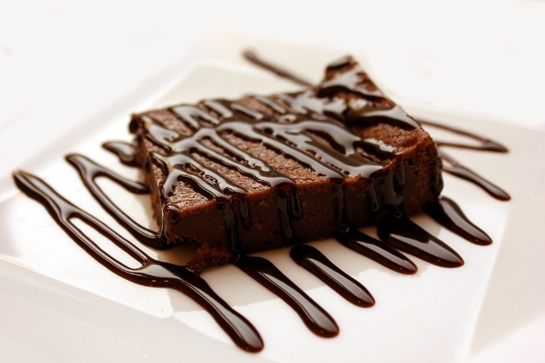
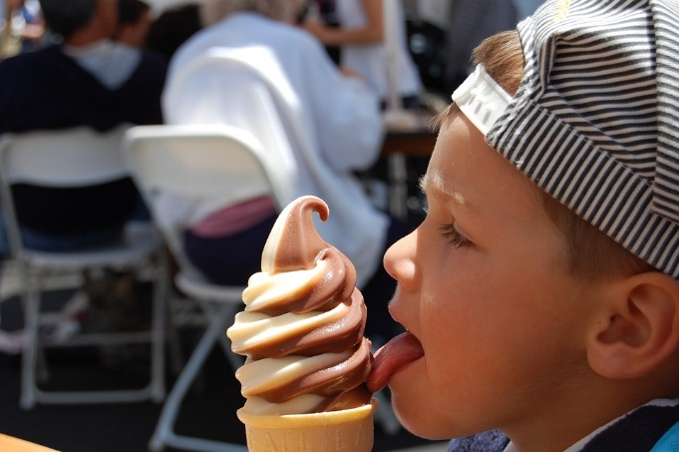
Be honest, now …
What food tempts you to say “yes” to just one more bite?
Unfortunately you discover the results of those seemingly harmless “one more” bites when you step on the scales.
Saying “yes” to those temptations make a difference
We have no one to blame but ourselves when we fall into sin

Slide 4
Listen for what not to say.
James 1:13 (NIV) When tempted, no one should say, "God is tempting me." For God cannot be tempted by evil, nor does he tempt anyone.

Slide 5
God Does Not Tempt You to Sin
What are some ways we may excuse our temptation to sin?
Why would we try to say God tempted us?
Why is it not possible for God to be at fault for our temptation to sin?

Slide 6
God Does Not Tempt You to Sin
Why is important to know that God doesn’t tempt anyone?
So what makes a temptation appealing?
If temptations promise good but never deliver, why do we so often say yes to them?

Slide 7
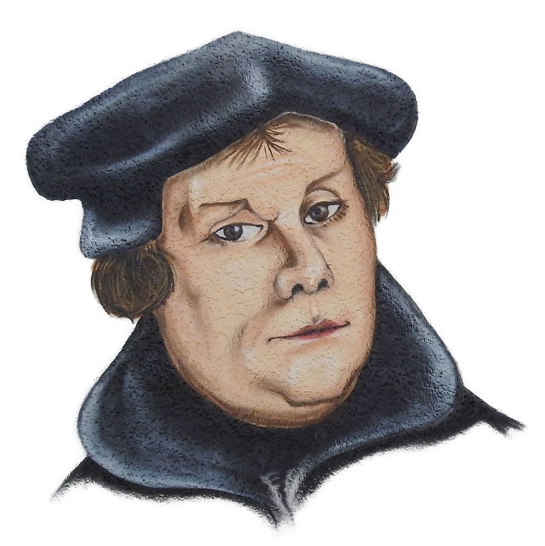
God Does Not Tempt You to Sin
Martin Luther said,
What does that have to do with temptations?
What practices can help us avoid the enticement of sin (or the birds from nesting in your hair)?
You cannot keep the birds from flying over your head, but you can keep them from making a nest in your hair.

Slide 8
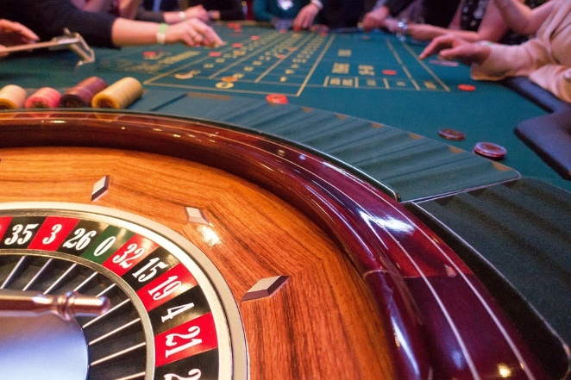
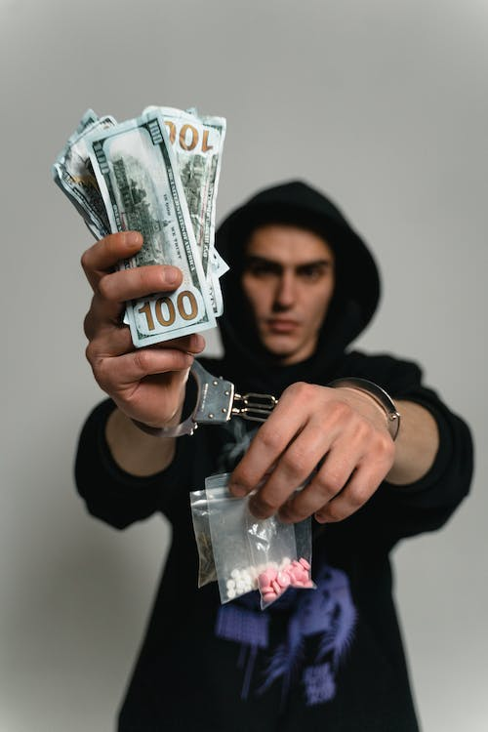
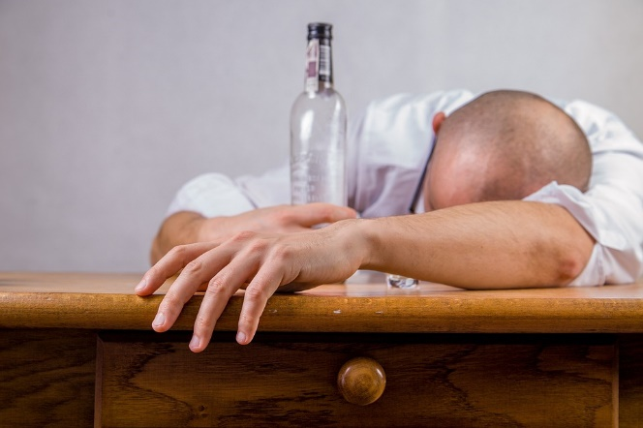
Temptation Begins with Our Own Sin Nature
What are some things that are tempting to some people but not to others?
Listen for who is to blame when we sin.

Slide 9
Listen for who is to blame when we sin.
James 1:14-15 (NIV) but each one is tempted when, by his own evil desire, he is dragged away and enticed. 15 Then, after desire has conceived, it gives birth to sin; and sin, when it is full-grown, gives birth to death.

Slide 10
Temptation Begins with Our Own Sin Nature
Let’s list the sequence that starts with temptation.
You should know that temptation follows a predictable pattern

Slide 11
Temptation Begins with Our Own Sin Nature
Consider some basic needs that we have … for each, identify how it can be twisted into something sinful.
Food
Approval
Shelter
Companionship
Transportation
Clothing
Entertainment

Slide 12
Listen for a reminder of God’s goodness to us.
James 1:16-18, 21 (NIV) Don't be deceived, my dear brothers. 17 Every good and perfect gift is from above, coming down from the Father of the heavenly lights, who does not change like shifting shadows.

Slide 13
Listen for a reminder of God’s goodness to us.
18 He chose to give us birth through the word of truth, that we might be a kind of firstfruits of all he created. … 21 (NL2) So get rid of all the filth and evil in your lives, and humbly accept the word God has planted in your hearts, for it has the power to save your souls.

Slide 14
Everything Good Comes from God
What do you see here about how God does demonstrated goodness to us?
What good gifts have you received from God?
How does James’ image of light illustrate the constancy and faithfulness of God?

Slide 15
Everything Good Comes from God
Verse 18 says, “He chose to give us birth through the word of truth” What do you think is the role of the Bible in leading a person to experience new birth?
It is vital to know specific passages which give the sinner these truths and the sequence in which to present them.

Slide 16
Everything Good Comes from God
Verse 21 says, “humbly accept the word planted in you” for the purpose of getting rid of the moral filth and evil excess … how does God’s Word help do this?

Slide 17
Application
Confess.
If you blamed others or God for your sin or the fact you fall into sin, confess that to God.
Admit your own responsibility and look to God to help you stand and resist the pull of sin.

Slide 18
Application
List.
Make a list of the good things God has done or placed in your life.
Add to your list any trials or difficulties God used to strengthen your faith in Him.
Offer a prayer of thanks for how He has worked in your life.

Slide 19
Application
Instruct.
Help someone you know who is struggling with temptation by sharing the truths you discovered in James 1:13-18.
Don’t just focus on the principle that we alone are to blame for our sin, but lift up the goodness of God who can walk with and strengthen us.

Slide 20
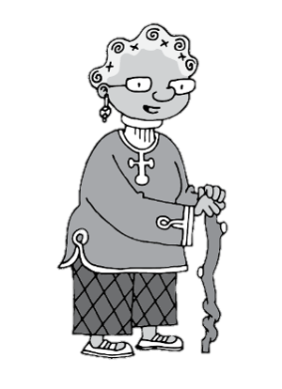
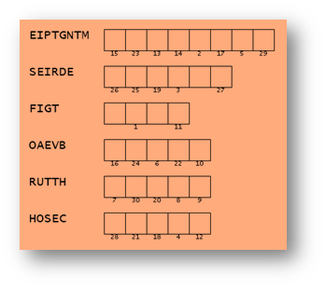
Family Activities
Spiros the Spy said this was a secret code. It looks more like words with letters rearranged. I think they are words from your Bible Study. I’ll bet those numbers mean something, too. Check your Family Activities page https://tinyurl.com/2vymyvwb for technical assistance. Or maybe you’d rather do the crossword!

Slide 21
The Source of Temptation
April 16

