Slide 1
The Sign of His Provision
March 23

Slide 2
Video Introduction
View Video

Slide 3
Think about it …
Imagine that one of the couples in our Bible Study class just had their home destroyed by a tornado. It was the home they had lived in for 40 years.
Why might they be doubting God
in this situation?
What kind of needs do they have?
What could you say to these people when you see them?

Slide 4
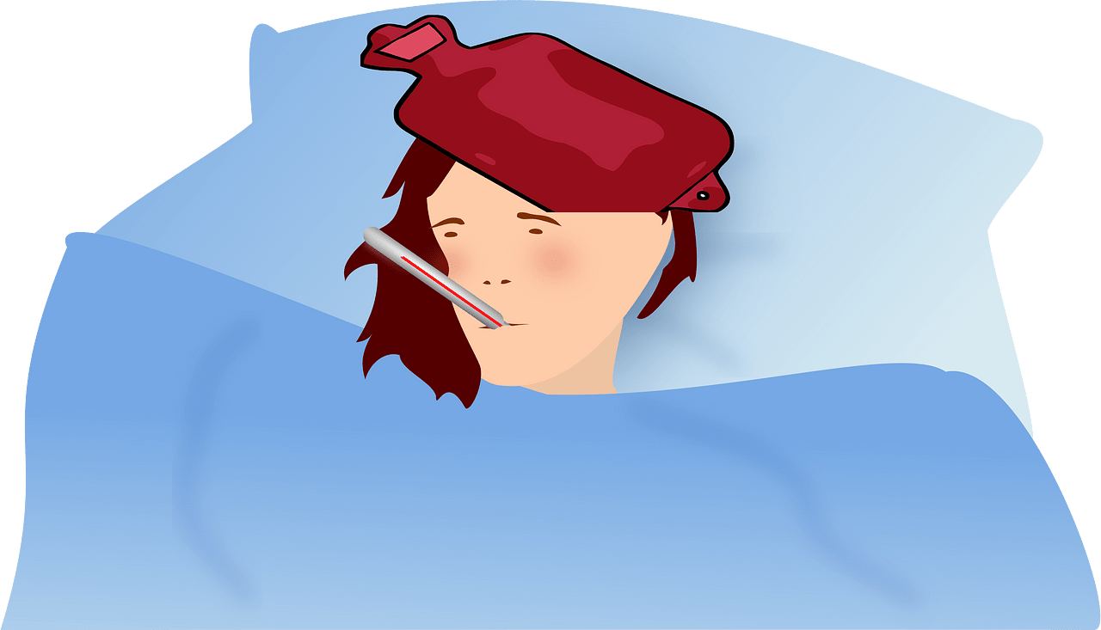
Think about it …
All of us have faced needs during times of crisis where we might have doubted God's provision for us
Today ⇨ We want to study how we can trust Jesus to provide for our needs

Slide 5
Listen for the response to a need.
John 6:1-5 (NIV) Some time after this, Jesus crossed to the far shore of the Sea of Galilee (that is, the Sea of Tiberias), 2 and a great crowd of people followed him because they saw the miraculous signs he had performed on the sick. 3 Then Jesus

Slide 6
Listen for the response to a need.
went up on a mountainside and sat down with his disciples. 4 The Jewish Passover Feast was near. 5 When Jesus looked up and saw a great crowd coming toward him, he said to Philip, "Where shall we buy bread for these people to eat?"

Slide 7
Jesus Sees the Need
Why were the crowds attracted to Jesus?
Note Jesus’ response to coming crowd.
He saw them gathering
He asked Philip, “where can we buy bread for these hungry people?”

Slide 8
Jesus Sees the Need
Why is it significant that Jesus noticed and cared about the physical needs of the crowd?
What does Jesus’ attitude towards all those people suggest to us?
What might be a typical reaction to situations that seem to present no readily available solution?

Slide 9
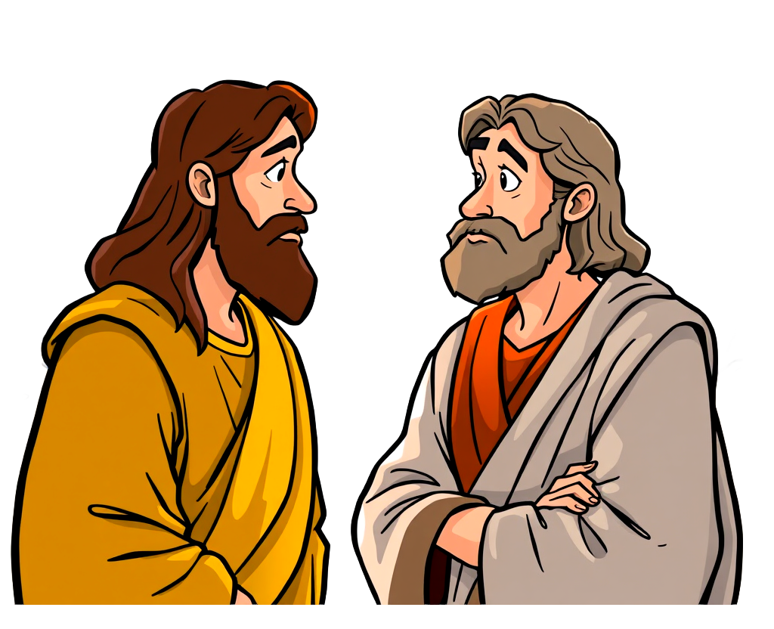
Jesus Sees the Need
Why do you think Jesus asked this question of Philip?
Philip, we need bread …

Slide 10
Listen for seemingly meager supply.
John 6:6-11 (NIV) He asked this only to test him, for he already had in mind what he was going to do. 7 Philip answered him, "Eight months' wages would not buy enough bread for each one to have a bite!" 8 Another of his disciples, Andrew, Simon Peter's brother, spoke up, 9 "Here is a boy with five small barley

Slide 11
Listen for the response to a need.
loaves and two small fish, but how far will they go among so many?" 10 Jesus said, "Have the people sit down." There was plenty of grass in that place, and the men sat down, about five thousand of them. 11 Jesus then took the loaves, gave thanks, and distributed to those who were seated as much as they wanted. He did the same with the fish.

Slide 12
Jesus Meets the Need
What kinds of thoughts or response would you have had if you had been there and Jesus asked you, "How can we supply these people's needs?
What kinds of resources are seemingly insufficient in our class to meet needs of people in our class, our church, our community?

Slide 13
Jesus Meets the Need
What’s wrong with the response, “here’s a little something, but it won’t make much difference”?
How can we place our meager “loaves and fishes” (resources) in Jesus’ hands?

Slide 14
Jesus Meets the Need
What obstacles hinder us from trusting Jesus to provide for us in today’s world?
How might Jesus multiply these things?

Slide 15
Listen for people’s reaction to the miracle.
John 6:12-15 (NIV) When they had all had enough to eat, he said to his disciples, "Gather the pieces that are left over. Let nothing be wasted." 13 So they gathered them and filled twelve baskets with the pieces of the five barley loaves left over by those who

Slide 16
Listen for people’s reaction to the miracle.
had eaten. 14 After the people saw the miraculous sign that Jesus did, they began to say, "Surely this is the Prophet who is to come into the world." 15 Jesus, knowing that they intended to come and make him king by force, withdrew again to a mountain by himself.

Slide 17
Jesus Sets His Own Agenda
What did the people desire to do?
Their thinking was flawed.
It was not the start of a political or military revolution.
This was not His mission.
The miracles were signs of His divinity.

Slide 18
Jesus Sets His Own Agenda
How can we know if we're focused more on what Jesus can do for us than on who He is?
What small gifts have you seen multiplied when you gave them to Jesus?

Slide 19
Application
Reflect.
Write out a prayer of confession to the Lord.
Admit the times that you have focused only on your desires.
Remember how your greatest need was provided in Christ and His provision.

Slide 20
Application
Share.
Find a way this week to live like the young boy from this passage
Share with someone what God has blessed you with, big or small.
Remember, God can take our little and make much of it!

Slide 21
Application
Seek.
Spend time in prayer regarding ways to show compassion as Jesus did, not as a burden but as a blessing.
Prayerfully seek out someone you can share the gospel with this week.

Slide 22
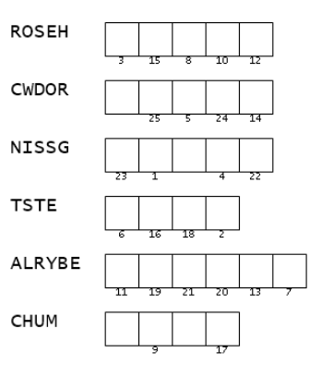
Family Activities
Oh wow … those words are messed up. And I’ll bet the last word is not really meant to be CHUM. They are from your Bible study, so that should help. Then use the numbers to put the right letters in the message. I think you can do this.

Slide 23
The Sign of His Provision
March 23

