Slide 1
The Sign of
His Power Over Death
April 13

Slide 2

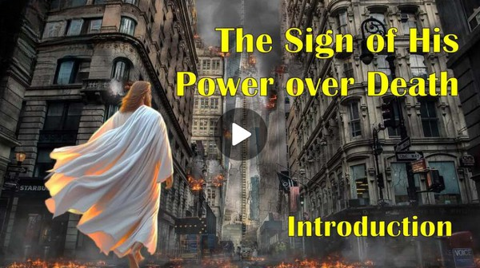
Video Introduction
View Video

Slide 3
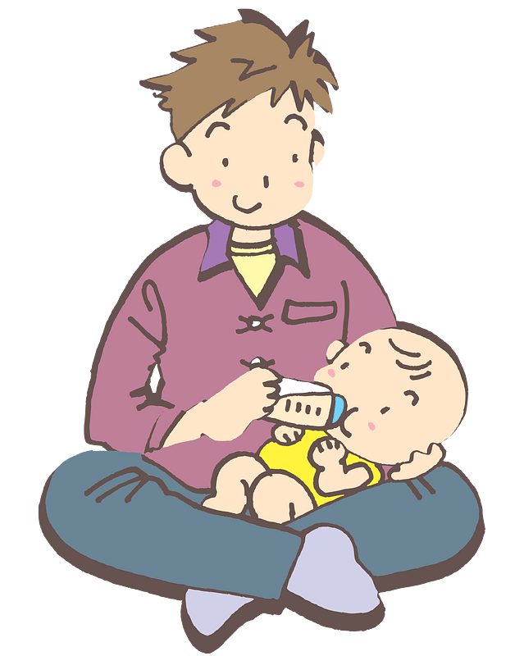


Amazing …
What are some pictures of new life that you have seen?
The most important new life we see is someone who comes to Jesus.
  Jesus offers us the hope of a new life.

Slide 4

Listen for the “I am” statement.
John 11:25-27 (NIV) Jesus said to her, "I am the resurrection and the life. He who believes in me will live, even though he dies; 26 and whoever lives and believes in me will never die. Do you believe this?" 27 "Yes, Lord," she told him, "I believe that you are the Christ, the Son of God, who was to come into the world."

Slide 5
Jesus Is the Resurrection and Life
What does this “I am” statement teach us about Jesus’ nature and character?
What did Jesus say would happen to those who believed in Him?
What question did Jesus pose to Martha?
What belief did Martha express to Jesus?

Slide 6
Jesus Is the Resurrection and Life
Why do you think Jesus asked if she believed? Wouldn’t He (as omniscient God) already know?
What does it mean to “believe in” Jesus?
To whom does He personally become resurrection and life?

Slide 7
Jesus Is the Resurrection and Life
How does the hope of eternal life influence your daily decisions?
How would you describe the hope of eternal life to someone who’s never heard about it?

Slide 8
Listen for a call to deeper faith.
John 11:38-40 (NIV) Jesus, once more deeply moved, came to the tomb. It was a cave with a stone laid across the entrance. 39 "Take away the stone," he said. "But, Lord," said Martha, the

Slide 9
Listen for a call to deeper faith.
sister of the dead man, "by this time there is a bad odor, for he has been there four days." 40 Then Jesus said, "Did I not tell you that if you believed, you would see the glory

Slide 10
Faithful Obedience Reveals God’s Glory
We’re told Jesus was deeply moved at the grave site. What strange request did He make?
What response does Martha have in this passage?
Why do you suppose Jesus told them to do this? He could have commanded the stone to roll away.

Slide 11
Faithful Obedience Reveals God’s Glory
What did Jesus remind her, considering her reluctance?
What has Jesus promised us that we must believe and see His glory demonstrated?
What can we do to maintain that belief that Jesus meets our needs and answers our prayers, even when our circumstances and His actions don’t make sense to us?

Slide 12
Listen for a challenge to believe.
John 11:41-44 (NIV) So they took away the stone. Then Jesus looked up and said, "Father, I thank you that you have heard me. 42 I knew that you always hear me, but I said this for the benefit of the people standing here, that they may believe that you

Slide 13
Listen for a challenge to believe.
sent me." 43 When he had said this, Jesus called in a loud voice, "Lazarus, come out!" 44 The dead man came out, his hands and feet wrapped with strips of linen, and a cloth around his face. Jesus said to them, "Take off the grave clothes and let him go."

Slide 14
Jesus Is More than Words
We should be in just as much awe, and praise Him just as much for the workings we see God do in our lives every day!
Why do you think Jesus prayed out loud?
How did Jesus raise Lazarus from the dead?
What did Lazarus do when Jesus called to him?
If you had been there when Jesus raised Lazarus from the dead, how do you think you might have responded?

Slide 15
Application
Explore.
  Do a computer search of Bible verses that show the nature of Jesus Christ.
  Share those with someone this week who may be struggling in his or her faith.

Slide 16
Application
Evaluate.
  Spend some time reflecting upon your personal confession and salvation story.
  Consider how your confession is being matched by how you are surrendering to the Lord.

Slide 17
Application
Invite.
  As a group, begin to pray for someone this week that you know may be skeptical of the truths of Christ.
  Take time during the week to invite this person to attend Easter services with you.

Slide 18

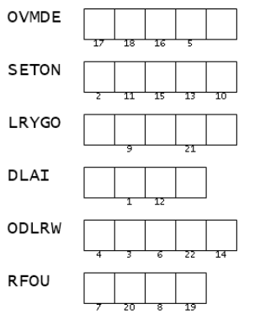
Family Activities
Well, I been “SETON” here a long time trying to figure this out. I guess I better look in John 11:25-27; 38-44 (NIV) to see what word has those letters. Then I suppose I use those numbers somehow.
Me, I’m going to https://tinyurl.com/4yvp6953 for Tech help and the color page .

Slide 19
The Sign of
His Power Over Death
April 13

