Slide 1
The Sign of His Light
April 6

Slide 2
Video Introduction
View Video

Slide 3
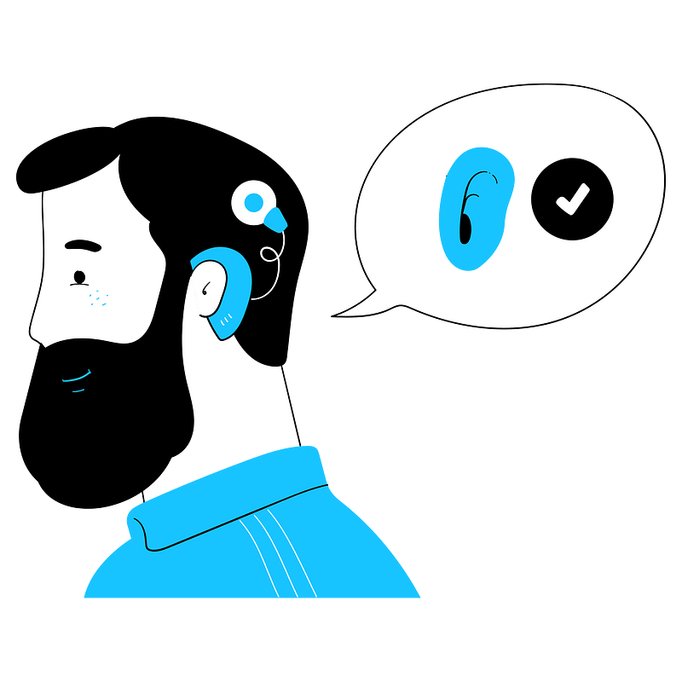
What was the clue?
What helped you realize your hearing or eyesight wasn’t what it used to be?
Today we will consider spiritual sight.
Only through Jesus can we truly see Truth.

Slide 4
Listen for a theological issue.
John 9:1-5 (NIV) As he went along, he saw a man blind from birth. 2 His disciples asked him, "Rabbi, who sinned, this man or his parents, that he was born blind?" 3 "Neither this man nor his parents sinned," said Jesus, "but

Slide 5
Listen for a theological issue.
this happened so that the work of God might be displayed in his life. 4 As long as it is day, we must do the work of him who sent me. Night is coming, when no one can work. 5 While I am in the world, I am the light of the world."

Slide 6
Jesus is the Light
What theological debate did the blind man’s presence generate among the disciples? Who did the disciples think was at fault for the man’s blindness?
How did Jesus answer their inquiry?
So … did God cause the blindness so Jesus could perform the miracle?

Slide 7
Jesus is the Light
Consider this answer to the accusation.
View verses 3 and 4 together
Interpret it to have a period after Jesus’ answer that neither the man nor his parents had sinned – the end of the sentence
The last half of verse 3 is the first part of the sentence which continues into verse 4
Then it would read, “But that the works of God should be made manifest in him, we must work the works of Him that sent me while it is day: the night comes when no man can work.”
No reason is given for the cause of the blindness

Slide 8
Jesus is the Light
What principle does it teach us about suffering?
Why do we often struggle to explain or understand suffering?
When have you seen God glorified in the midst of suffering?
How can our group help one another when suffering occurs?

Slide 9
Listen for unusual doctoring.
John 9:6-11 (NIV) Having said this, he spit on the ground, made some mud with the saliva, and put it on the man's eyes. 7 "Go," he told him, "wash in the Pool of Siloam" (this word means Sent). So the man went and washed, and came

Slide 10
Listen for unusual doctoring.
home seeing. 8 His neighbors and those who had formerly seen him begging asked, "Isn't this the same man who used to sit and beg?" 9 Some claimed that he was. Others said, "No, he only looks like him." But he himself insisted, "I am

Slide 11
Listen for unusual doctoring.
the man." 10 "How then were your eyes opened?" they demanded. 11 He replied, "The man they call Jesus made some mud and put it on my eyes. He told me to go to Siloam and wash. So I went and washed, and then I could see."

Slide 12
Jesus Gives Sight
Note the unusual method Jesus used to bring about the healing.
Spitting in the dirt, making a mud “ointment”
Sends the man to a local spring to wash it off

Slide 13
Jesus Gives Sight
On what basis was the man given his sight; saliva, dirt, mud, water, or something more?
What were the various responses from others who saw the man and realized he was no longer blind?
They all wanted to know how it was he could now see

Slide 14
Jesus Gives Sight
So … we want to know, when has Jesus opened your spiritual eyes in a way that helped you see things differently?
In what ways are we sometimes spiritually blind and in need of healing?

Slide 15
Listen for a snappy comeback.
John 9:30-33 (NIV) The man answered, "Now that is remarkable! You don't know where he comes from, yet he opened my eyes. 31 We know that God does not listen to sinners. He listens to the godly man who does his will. 32 Nobody has ever heard of opening the eyes of a man born blind. 33 If this man were not from God, he could do nothing."

Slide 16
Jesus’ Actions Show Who He Is
Religious leaders were upset because this was “work” that had happened on the Sabbath
They have grilled him on who was this “Sabbath breaker”
They accuse the man’s healer [Jesus] as being a sinner … having done “work” on the Sabbath.

Slide 17
Jesus’ Actions Show Who He Is
What intelligent responses does the man make?
The religious leaders were upset because Jesus did things they thought would threaten their position. How do people respond when the status quo is disturbed?

Slide 18
Jesus’ Actions Show Who He Is
What are some other obstacles that prevent people from recognizing God’s work today?
Why are we sometimes hesitant to ask God for things only He can do?

Slide 19
Application
Obey.
This man grew in his spiritual sight by being obedient
Consider areas that may even be blind spots for you.
Ask God to make you aware, so you can obey.
Ask for accountability from a group member to help you grow in this particular area once you are aware.

Slide 20
Application
Testify.
Share your personal testimony of your life before Christ, how you came to trust Christ, and your life since with someone who isn’t a believer.
After all, once you were blind, but now you see!

Slide 21
Application
Serve.
Spend some time considering how you can engage and support families or individuals who are disabled or have a handicap.
Show the love of Jesus as your Savior did!

Slide 22
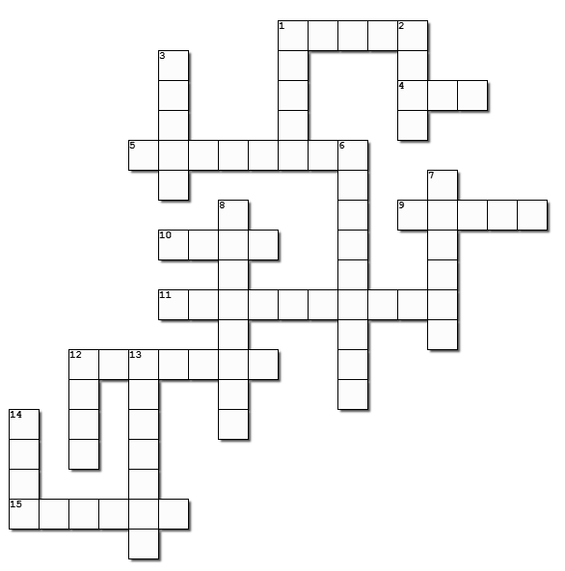
Family Activities
Help and more Fun Family Activities found at https://tinyurl.com/4arn9pka

Slide 23
The Sign of His Light
April 6

