Slide 1
The Sign of His Grace
March 9

Slide 2
Video Introduction
View Video

Slide 3
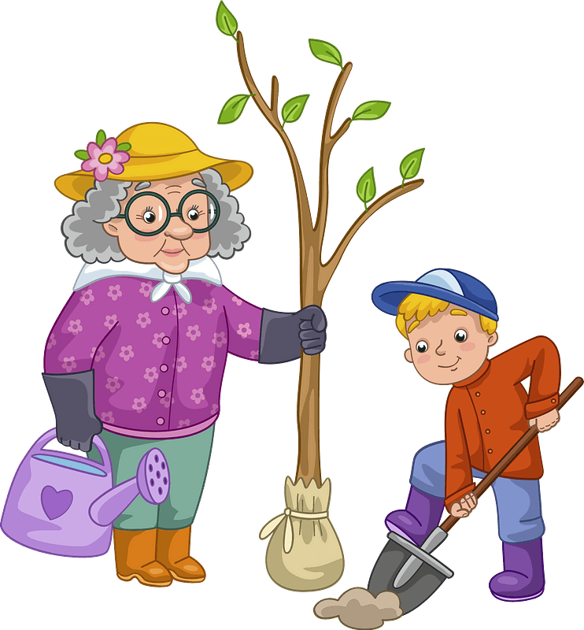
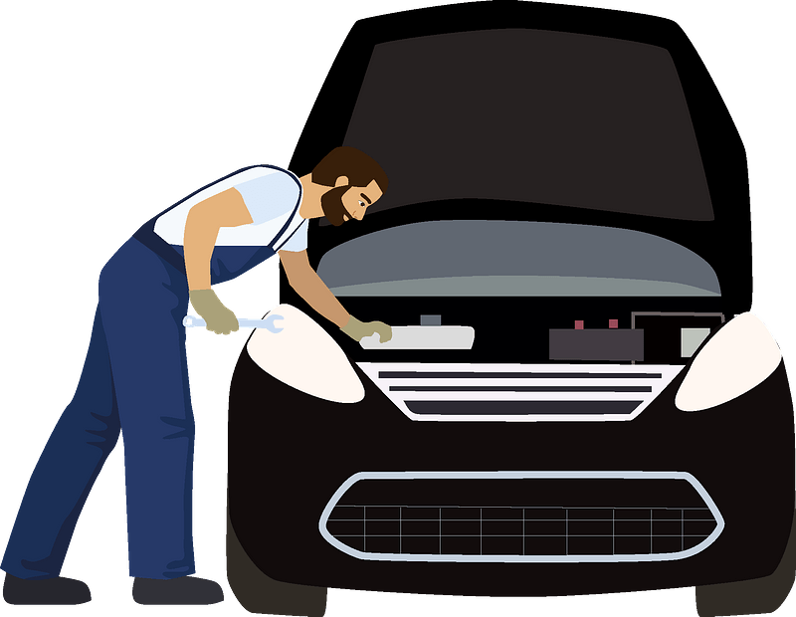
Admit it, now …
In what situations are you least likely to ask for help?
Jesus wants us to come to Him for help.
Jesus works on behalf of all who come to Him.
He wants to express his grace to us.

Slide 4
Listen for a request for help.
John 4:46-47 (NIV) Once more he visited Cana in Galilee, where he had turned the water into wine. And there was a certain royal official whose son lay sick at Capernaum. 47 When this man heard that Jesus had arrived in Galilee from Judea, he went to him and begged him to come and heal his son, who was close to death.

Slide 5
Bring It to Jesus
Jesus is returning to Cana in Galilee.
This is where he performed the first sign/miracle
Turned the water into wine

Slide 6
Bring It to Jesus
What words indicate the earnestness and urgency of his appeal to Jesus?
What is it about Jesus that would motivate you to take your needs to Him?
Why might people hesitate to take their needs to Jesus?

Slide 7
Bring It to Jesus
In what ways are we typically more interested in what Jesus can do for us than what we can do for Jesus?
Why do you think so many of our requests of Jesus involve physical needs rather than spiritual things?

Slide 8
Listen for desperation and assurance.
John 4:48-50 (NIV) "Unless you people see miraculous signs and wonders," Jesus told him, "you will never believe." 49 The royal official said, "Sir, come down before my child dies." 50 Jesus replied, "You may go. Your son will live." The man took Jesus at his word and departed.

Slide 9
Take God at His Word
What was Jesus’s unusual reply to the nobleman’s request to come with him?
How did the nobleman demonstrate his next step of faith?
How might our lives be different if we took Jesus at His word?

Slide 10
Take God at His Word
What’s the difference between believing in God and believing God?
Believing IN God | Believing God

Slide 11
Take God at His Word
What are some things God has told us in His Word that are sometimes hard for you to believe?
The official had to trust Jesus before seeing the miracle—how can we practice that kind of faith in our lives?

Slide 12
Listen for Timing
John 4:51-54 (NIV) While he was still on the way, his servants met him with the news that his boy was living. 52 When he inquired as to the time when his son got better, they said to him, "The fever left him yesterday at the seventh hour." 53 Then

Slide 13
Listen for Timing
the father realized that this was the exact time at which Jesus had said to him, "Your son will live." So he and all his household believed. 54 This was the second miraculous sign that Jesus performed, having come from Judea to Galilee.

Slide 14
Let God Work as He Pleases
What encouraging word did the nobleman receive while traveling back home?
He asked the servants when the improvement had happened. What did he find out?

Slide 15
Let God Work as He Pleases
What does this tell us about the relationship between Jesus' words and His power?
When the nobleman’s household found out about this miracle, they all believed. How does experiencing God's grace in our lives affect not just us individually but those around us?

Slide 16
Application
Respond
If you haven’t placed your faith in Christ, there’s no better time than right now to begin your journey with Christ and let Him give you victory in your life!
Talk to a pastor or group leader about next steps.
Some help is provided on the inside front cover of your Bible study guide.

Slide 17
Application
Reflect.
Write down how your faith is similar or different from the royal official’s faith and how it has experienced transformation.
Identify steps you can take that will help you grow in your walk with God.

Slide 18
Application
Share.
Take a moment to share with someone in your group or church how you have seen your faith grow in both answered and unanswered prayer.
Ask that person about his or her own journey with the Lord.

Slide 19
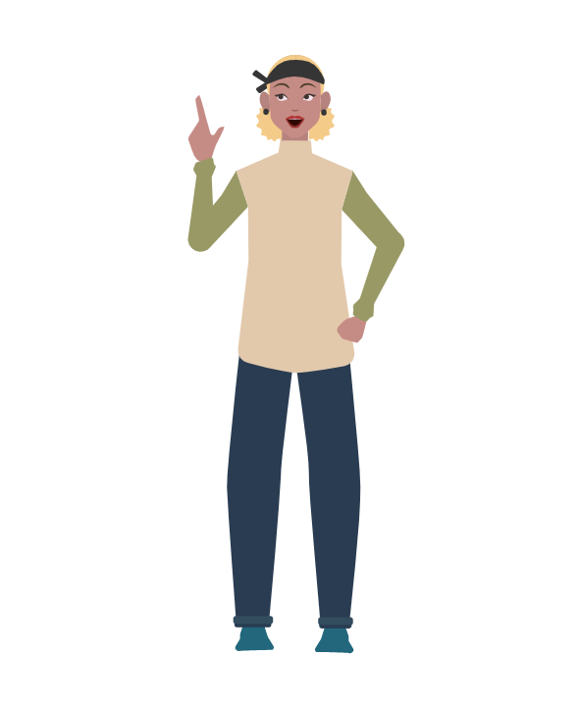
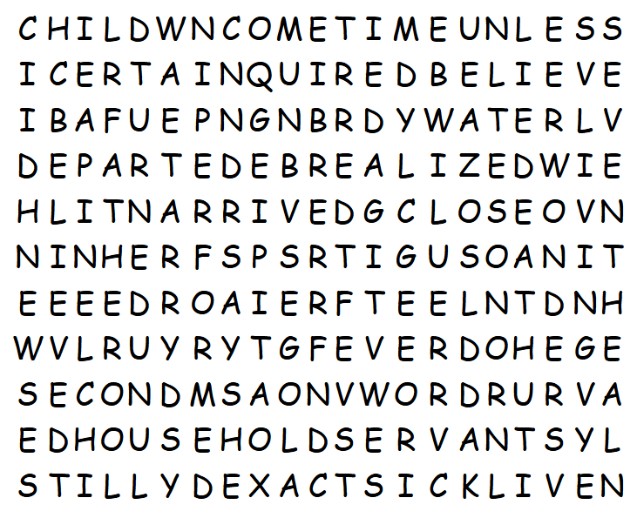
Family Activities
I don’t know what a “bafue” is. Maybe it’s not in the word list from your Bible passage. The Word Search Lady says you can avoid extra book reports if you find the most words. Don’t tell her I said so, but you can get help at https://tinyurl.com/38nak4ku or get the crossword or color page.

Slide 20
The Sign of His Grace
March 9

