Slide 1
The Sign of His Authority
March 16

Slide 2
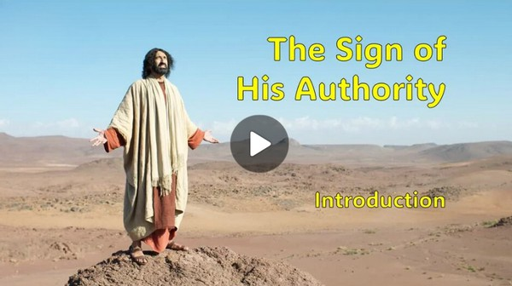
Video Introduction
View Video

Slide 3
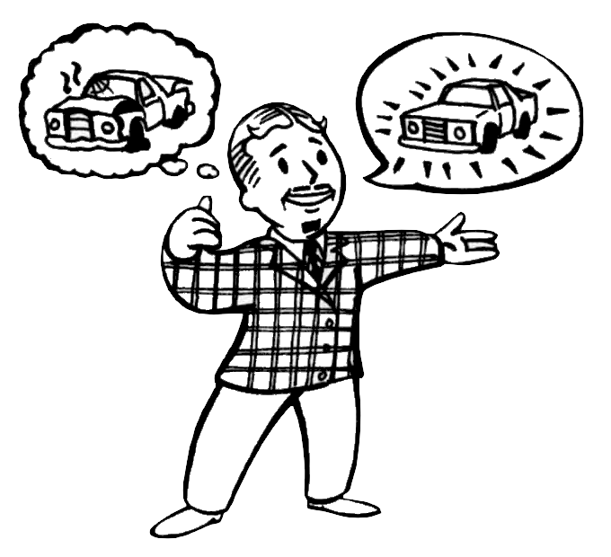
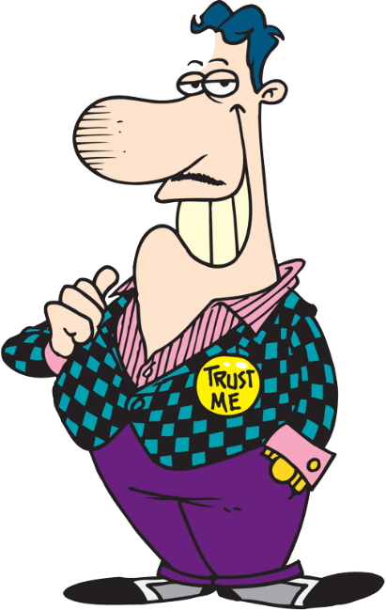
Admit it, now …
What gimmick or sales pitch did you buy into but later regret?
So often those special offers just don’t meet expectations.
But, Jesus works in a way that goes beyond our expectations.

Slide 4
Listen for who could help.
John 5:1-7 (NIV) Some time later, Jesus went up to Jerusalem for a feast of the Jews. 2 Now there is in Jerusalem near the Sheep Gate a pool, which in Aramaic is called Bethesda and which is surrounded by five covered

Slide 5
Listen for who could help.
colonnades. 3 Here a great number of disabled people used to lie--the blind, the lame, the paralyzed. One who was there had been an invalid for thirty-eight years. 6 When Jesus saw him lying there and learned that he had been in

Slide 6
Listen for who could help.
this condition for a long time, he asked him, "Do you want to get well?" 7 "Sir," the invalid replied, "I have no one to help me into the pool when the water is stirred. While I am trying to get in, someone else goes down ahead of me."

Slide 7
Jesus Does What We Cannot
Note the setting for the encounter described in these verses.
Near the sheep gate
Beside a pool
Surrounded by 5 colonnades or porches
Adjacent to the temple

Slide 8
Jesus Does What We Cannot
Who were people gathered around the pool, why were they gathered there?
What was the situation of one particular man lying at the pool?
What did Jesus ask him? How did the man respond?

Slide 9
Jesus Does What We Cannot
Why did Jesus ask him if he wished to get well? Isn’t that an obvious question? Why is this question important/necessary?
The man may have felt like life had treated him unfairly. In what way do you think life is unfair?

Slide 10
Jesus Does What We Cannot
When/why do we tend to get impatient with God’s timing in our lives?
This man was depending on a random water flow and some way to jump into the pool. On what in life, other than God, do we sometimes depend?

Slide 11
Listen for what only Jesus could do.
John 5:8-11 (NIV) Then Jesus said to him, "Get up! Pick up your mat and walk." 9 At once the man was cured; he picked up his mat and walked. The day on which this took place was a Sabbath, 10 and so

Slide 12
Listen for what only Jesus could do.
the Jews said to the man who had been healed, "It is the Sabbath; the law forbids you to carry your mat." 11 But he replied, "The man who made me well said to me, 'Pick up your mat and walk.'"

Slide 13
Jesus Does More than We Expect
Note the three-pronged admonition did Jesus give to the man.
Get up
Pick up your mat
Walk

Slide 14
Jesus Does More than We Expect
What might have encouraged the man to stand, even though he hadn’t been able to do so for 38 years?
What were the religious leaders more concerned about?
Why do you suppose Jesus choose to heal this man on the Sabbath?

Slide 15
Jesus Does More than We Expect
When has someone tried to squelch your freedom in Christ with religious rules or regulations?
Why do some people care more about keeping certain "religious" rules than they do about developing a meaningful relationship with Jesus?

Slide 16
Listen for an assassination plan.
John 5:17-20 (NIV) Jesus said to them, "My Father is always at his work to this very day, and I, too, am working." 18 For this reason the Jews tried all the harder to kill him; not only was he breaking the Sabbath, but he was even calling God his own Father, making himself equal with God. 19 Jesus gave

Slide 17
Listen for an assassination plan.
them this answer: "I tell you the truth, the Son can do nothing by himself; he can do only what he sees his Father doing, because whatever the Father does the Son also does. 20 For the Father loves the Son and shows him all he does. Yes, to your amazement he will show him even greater things than these.

Slide 18
Authority to Do Only what God Does
What words and phrases point to as the source of Jesus’ power to act?
What can we learn from the fact that the Son gives life to “whom He wishes” or “to whom He is pleased to give it”?

Slide 19
Authority to Do Only what God Does
What did Jesus say that suggests what the Father does through the Son is not limited? What was at least one greater work that the Son would do?
How can we join God and participate in His work?

Slide 20
Application
Submit to authority.
Reflect upon areas of your life where you have not submitted to God’s authority.
Consider the difference it would make if you did so today.
Write those things down and surrender them to Him.

Slide 21
Application
Share gratitude.
Gratitude helps with moments of skepticism.
Share with your group or a friend things you are grateful for in your life.
Be sure to direct the thanks to God.

Slide 22
Application
Celebrate with others.
Find a way to celebrate with someone in your group or family something that the Lord has done recently in his or her life.
Spend time worshiping God for His faithfulness.

Slide 23
Family Activities
This is the key of a coded message received by a mission trip group to Loupezil Virlip. It’s incomplete, but you should be able to decode enough of the message to make sense of it. Tech help and more fun Family Activities are found at https://tinyurl.com/5xw75u32

Slide 24
The Sign of His Authority
March 16

