Slide 1
The Ruler Who Cares for His People
January 9

Slide 2

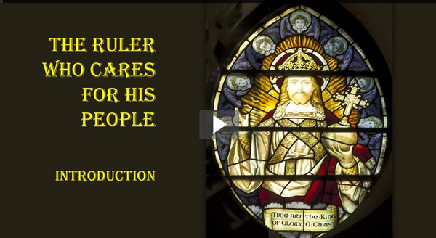
Video Introduction
View Video

Slide 3
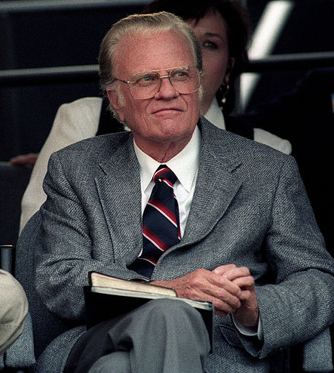
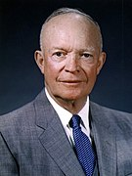
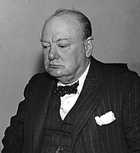
Your opinion?
Who, in your view, is one of the greatest leaders of our time?
Great leaders have different leading styles.
  Today we consider Jesus as a leader
  Jesus is a leader who leads and cares for His people.
Photo by Paul M. Walsh

Slide 4
Listen for a prophesied leader.
Micah 5:2-5a (NIV) "But you, Bethlehem Ephrathah, though you are small among the clans of Judah, out of you will come for me one who will be ruler over Israel, whose origins are from of old, from ancient times." 3 Therefore Israel will be abandoned until the time when she who is in labor gives birth

Slide 5

Listen for a prophesied leader.
and the rest of his brothers return to join the Israelites. 4 He will stand and shepherd his flock in the strength of the LORD, in the majesty of the name of the LORD his God. And they will live securely, for then his greatness will reach to the ends of the earth. 5 And he will be their peace.

Slide 6
The King Who Shepherds His People
What is the historical significance of Bethlehem Ephratah?
What promise does the Lord make to Israel?
What are some ways we need to see peace?

Slide 7
The King Who Shepherds His People
What distinguishes the new kind of king the Lord promises?
How is this ruler still at work in our lives today?

Slide 8
Listen for who are the Magi.
Matthew 2:1-6 (NIV) After Jesus was born in Bethlehem in Judea, during the time of King Herod, Magi from the east came to Jerusalem 2 and asked, "Where is the one who has been born king of the Jews? We saw his star in the east and have come to worship him." 3 When King Herod heard this he was disturbed, and all Jerusalem with him. When he had

Slide 9
Listen for who are the Magi.
called together all the people's chief priests and teachers of the law, he asked them where the Christ was to be born. 5 "In Bethlehem in Judea," they replied, "for this is what the prophet has written: 6 "'But you, Bethlehem, in the land of Judah, are by no means least among the rulers of Judah; for out of you will come a ruler who will be the shepherd of my people Israel.'"

Slide 10
Wise Men Seek Him … Still
What was extraordinary about the visit of these men from the east?
The Magi knew of the king of the Jews because of the special star they saw, what did they not know?
How did King Herod react to the visit of the Magi?

Slide 11
Wise Men Seek Him … Still
Why was a powerful king disturbed by the presence of a helpless baby?
Herod deceitfully used religion for personal ends. In what ways do people do this in our society today?
Herod wanted to keep other people from showing allegiance to this “new king” – what kinds of things might keep you from truly worshiping when you come to worship services?

Slide 12
Wise Men Seek Him … Still
If the scholars knew what the scriptures said about the promised Messiah, why do you think they did not go worship Him themselves?
They missed the Truth God had placed in scripture. What are some things we can do so we do not miss Truth God wants us to know as we study His Word?

Slide 13
Listen for the response of the Magi.
Matthew 2:9-11 (NIV) After they had heard the king, they went on their way, and the star they had seen in the east went ahead of them until it stopped over the place where the child was. 10 When they saw the star, they were overjoyed. 11 On coming to

Slide 14
Listen for the response of the Magi.
the house, they saw the child with his mother Mary, and they bowed down and worshiped him. Then they opened their treasures and presented him with gifts of gold and of incense and of myrrh.

Slide 15
The Truly Wise Still Worship the King
Let’s enumerate all the milestones have we seen in the whole lesson which led the wise men to Jesus.
What words and phrases describe the worship exhibited by the wise men?
How do these elements of worship suggest to us how we can better worship Jesus, the Messiah?

Slide 16
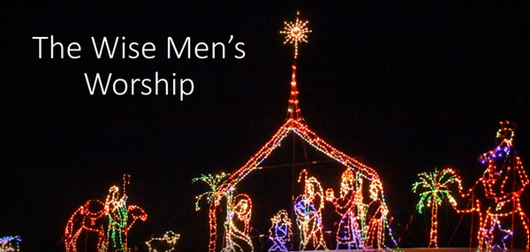
The Truly Wise Still Worship the King
Some significance can be inferred from the nature of the gifts.
  View video about these gifts

Slide 17
The Truly Wise Still Worship the King
List the contrasts between those who worshiped the baby Jesus.
Shepherds | Magi
Jews | ?
? | Royalty
Outcasts | ?
? | Very Rich
Came a short distance. | ?

Slide 18
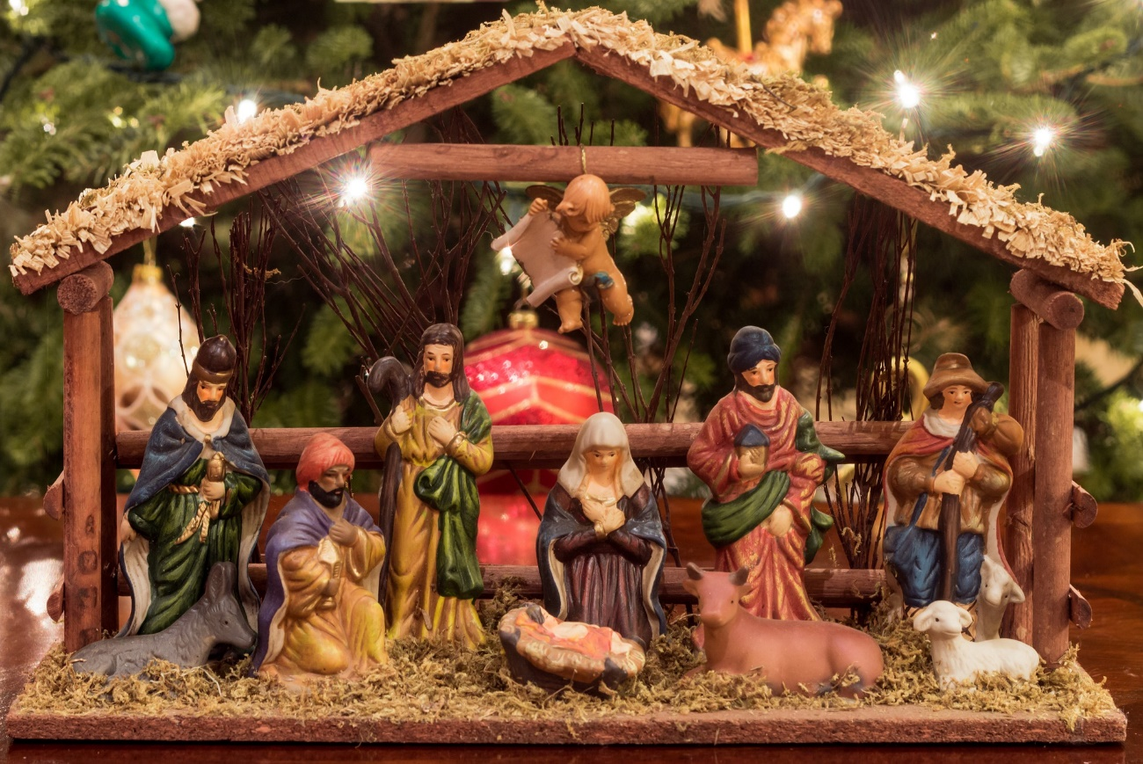
The Truly Wise Still Worship the King
What was the same
for both groups was
they came to
worship Jesus
They came to
declare the worth
of the Christ Child … He is worthy of our praise.

Slide 19
Application
Trust your Shepherd.
  Trust Jesus to guide you with care. Consider if there is an area where He is calling you to obedience, but you are resisting.
  If so, acknowledge Jesus as your caring shepherd and trust His guidance.

Slide 20
Application
Acknowledge your King.
  The wise men bowed down in recognition of the King.
  Bow or kneel when you pray this week as a physical sign that you recognize Jesus as King.
  Consider setting up a prayer place where you can make this a regular part of your quiet time with Him.

Slide 21
Application
Share about your Shepherd King.
  Use a concordance or online Bible to find occurrences of the word “shepherd” throughout the Bible.
  Note how this increases your understanding of the ways Jesus cares for His people.
  Find someone you can share this truth with this week.

Slide 22
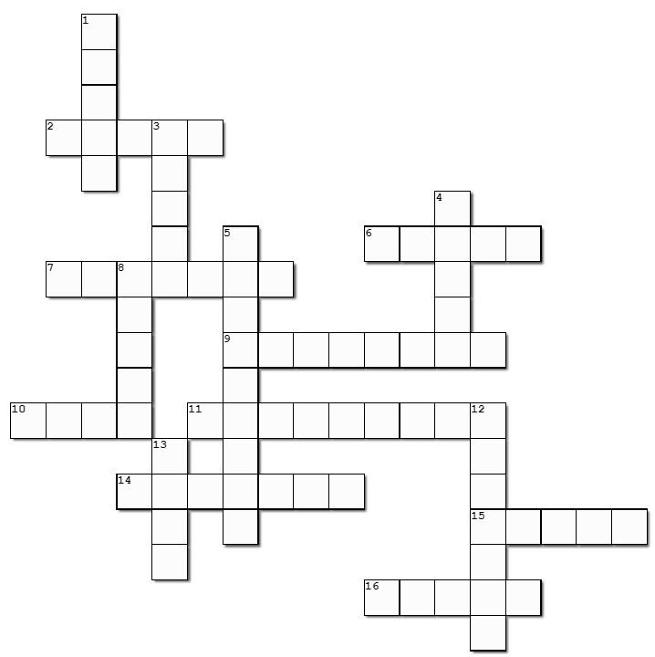

Family Activities
Aiee Cuccaracha! I hope there are clues for this crossword. If you get stuck go to https://tinyurl.com/274yr3d9 There are other interesting and informative activities, also.

Slide 23
The Ruler Who Cares for His People
January 9

