Slide 1
The Return of Jesus
April 18

Slide 2

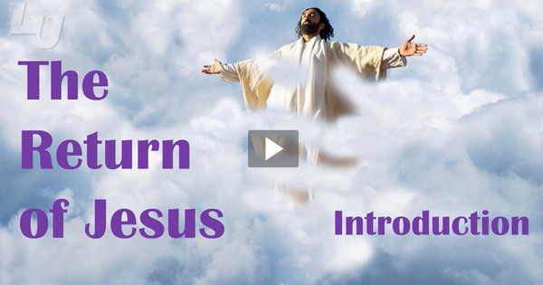
Video Introduction
View Video

Slide 3



Can’t wait …
What activity or event are you looking forward to in the next few weeks?
We all have milestone events in life that we look forward to with both excitement and some trepidation.
  The one milestone event that faces every person in the world is the Second Coming of Jesus Christ.
  Today we study the reality that Jesus will return to establish His eternal kingdom.

Slide 4
Listen for Q and A.
Matthew 24:3-8 (NIV) As Jesus was sitting on the Mount of Olives, the disciples came to him privately. "Tell us," they said, "when will this happen, and what will be the sign of your coming and of the end of the age?" 4 Jesus answered: "Watch out that no one deceives you. 5 For many will come in my name, claiming, 'I am the Christ,' and will deceive many.

Slide 5
Listen for Q and A.
You will hear of wars and rumors of wars, but see to it that you are not alarmed. Such things must happen, but the end is still to come. 7 Nation will rise against nation, and kingdom against kingdom. There will be famines and earthquakes in various places. 8 All these are the beginning of birth pains.

Slide 6
Signs of Christ’s Return
What questions did the disciples ask Jesus upon hearing Him speak about the destruction of the temple?
What did He caution them to avoid?
What were some ways in which people could be deceived to think the end of time was near?

Slide 7
Signs of Christ’s Return
Jesus said these things are like “labor pains” that precede a birth. What can encourage us amidst Jesus’ warnings that things are going to get a lot worse?
How does talk of the end times motivate us to live a holy life?

Slide 8
Signs of Christ’s Return
At the same time, how can we become sidetracked by discussion of the end times?
How is it helpful that Jesus didn’t give us a specific time or date for His return?

Slide 9
Listen for true signs of Jesus’ return.
Matthew 24:29-32 (NIV) "Immediately after the distress of those days "'the sun will be darkened, and the moon will not give its light; the stars will fall from the sky, and the heavenly bodies will be shaken.' 30 "At that time the sign of the Son of Man will appear in the sky, and all the nations of the earth will mourn. They will see the Son of Man coming

Slide 10
Listen for true signs of Jesus’ return.
on the clouds of the sky, with power and great glory. 31 And he will send his angels with a loud trumpet call, and they will gather his elect from the four winds, from one end of the heavens to the other. 32 "Now learn this lesson from the fig tree: As soon as its twigs get tender and its leaves come out, you know that summer is near.

Slide 11
Jesus Will Visibly Return
Why will no one miss Christ’s return?
The verse says all nations will mourn. What do you think that means?
What about those who are God’s people through Jesus?
What lesson can be learned from a fig tree budding in spring?

Slide 12
Jesus Will Visibly Return
Based on these verses, how would you describe Jesus’ return?
How could you use this passage to talk to a nonbeliever about Jesus Christ?
In what specific ways does this passage encourage you to pray?

Slide 13
Listen for how to be ready.
Matthew 24:42-44 (NIV) "Therefore keep watch, because you do not know on what day your Lord will come. 43 But understand this: If the owner of the house had known at what time of night the thief was coming, he would have kept

Slide 14
Listen for how to be ready.
watch and would not have let his house be broken into. 44 So you also must be ready, because the Son of Man will come at an hour when you do not expect him.

Slide 15
Be prepared for Christ’s Return
What life principle does Jesus give concerning His return?
How does He illustrate that principle?
What makes Jesus' return seem distant and unreal to many people?
What other events in your life have seemed distant and unreal and yet they have eventually taken place?

Slide 16
Be prepared for Christ’s Return
As you anticipated Christmas or a visit by relatives or the end of school, how did it affect your day-to-day life?
How would an alert believer live his or her life differently in anticipation of Christ's return? What is involved in getting ready?

Slide 17

Application
Thank Jesus for the promise of returning and setting up a kingdom that is infinitely greater than this world we live in.
Ask Him to help you live a life of wisdom and readiness.

Slide 18

Application
Prepare yourself.
  Review your plans and schedule for the week .
  Consider steps you can take that show you are ready and prepared for Christ’s return.

Slide 19

Application
Prepare others.
  Identify those who are not ready
  for Christ’s return.
  Pray and look for opportunities
  to either lead them into a
  relationship with Christ or
  encourage them to renew
  their walk with Him.

Slide 20
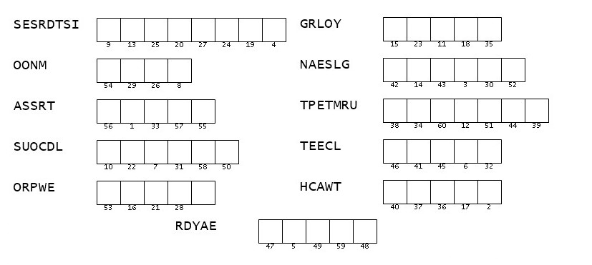
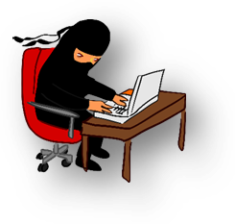
Family Activities
Another Word Ninja challenge. Unscramble these words (from your Bible Study Passages) and use the numbers under the letters to determine the important message. Pass it on to the person in charge of your church calendar. If you get stuck, refer to the assistance available at https://tinyurl.com/4vy75u6u Other activities of intrigue are posted there also.

Slide 21
The Return of Jesus
April 18

