Slide 1
The Resurrection of Jesus
April 4

Slide 2
Video Introduction
View Video

Slide 3
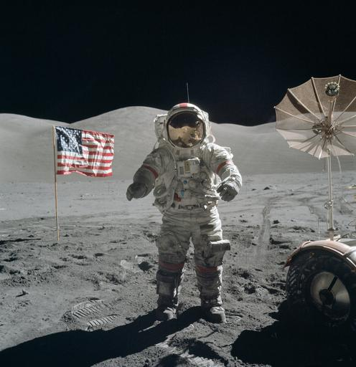
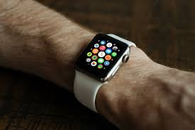
Think about it …
What are some things once thought impossible that have become a reality?
Maybe you thought it would be impossible for someone you know to get their life straightened out.
New life is possible when we trust in the risen Christ.

Slide 4
Listen for John’s response.
John 20:3-9 (NIV) So Peter and the other disciple started for the tomb. 4 Both were running, but the other disciple outran Peter and reached the tomb first. 5 He bent over and looked in at the strips of linen lying there but did not go in. 6 Then Simon Peter, who was behind him, arrived and went into the tomb. He saw the strips of linen lying there,

Slide 5
Listen for John’s response.
as well as the burial cloth that had been around Jesus' head. The cloth was folded up by itself, separate from the linen. 8 Finally the other disciple, who had reached the tomb first, also went inside. He saw and believed. 9 (They still did not understand from Scripture that Jesus had to rise from the dead.)

Slide 6
The Empty Tomb Gives Proof
What prompted Peter and John to go to the place where Jesus had been buried?
What did Peter see, and how does he appear to have responded to what he saw?
How did the other disciple, John, respond to what he saw?

Slide 7
The Empty Tomb Gives Proof
How do you think John’s seeing was different from the Mary’s and Peter’s seeing?
What obstacles can keep people from fully seeing the reality of the resurrection and its implications?
How does the empty tomb give us hope?

Slide 8
The Empty Tomb Gives Proof
It is entirely possible to place your faith in trust in Jesus by believing in His death and resurrection without fully understanding the theology regarding salvation
Consider elements of our faith that we believe but don’t fully understand …
The Trinity
The indwelling of the Holy Spirit
Why God would love us enough to die for us
The how of creation and the universe
The when of the Second Coming of Christ

Slide 9
Listen for events of Jesus’ first reappearance.
John 20:19-23 (NIV) On the evening of that first day of the week, when the disciples were together, with the doors locked for fear of the Jews, Jesus came and stood among them and said, "Peace be with you!" 20 After he said this, he showed them his hands and side. The disciples were overjoyed when they saw the Lord. 21 Again Jesus said,

Slide 10
Listen for events of Jesus’ first reappearance.
"Peace be with you! As the Father has sent me, I am sending you." 22 And with that he breathed on them and said, "Receive the Holy Spirit. 23 If you forgive anyone his sins, they are forgiven; if you do not forgive them, they are not forgiven."

Slide 11
Jesus Proved He Is Alive
How soon after His resurrection did Jesus appear to His disciples?
Why do you suppose they were gathered together?
When kinds of situations might cause us to experienced doubts and questions about our faith?

Slide 12
Jesus Proved He Is Alive
If you had been in that room with the disciples, how might you have reacted when Jesus appeared?
Jesus greeted them with “Shalom” … “Peace be with you”. How has Jesus brought peace to your life?
What was the nature and scope of the mission He gave them (and us) and what preparation has He given?

Slide 13
Listen for Thomas’ revelation.
John 20:27-29 (NIV) Then he said to Thomas, "Put your finger here; see my hands. Reach out your hand and put it into my side. Stop doubting and believe." 28 Thomas said to him, "My Lord and my God!" 29 Then Jesus told him, "Because you have seen me, you have believed; blessed are those who have not seen and yet have believed."

Slide 14
Believing Is Seeing
How was this appearance different from the first? What did Jesus invite Thomas to do?
Do you consider Thomas a skeptic or an honest searcher?
Skeptic | Honest Seacher

Slide 15
Believing Is Seeing
None of us have seen Jesus physically. What do we learn from the response of Thomas?
Thomas wanted a personal, firsthand experience and got it. What kind of firsthand experience can we have with the risen Jesus?
Thomas doubted, even though he was with Jesus for 3 years. How should we deal with our doubts about Christianity?

Slide 16
Application
Trust.
If you have never trusted Jesus as your Savior and Lord, give your life to Him now.
Talk to your Bible study leader or read the inside cover of this book.

Slide 17
Application
Prepare.
Write out your testimony of how you came to trust in Christ.
As you write, take note of how Christ has given you a new life.

Slide 18
Application
Proclaim.
Identify someone in your life who has not trusted Christ.
Invite the person for coffee or lunch and have an intentional gospel conversation with him or her.

Slide 19
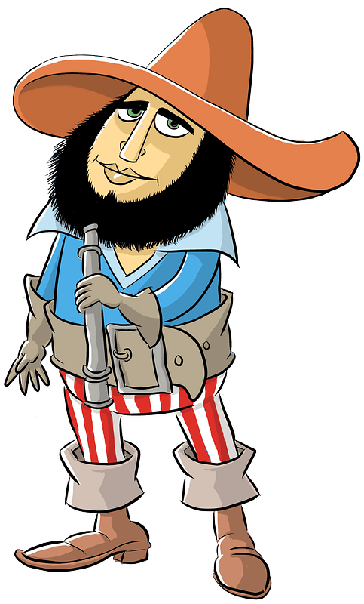
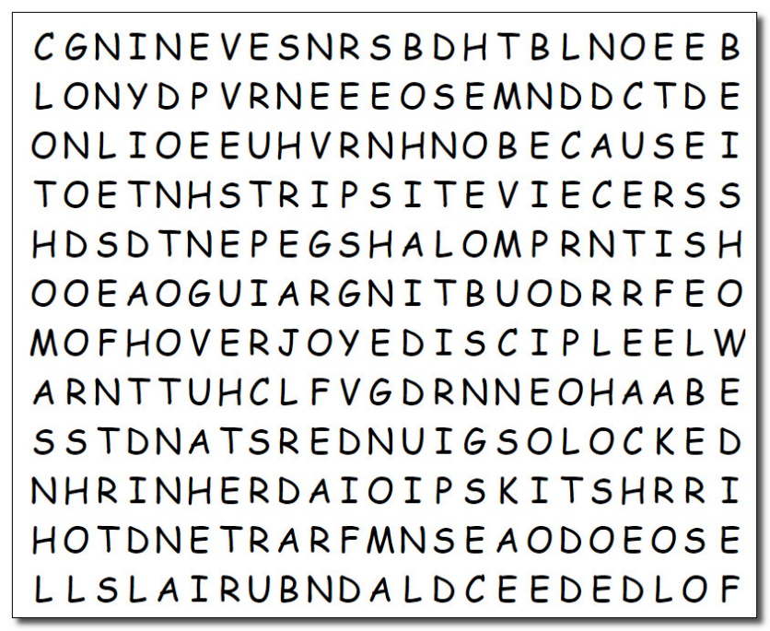
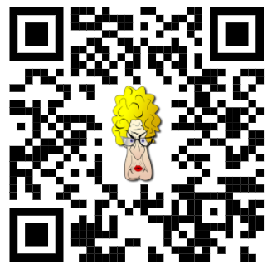
Family Activities
Arrgh … those words from our Bible Study are every which way. The Word Search Lady says she’ll make me walk the plank if I don’t find them all. Use the QR code to check out other Family Easter Activities.

Slide 20
The Resurrection of Jesus
April 4

