Slide 1
The Resurrection of Jesus
March 31

Slide 2

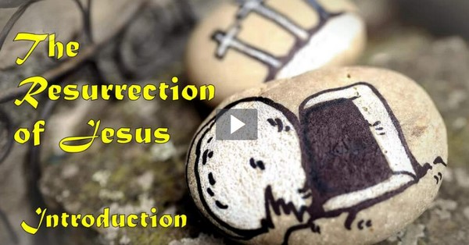
Video Introduction
View Video

Slide 3
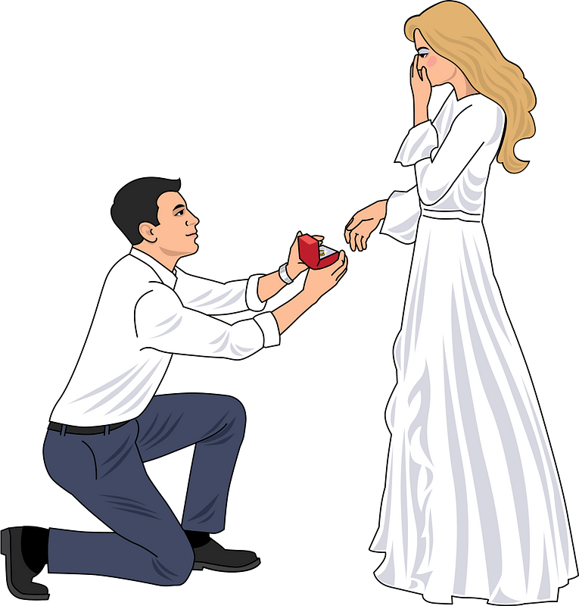


You told them so …
When was a time you told a true story that other people found hard to believe?
Today we look at some important news shared by some women ⇨ “Jesus is Alive!”
  It was totally true but was hard for many to believe when they first heard it
  It is still true today and some people still struggle with the reality!
  Jesus rose again to give us victory over death.

Slide 4
Listen for multiple surprises.
Luke 24:1-6a (NIV) On the first day of the week, very early in the morning, the women took the spices they had prepared and went to the tomb. 2 They found the stone rolled away from the tomb, 3 but when they entered, they did not find the body of the Lord Jesus. 4 While they

Slide 5

Listen for multiple surprises.
were wondering about this, suddenly two men in clothes that gleamed like lightning stood beside them. 5 In their fright the women bowed down with their faces to the ground, but the men said to them, "Why do you look for the living among the dead? 6 He is not here; he has risen!

Slide 6
Look to the Empty Tomb
Why did the women go to Jesus’ tomb?
What emotions would you have experienced on the way to the tomb?
So, what surprises did they experience as they got to the tomb?

Slide 7
Look to the Empty Tomb
Note the glorious message they heard.
  You are looking among the dead for Someone who is alive!
  Jesus is not here.
  He is risen !

Slide 8
Look to the Empty Tomb
Consider Paul’s comments …
  And if Christ has not been raised, our preaching is useless and so is your faith. More than that, we are then found to be false witnesses about God … And if Christ has not been raised, your faith is futile; you are still in your sins. Then those also who have fallen asleep in Christ are lost. If only for this life we have hope in Christ, we are to be pitied more than all men.
According to Paul, what would be different if Jesus had not risen from the dead?

Slide 9
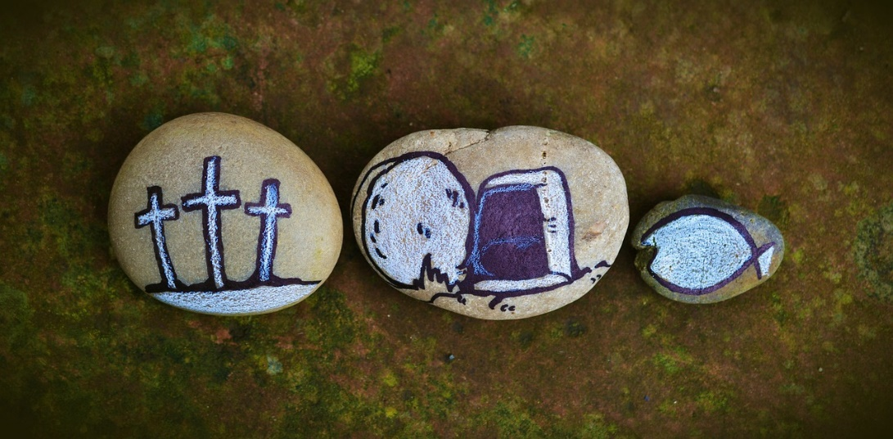
Look to the Empty Tomb
How could / should the life of a believer reflect one’s belief that He is risen?

Slide 10
Listen for a reminder.
Luke 24:6b-8 (NIV) Remember how he told you, while he was still with you in Galilee: 7 'The Son of Man must be delivered into the hands of sinful men, be crucified and on the third day be raised again.'" 8 Then they remembered his words.

Slide 11
Remember What Jesus Said
Of what words of Jesus were the women reminded?
Why do you think they weren’t yet remembering what He said about raising again from the dead?
What words indicate divine necessity and divine control over what happened to Jesus?

Slide 12
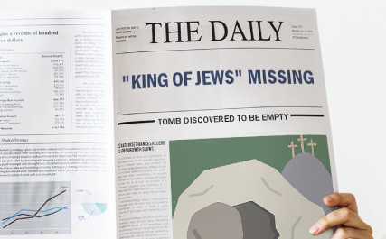
Remember What Jesus Said
What kinds of things distract believers from the reality of what Jesus said?
You are a news reporter
when Jesus arose. What
title or headline would
you write for a news
article about Jesus death
and resurrection?
All these headlines are still true today!

Slide 13
Listen for proof that it really happened.
Luke 24:38-43 (NIV) He said to them, "Why are you troubled, and why do doubts rise in your minds? 39 Look at my hands and my feet. It is I myself! Touch me and see; a ghost does not have flesh and bones, as you see I have." 40 When he had said

Slide 14
Listen for proof that it really happened.
this, he showed them his hands and feet. 41 And while they still did not believe it because of joy and amazement, he asked them, "Do you have anything here to eat?" 42 They gave him a piece of broiled fish, 43 and he took it and ate it in their presence.

Slide 15
Jesus Makes Himself Known
The disciples thought they were seeing a ghost. What kinds of things contributed to this reaction?
How did He prove that He was not a ghost, He indeed had a real (yet risen) body?
How does Jesus reveal Himself to us today?

Slide 16
Jesus Makes Himself Known
The disciples needed God’s peace because of the traumatic events in which they were involved. What kinds of traumatic events do we have that cry out for God’s peace?
Consider that the reality of a risen Savior can indeed bring peace to these situations

Slide 17
Application
A Reminder.
  On a notecard, write the simple declaration that changes everything: “He is risen!”
  Place the notecard on your mirror so that you can be reminded every day of the reality of Jesus’s resurrection.

Slide 18
Application
A Summary.
  Memorize 1 Corinthians 15:1-8
  It is a great summary of the story of Jesus.

Slide 19
Application
A Reflection.
  In a journal, write the words
  “Because Jesus is alive . . .”
  at the top of several pages.
  Use each page to reflect on an area of your life
  Consider how the resurrection changes that area of life.
  For example, “Because Jesus is alive, my spending habits . . .”

Slide 20
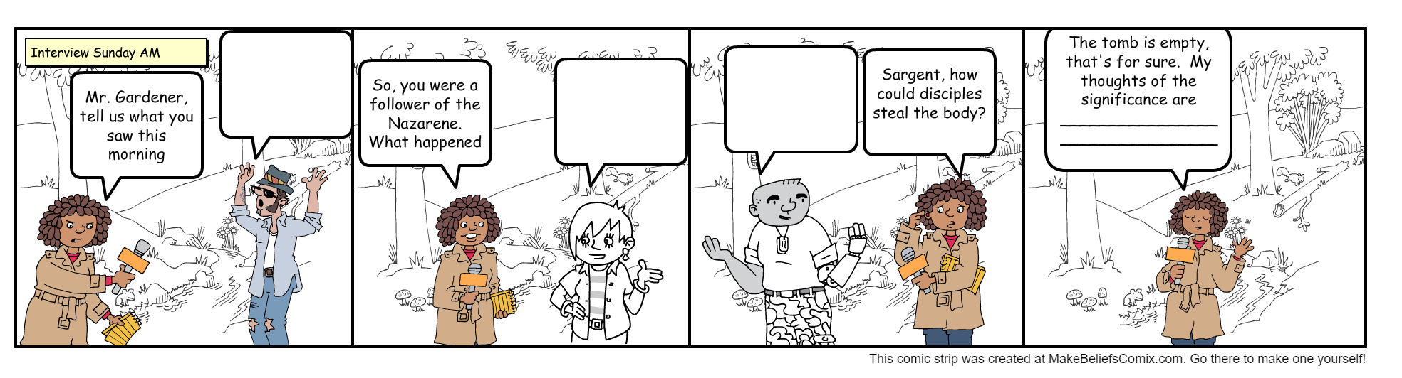
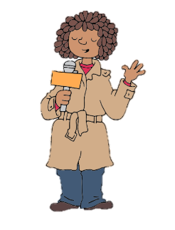
Family Activities
That interview session was a once in a lifetime opportunity. You can just imagine the stories they had to tell. Go ahead, imagine! If you want to do the crossword or wordsearch go to https://tinyurl.com/yph8h637

Slide 21
The Resurrection of Jesus
March 31

