Slide 1
The Purpose of Humanity
March 14

Slide 2

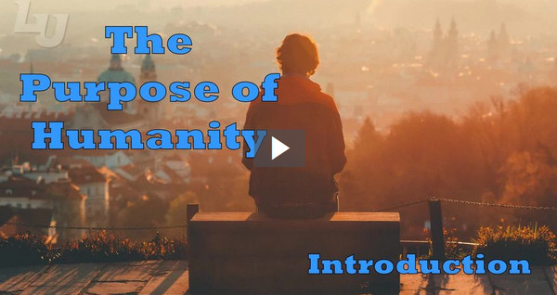
Video Introduction
View Video

Slide 3
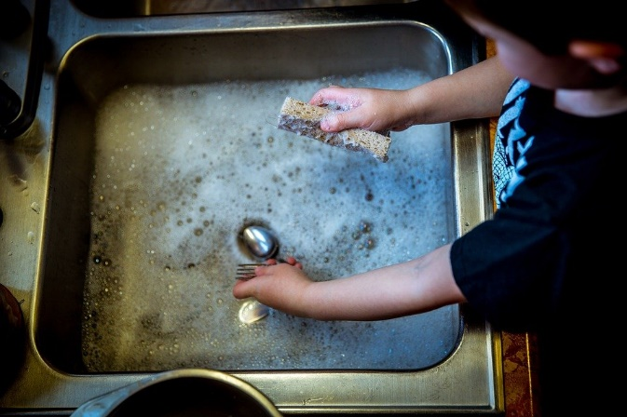

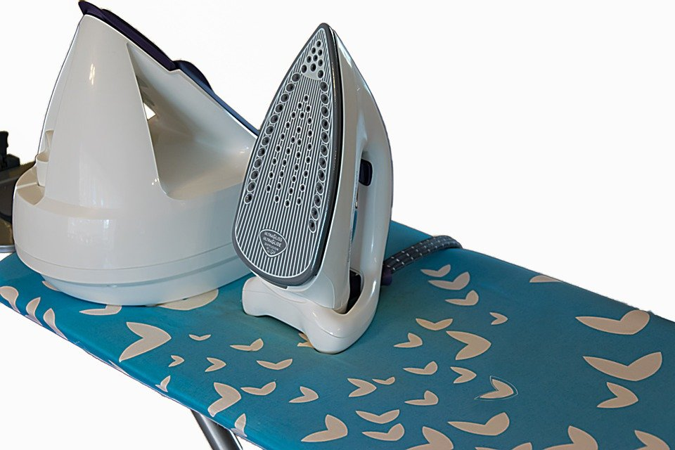
Be honest, now …
What is your least favorite household responsibility?
Ultimately, our responsibilities at home and at work are given to us by God
  He created us to serve and honor Him.
  Our responsibilities can be a means of satisfaction and fulfillment.

Slide 4
Listen for how things started.
Genesis 1:1-5 (NIV) In the beginning God created the heavens and the earth. 2 Now the earth was formless and empty, darkness was over the surface of the deep, and the Spirit of God was hovering over the waters. 3 And God said, "Let there be light,"

Slide 5
Listen for how things started.
and there was light. 4 God saw that the light was good, and he separated the light from the darkness. 5 God called the light "day," and the darkness he called "night." And there was evening, and there was morning--the first day.

Slide 6
God Created Everything
Use your imagination … how do you think it looked when God created something out of nothing?
Consider that very first verse … how does accepting that statement as fact impact how you view life and the world?
What is the significance of God speaking the creation into existence?

Slide 7
God Created Everything
What difference does it make that the Creator, not the creation, is at the center of the creation story?
When might someone’s life feel formless and empty, as described in verse 2?
What can God do for us when we experience emptiness?

Slide 8
Listen for how we were created.
Genesis 1:26-27 (NIV) Then God said, "Let us make man in our image, in our likeness, and let them rule over the fish of the sea and the birds of the air, over the livestock, over all the earth, and over all the creatures that move along the ground." 27 So God created man in his own image, in the image of God he created him; male and female he created them.

Slide 9
Created in God’s Image
What do you think it means when you read that you are made “in the image of God”?
According to these verses, how does humankind fit into God’s plan and purpose for His creation?
What evidence do you see in this passage that God places high value on us?

Slide 10
Created in God’s Image
How can you celebrate the blessing of being made in God’s image?
God places high value on us … how can we place a higher value on others?

Slide 11
Listen for God’s purpose for humanity.
Genesis 1:28-31 (NIV) God blessed them and said to them, "Be fruitful and increase in number; fill the earth and subdue it. Rule over the fish of the sea and the birds of the air and over every living creature that moves on the ground." Then God said, "I give you every seed-bearing plant on the face of the whole earth and every tree that has fruit with

Slide 12
Listen for God’s purpose for humanity.
seed in it. They will be yours for food. 30 And to all the beasts of the earth and all the birds of the air and all the creatures that move on the ground--everything that has the breath of life in it--I give every green plant for food." And it was so. 31 God saw all that he had made, and it was very good. And there was evening, and there was morning--the sixth day.

Slide 13
Commissioned to Care for, Enjoy Creation
What actions of God stated in verse 28 suggest a unique relationship between God and human beings?
What blessings and provision of God are identified in these verses?
How did God evaluate the totality of His creation?

Slide 14
Commissioned to Care for, Enjoy Creation
How does understanding that God created the universe and everything in it—including you—help you discover purpose for living and bring you joy?
What are some of the most fulfilling things you can do to render service to God and give honorable witness to who He is in your life?

Slide 15
Application
Praise.
  Take a few minutes to thank God for creating you—and then thank Him for creating you in His image.
  Ask for His help to live out this great privilege and responsibility.

Slide 16
Application
List.
  Write down a few characteristics that God’s image-bearers should have and evaluate yourself on them.
  How can you better represent the Lord?

Slide 17
Application
Disciple.
  We are to lead others to know and grow in Christ, the One who restores the sin-marred image of God in us.
  Who are two other people in your life with whom you can begin meeting regularly so that you can help them to be like Him?
  Make a plan to reach out to them.

Slide 18
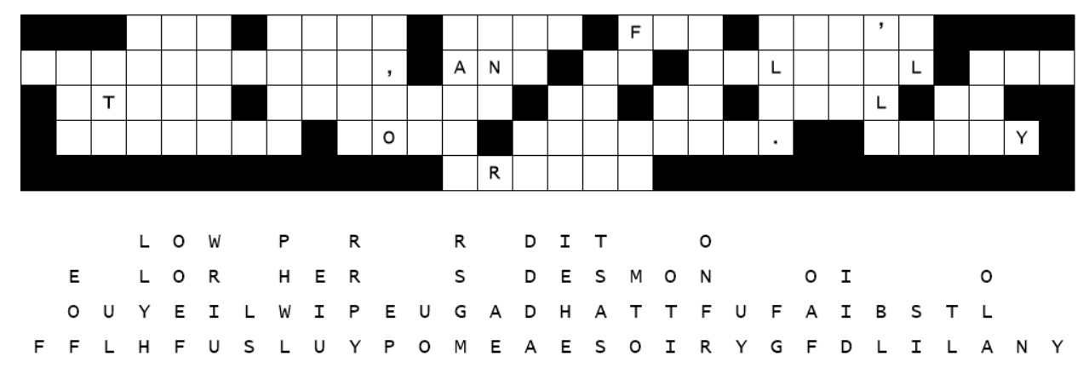
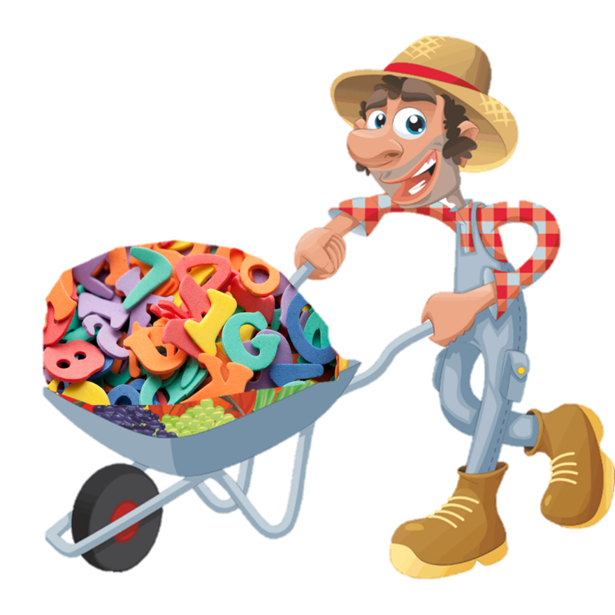
Family Activities
These here letters all fell down … straight down. You can figger out where they go and fix the sign. If you need help, go to https://tinyurl.com/4kupu9cs There’s other cool stuff for yer whole family, too.
Freeimageslive.co.uk

Slide 19
The Purpose of Humanity
March 14

