Slide 1
The Protection of God’s Name
January 7

Slide 2
Video Introduction
View Video

Slide 3
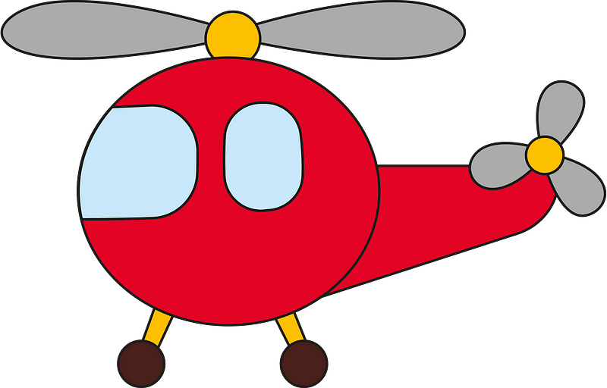
Do you know?
What is a “helicopter parent”? Why do they act that way?
Even with parents who are super protective, they cannot solve every problem in one’s life.
Today we consider how God is our ultimate protection
We can trust Him to strengthen and help us.

Slide 4
Listen for names of God.
Psalm 91:1-6 (NIV) He who dwells in the shelter of the Most High will rest in the shadow of the Almighty. 2 I will say of the LORD, "He is my refuge and my fortress, my God, in whom I trust." 3 Surely he will save you from the fowler's snare and from the deadly pestilence. 4 He will cover

Slide 5
Listen for names of God.
you with his feathers, and under his wings you will find refuge; his faithfulness will be your shield and rampart. 5 You will not fear the terror of night, nor the arrow that flies by day, 6 nor the pestilence that stalks in the darkness, nor the plague that destroys at midday.

Slide 6
Trust God’s Power to Protect
What four names are used to refer to God?
Note the meaning or emphasis of each one.
Name | Meaning
The Most High | Supreme One, sovereign, superiority
The Almighty | Translates “El Shaddai”, powerful, omnipotent
LORD – Jehovah - Yahweh | The personal Covenant Name of God The “I Am” The God Who IS
My God | Elohim – The One True God

Slide 7
Trust God’s Power to Protect
What are dangers from which God will protect or rescue those who trust in God?
How has God helped you when you felt trapped, experienced plague, were terrorized, or attacked?
What are images used in the passage to convey God’s protection over His loved ones?

Slide 8
Trust God’s Power to Protect
Why do we sometimes forget God’s promise of protection?
In what ways do you find that God calms your fears when circumstances around you could leave you frightened?
As always …
It is easy sitting in Sunday School to describe the calming presence and power of God
It is much more of a struggle to apply these principles when everything around you is coming apart!

Slide 9
Listen for God’s provision.
Psalm 91:9-13 (NIV) If you make the Most High your dwelling-- even the LORD, who is my refuge-- 10 then no harm will befall you, no disaster will come near your tent. 11 For he will command his angels concerning you to

Slide 10
Listen for God’s provision.
guard you in all your ways; 12 they will lift you up in their hands, so that you will not strike your foot against a stone. 13 You will tread upon the lion and the cobra; you will trample the great lion and the serpent.

Slide 11
Rest in God’s Security
Note the conditions of the “if statement”.
Make the Most High your dwelling
Take refuge in The God Who IS
List the promises that are extended to those who meet these conditions?
How do God’s angels minister to His people?

Slide 12
Rest in God’s Security
What does it mean to make God your “dwelling place”?
How do we know God cares about us when we experience dangerous and difficult times?

Slide 13
Listen for God’s promises.
Psalm 91:14-16 (NIV) "Because he loves me," says the LORD, "I will rescue him; I will protect him, for he acknowledges my name. 15 He will call upon me, and I will answer him; I will be with him in trouble, I will deliver him and honor him. 16 With long life will I satisfy him and show him my salvation."

Slide 14
God Works in Our Behalf
God is speaking here. What actions does He state that describe how a believer relates to Him?
List the responses of God to these expressions of faith and trust.
What are some ways in which God has ministered to you in one of these ways recently?

Slide 15
God Works in Our Behalf
How can the principles of Psalm 91 shape the way we support and care for one another within our community or Bible Study group?
Be encouraged for your own needs by the reality of God at work in one another's lives.
Support one another in prayer for all these kinds of needs.

Slide 16
Application
Look in.
Meditate on what makes you feel insecure.
What causes you to be afraid?

Slide 17
Application
Look up.
Use Bible resources to look up other names of God.
Look up to Him in prayer and surrender your cares to Him.

Slide 18
Application
Look out.
Look out for a friend who is experiencing difficulties.
Encourage your friend by sharing these insights.

Slide 19
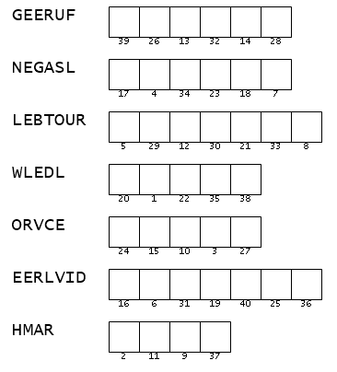
Family Activities
Attention! This ultra secret message key has been forwarded by Spiros the Spy, on mission in Puertankibon. These are scrambled words taken from your Bible Study passage. Unscramble them and use the numbers to fill in the message form. Tech help (and the Crossword puzzle) are available at http://tinyurl.com/27z7y3cd

Slide 20
The Protection of God’s Name
January 7

