Slide 1
The Problem with Work
March 24

Slide 2

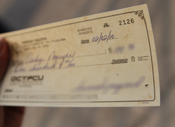
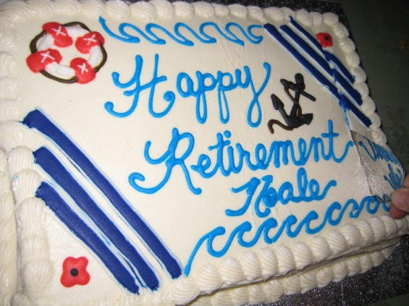
Think about it …
What is something about work that you find satisfying?
Some days, our jobs seem frustrating, other days they feel rewarding.
  Today we study Solomon’s take on working
  We will conclude that our work gains meaning when it’s done to honor Christ

Slide 3
Planning ..
When we make out our wills, consider the decisions of who are recipients of our inheritance?
  Children, grandchildren
  Responsible heirs
  Family heirlooms to those who will treasure them
Listen for how Solomon felt about leaving behind his accomplishments

Slide 4
Listen for Solomon’s attitude towards his heirs.
Ecclesiastes 2:18-23 (NIV) I hated all the things I had toiled for under the sun, because I must leave them to the one who comes after me. 19 And who knows whether he will be a wise man or a fool? Yet he will have control over all the work into which I have poured my effort and skill under the sun. This too is meaningless. …

Slide 5
Listen for Solomon’s attitude towards his heirs.
So my heart began to despair over all my toilsome labor under the sun. 21 For a man may do his work with wisdom, knowledge and skill, and then he must leave all he owns to someone who has not worked for it. This too is meaningless and a great misfortune. …

Slide 6

Listen for Solomon’s attitude towards his heirs.
What does a man get for all the toil and anxious striving with which he labors under the sun? 23 All his days his work is pain and grief; even at night his mind does not rest. This too is meaningless.

Slide 7
Feeling of Futility
Find words in the text that describe Solomon’s feelings or emotions.
What concern did he have about the character of the person who would succeed him and inherit or in some way acquire all he had worked hard to gain for himself?
When have you seen someone working all of their life and leaving it to someone else to reap the benefits?

Slide 8
Feeling of Futility
When have you felt like your work was futile or limited?
What products can you think of where almost overnight are made obsolete by a different industry?
All these represent people who designed and manufactured products and have lost those jobs. Even if you found other or similar work, you still could feel frustration at all the previous work now meaningless

Slide 9
Feeling of Futility
How would you summarize the current older generation’s approach to work?
How has our culture’s attitude toward work changed over the years?

Slide 10
Feeling of Futility
In what ways does a misplaced focus on work, money, and leaving an inheritance lead to many sleepless nights?
What actions on our part increase the likelihood that those who follow us will treasure the real treasures and work for genuine values?

Slide 11
Listen for comments on eternity.
Ecclesiastes 3:9-13 (NIV) What does the worker gain from his toil? 10 I have seen the burden God has laid on men. 11 He has made everything beautiful in its time. He has also set eternity in the hearts of men; yet they cannot fathom …

Slide 12
Listen for comments on eternity.
what God has done from beginning to end. 12 I know that there is nothing better for men than to be happy and do good while they live. 13 That everyone may eat and drink, and find satisfaction in all his toil--this is the gift of God.

Slide 13
Work Is God’s Gift
How is the fact that God has placed eternity in our heart manifested in our society?
According to these verses, how might the anticipation of eternity be frustrating?
What troubling question does the Preacher surface in these verses?
How does the Preacher seem to assess work in the scheme of God’s order of things?

Slide 14
Work Is God’s Gift
Solomon says that our labor, our work is a gift from God. How would that attitude help us? What difference does one’s attitude toward work make in doing that work?
What are some things you can do in your current phase of life to enjoy the fruit of your labor?
How could approaching work as a gift from God benefit you and be a witness to others?

Slide 15

Application
View Video

Slide 16
Application
Be thankful.
  Acknowledge that the job you have and the work you do is from God.
  Give Him thanks.

Slide 17
Application
Rest.
  Balance your work with rest.
  Your work is important, but it should never consume you.
  Block out time daily for rest, and set aside a day for rest.

Slide 18
Application
Work for Christ.
  Consider the ways you can honor Christ and bring an eternal perspective to your work.
  Don’t consider just the things you do; consider the people you interact with.
  Look for ways to point to Christ in your work related relationships

Slide 19

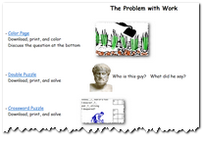
Family Activities
Hey, I want to hurry and finish my work today so I can go show my kids the Family Activities puzzles and interesting discussion questions. You can find them at https://tinyurl.com/y4x7n5se

Slide 20
The Problem with Work
March 24

