Slide 1
The Problem with Wisdom
March 17

Slide 2



Think about it …
What valuable life lesson have you learned that had nothing to do with formal education?
Education and even experience can only do so much
  True Wisdom is grounded in trust in God.

Slide 3
Listen for a contrast.
Ecclesiastes 2:12-17 (NIV) Then I turned my thoughts to consider wisdom, and also madness and folly. What more can the king's successor do than what has already been done? 13 I saw that wisdom is better than folly, just as light is better than darkness. 14 The wise man has eyes in his head, while the fool walks in the darkness

Slide 4
Listen for a contrast.
but I came to realize that the same fate overtakes them both. 15 Then I thought in my heart, "The fate of the fool will overtake me also. What then do I gain by being wise?" I said in my heart, "This too is meaningless." 16 For the wise man, like the fool, will not be long remembered; in days to come both will be forgotten. Like the fool,

Slide 5

Listen for a contrast.
the wise man too must die 17 So I hated life, because the work that is done under the sun was grievous to me. All of it is meaningless, a chasing after the wind.

Slide 6
Limited Advantages of Wisdom
What subject did the Preacher return to in these verses? What two things did he contrast?
What advantage did wisdom have over folly?
Why is human wisdom inadequate for life’s biggest problems?
Who are some people you’ve heard of whose memory of them has lasted longer than others?

Slide 7
Limited Advantages of Wisdom
Nevertheless, what fate did both the wise and the foolish, the famous and the infamous share in common?
Why did his realizing that common fate prove to be troublesome to the Preacher?
How does knowing Christ as your personal Savior and Lord change each of Solomon’s perceptions of life?

Slide 8
Listen for what is unreachable.
Ecclesiastes 7:23-25 (NIV) All this I tested by wisdom and I said, "I am determined to be wise"-- but this was beyond me. 24 Whatever wisdom may be, it is far off and most profound-- who can discover it? 25 So I turned my mind to understand, to investigate and to search out wisdom and the scheme of things and to understand the stupidity of wickedness and the madness of folly.

Slide 9
Limited Abilities of Wisdom
What had the Preacher determined to do? How successful was he?
Why did he fail? If he came to know anything, what was it?
What are some things in our day that human wisdom still cannot explain?

Slide 10
Limited Abilities of Wisdom
Since wisdom is beyond us, why do we continue pursuing it?
How does a person gain true wisdom? What advice would you give to Solomon?

Slide 11
Listen for what people search.
Ecclesiastes 7:26-29 (NIV) I find more bitter than death the woman who is a snare, whose heart is a trap and whose hands are chains. The man who pleases God will escape her, but the sinner she will ensnare. 27 "Look," says the Teacher, "this is what I have discovered:

Slide 12
Listen for what people search.
"Adding one thing to another to discover the scheme of things-- 28 while I was still searching but not finding-- I found one [upright] man among a thousand, but not one [upright] woman among them all. 29 This only have I found: God made mankind upright, but men have gone in search of many schemes."

Slide 13
Pursue Knowledge, Apply God’s Wisdom
What did Solomon find while he was still searching?
Why do people tend toward extremes rather than balance?
Why do people choose to go in search of their own schemes rather than follow God’s plan?
What sort of schemes are people in our society pursuing?

Slide 14
Pursue Knowledge, Apply God’s Wisdom
What example did the Preacher cite of something to be avoided by one who would live according to godly wisdom?
How does trust in God’s wisdom add value to your life?
How does the fear of God (Prov. 1:7) help us gain wisdom?

Slide 15
Application
Consider God’s good creation.
  On a clear night this week, go outside and look up at the stars.
  Read Genesis 1 and Psalm 8, and thank God for His wise, creative, and powerful work.

Slide 16
Application
Memorize Proverbs 3:5-6.
  “Trust in the Lord with all your heart, and do not rely on your own understanding; in all your ways know him, and he will make your paths straight.”
  As you go through the week, think of ways you can pursue God and trust in His wisdom, rather than relying on yourself.

Slide 17
Application
Have a conversation.
  Spend time with an unbelieving friend, and ask them how they might explain the problems in the world and the nature of sin and evil.
  As you listen without judging, pray and seek the opportunity to share the gospel and the wisdom of God.

Slide 18

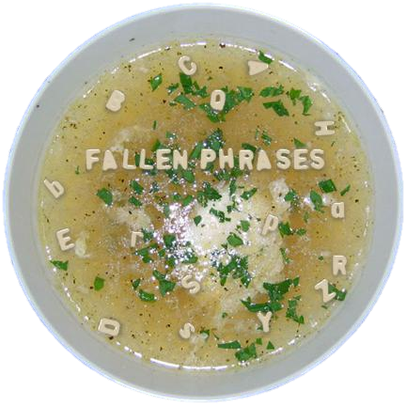

Family Activities
Look what happened in my soup! Well, the letters in your puzzle didn’t fall so nicely. But you can fix ‘em. You can find the solution AND other neat family activities at https://tinyurl.com/y2vd93pe

Slide 19
The Problem with Wisdom
March 17

