Slide 1
The Pitfall of Temptation
January 30

Slide 2

Video Introduction
View Video

Slide 3

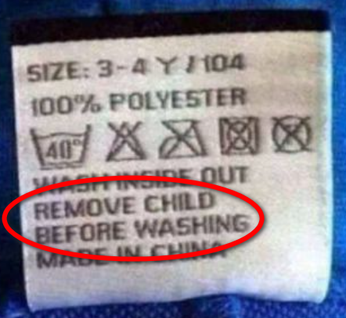
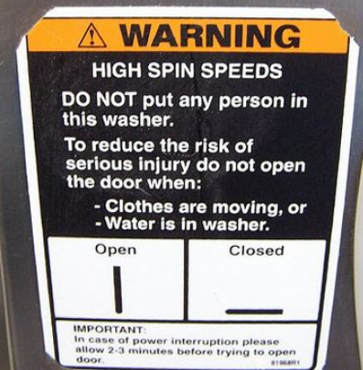
Be honest, now …
What are some warning labels or signs you actually pay attention to?
Warning labels are there for our protection
  Wouldn’t it be nice if temptation came with a warning label?
  Today we look at resisting temptation
  It’s easier to resist when we know what is at stake

Slide 4
Listen for good news and bad news.
Genesis 39:1-7 (NIV) Now Joseph had been taken down to Egypt. Potiphar, an Egyptian who was one of Pharaoh's officials, the captain of the guard, bought him from the Ishmaelites who had taken him there. The LORD was with Joseph and he prospered, and he lived in the house of his Egyptian master. 3 When his master saw that the LORD

Slide 5
Listen for good news and bad news.
was with him and that the LORD gave him success in everything he did, 4 Joseph found favor in his eyes and became his attendant. Potiphar put him in charge of his household, and he entrusted to his care everything he owned. 5 From the time he put him in charge of his household and of all that he owned, the LORD blessed the household of the Egyptian because of Joseph.

Slide 6
Listen for good news and bad news.
The blessing of the LORD was on everything Potiphar had, both in the house and in the field. 6 So he left in Joseph's care everything he had; with Joseph in charge, he did not concern himself with anything except the food he ate. Now Joseph was well-built and handsome, 7 and after a while his master's wife took notice of Joseph and said, "Come to bed with me!"

Slide 7
Be Careful !
Even though Joseph was sold as a slave, how did God bless Him?
As far as his assets were concerned, to what degree did Potiphar trust Joseph?
We are told that God was with Joseph. In general, what characteristics about someone suggest that God is with him or her?

Slide 8
Be Careful !
What are some dangers we face when things are going well for us?
Why is it important to stay on guard against temptation when things are going well?
What was the temptation with which Joseph was confronted?

Slide 9
Listen for trouble.
Genesis 39:8-10 (NIV) But he refused. "With me in charge," he told her, "my master does not concern himself with anything in the house; everything he owns he has entrusted to my care. 9 No one is greater in this house than I am.

Slide 10
Listen for trouble.
My master has withheld nothing from me except you, because you are his wife. How then could I do such a wicked thing and sin against God?" 10 And though she spoke to Joseph day after day, he refused to go to bed with her or even be with her.

Slide 11
Be Ready !
How did the temptation intensify?
On what basis did he refuse to give in to the temptation?
Why did Joseph have to exercise constant vigilance?
What are the consequences of sexual sin?

Slide 12
Be Ready !
What kinds of negative effects result when we give in to any temptation?
What should motivate us to strive for holiness?

Slide 13
Listen for an escape plan.
Genesis 39:11-12 (NIV) One day he went into the house to attend to his duties, and none of the household servants was inside. 12 She caught him by his cloak and said, "Come to bed with me!" But he left his cloak in her hand and ran out of the house.

Slide 14
Run !
In what unavoidable situation did Joseph find himself?
How did Joseph respond?
In a culture saturated with temptation, how do we avoid giving in to temptation?

Slide 15
Run !
We talked about negative effects of giving in … what would be positive effects of resisting and rejecting temptation?
What role does our group play in helping us overcome temptation?

Slide 16
Application
Take stock.
  Do you find it difficult to walk away from certain temptations?
  Ask God to help you form a plan to fight repeating temptations in your life.

Slide 17
Application
Partner up.
  Sometimes the best gift God can give us in the face of temptation is a godly friend.
  Reach out to a friend this week and ask if they will hold you accountable to a specific temptation you are trying to avoid.

Slide 18
Application
Begin a fast.
  One of the ways to overcome temptation is to train our minds using a spiritual discipline like fasting.
  This week, choose to devote TV time to devotional reading, developing friendships, or taking prayer walks.

Slide 19
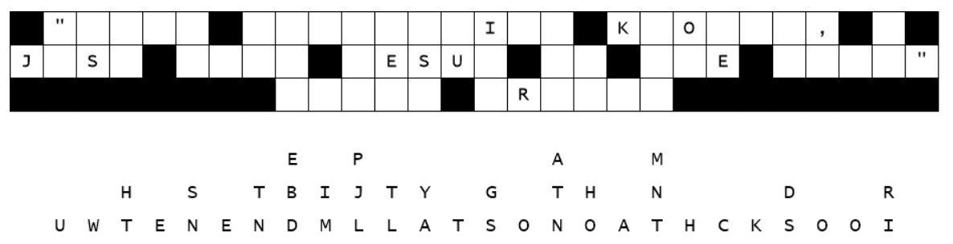

Family Activities
We have a report of letters down. We need some help here. Further opportunities are available at https://tinyurl.com/zptmj7ze

Slide 20
The Pitfall of Temptation
January 30

