Slide 1
The Pitfall of Hard Times
February 13

Slide 2


Video Introduction
View Video

Slide 3



Think carefully …
What is your number one survival tip to prepare for a crisis?
A tragedy or crisis can happen at any time …
  Many times we are unprepared for such a crisis, but God is never surprised
  Today we look at the fact that God has a plan to see you through any crisis

Slide 4
Listen for breaking news.
Genesis 41:28-32 (NIV) "It is just as I said to Pharaoh: God has shown Pharaoh what he is about to do. 29 Seven years of great abundance are coming throughout the land of Egypt, 30 but seven years of famine will follow them. Then all the abundance in Egypt will be forgotten,

Slide 5

Listen for breaking news.
and the famine will ravage the land. 31 The abundance in the land will not be remembered, because the famine that follows it will be so severe. 32 The reason the dream was given to Pharaoh in two forms is that the matter has been firmly decided by God, and God will do it soon.

Slide 6
Seek God’s Wisdom
What did Pharoah’s dream mean?
What words and phrases tell you about to whom Joseph gave credit concerning his interpretation of the dreams?
In what ways do we see the activity of God in these verses?
Besides being active, what other truths about God do you see here?

Slide 7
Seek God’s Wisdom
Why was God not surprised by the turn of events that were about to occur in Egypt?
What are some reasons we might fail to seek God’s wisdom when making decisions?
What are some ways we can seek wisdom from God?

Slide 8
Seek God’s Wisdom
How should we live our lives so that those around will view us as people in whom the Spirit of God dwells?

Slide 9
Listen for how Joseph followed God’s plan.
Genesis 41:47-49 (NIV) During the seven years of abundance the land produced plentifully. 48 Joseph collected all the food produced in those seven years of abundance in Egypt and stored it in the cities. In each city he put the

Slide 10
Listen for how Joseph followed God’s plan.
food grown in the fields surrounding it. 49 Joseph stored up huge quantities of grain, like the sand of the sea; it was so much that he stopped keeping records because it was beyond measure.

Slide 11
Follow God’s Plan
How did Joseph involve himself in the plan he had proposed to Pharaoh?
What can we learn from Joseph’s plan to guide Egypt through the years of abundance and famine?
How do you think God is preparing our church for present and future challenges?

Slide 12
Follow God’s Plan
When is it most challenging for you to follow God’s plan?
How can we discern that something is God’s plan and not our own?

Slide 13
Listen for events in Joseph’s personal life.
Genesis 41:50-54 (NIV) Before the years of famine came, two sons were born to Joseph by Asenath daughter of Potiphera, priest of On. 51 Joseph named his firstborn Manasseh and said, "It is because God has made me forget

Slide 14
Listen for events in Joseph’s personal life.
all my trouble and all my father's household." 52 The second son he named Ephraim and said, "It is because God has made me fruitful in the land of my suffering." 53 The seven years of abundance in Egypt came to an end,

Slide 15
Be Fruitful Even in Famine
It appears Joseph’s family was an arranged marriage. Note the meanings of the names he gave his two sons. What might be some words in our language that would be descriptive names for these sons?
Manasseh Forgot My Troubles | Ephraim Fruitful after Suffering

Slide 16
Be Fruitful Even in Famine
We might not name our children with some of these descriptive names, but what could we be doing or saying to express our awareness and thanksgiving for God’s working in our lives?
With what kinds of life crises are people struggling with these days?

Slide 17
Be Fruitful Even in Famine
While it is not healthy to deny our feelings and to act as if our struggles aren’t real, what can you do to learn from a current crisis that would increase your faith and draw you closer to God?

Slide 18
Application
Make a list.
  Make a list of all the beautiful things happening in your life right now.
  Tape it to your bathroom mirror and begin every day with praise.

Slide 19
Application
Consider.
  Consider all the hard things you are going through right now.
  As you pray while you take a walk around your neighborhood, read them aloud and give them all to God.

Slide 20
Application
Memorize.
  Memorize Isaiah 26:3. It’s an easy one!
  “You will keep in perfect peace those whose minds are steadfast, because they trust in you.”

Slide 21
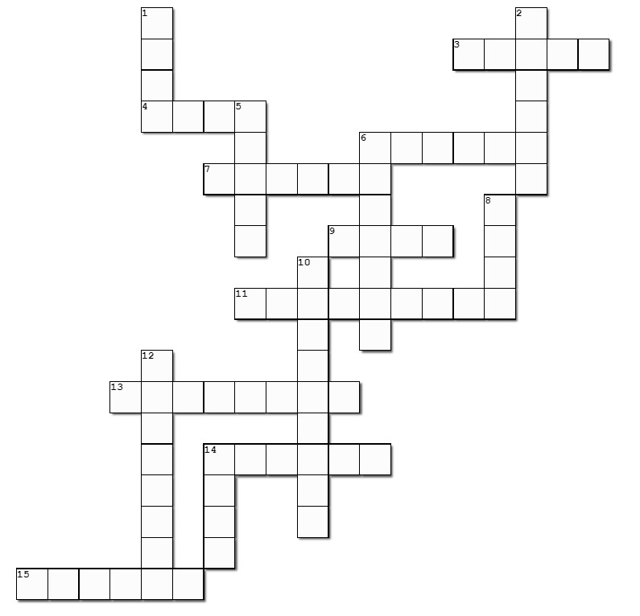

Family Activities
Pshaw! We got comments about a posted solution that was for the wrong crossword puzzle … sorry about that! The fellow who puts all this together is getting to be “of an age”, you know. The help this week claims to be at https://tinyurl.com/3yxbve78 .
We’ll see. Double check the other stuff that’s there also.

Slide 22
The Pitfall of Hard Times
February 6

