Slide 1
The Pitfall of
Guilt and Grudges
February 27

Slide 2

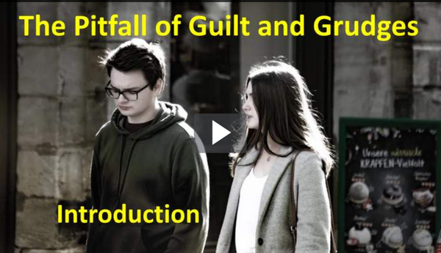
Video Introduction
View Video

Slide 3
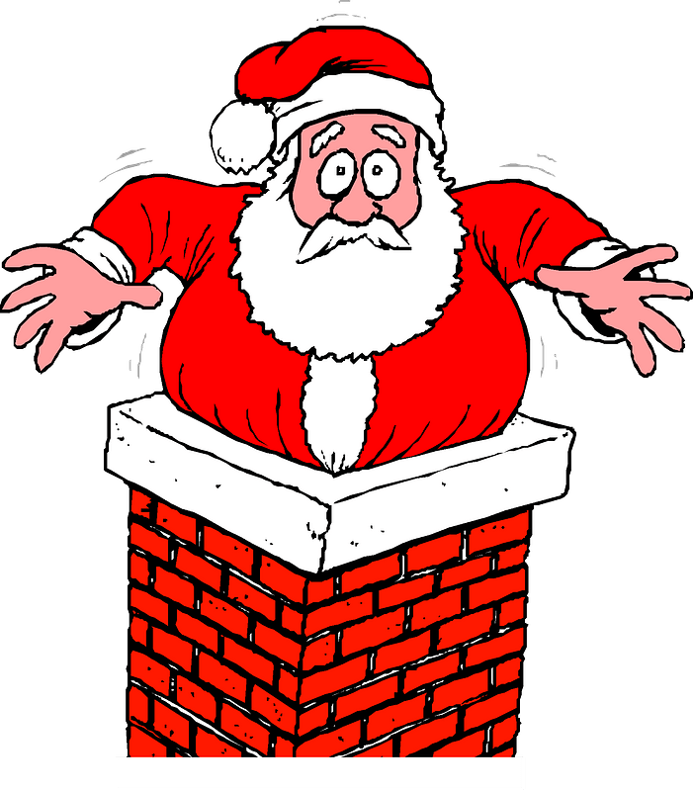
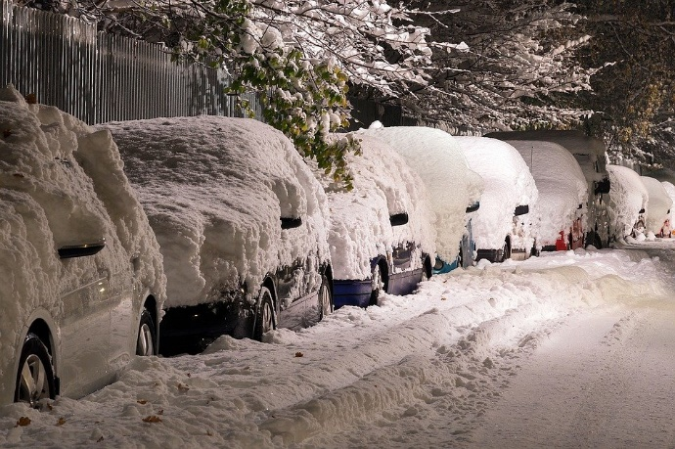
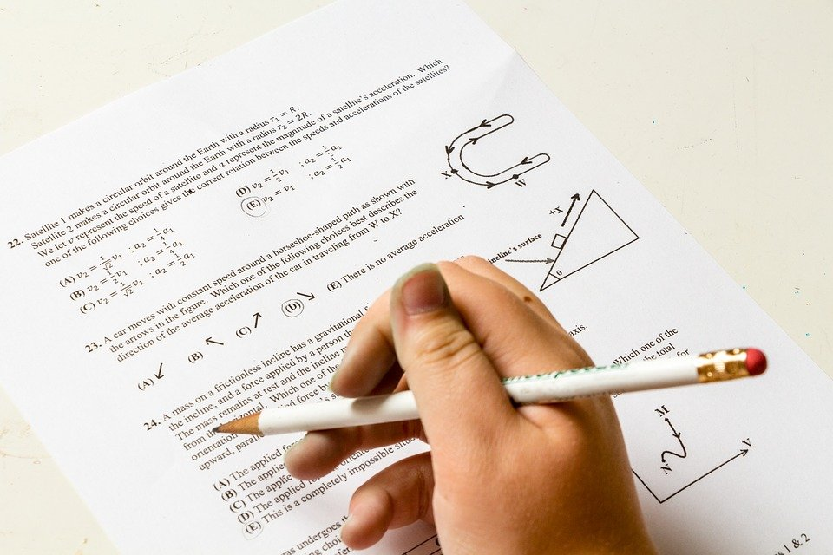
Remember that incident?
When was the last time you were stuck, either literally or figuratively?
It is possible to be stuck spiritually,
  Making no progress, falling for the same temptation.
  We can only move forward when we embrace God’s forgiveness.

Slide 4
Listen for fear of revenge.
Genesis 50:15-18 (NIV) When Joseph's brothers saw that their father was dead, they said, "What if Joseph holds a grudge against us and pays us back for all the wrongs we did to him?" 16 So they sent word to Joseph, saying, "Your father left these instructions before he died: 17 'This is what you are to say to Joseph: I ask you to forgive

Slide 5

Listen for fear of revenge.
your brothers the sins and the wrongs they committed in treating you so badly.' Now please forgive the sins of the servants of the God of your father." When their message came to him, Joseph wept. 18 His brothers then came and threw themselves down before him. "We are your slaves," they said.

Slide 6
Guilt vs. Grudges
What did the brothers fear from Joseph following their father’s death?
What words or phrases describe the depth of their pleas for forgiveness?
What may have prompted Joseph to weep upon hearing the message asking for forgiveness?
What’s really going on when we hold a grudge?

Slide 7
Guilt vs. Grudges
What makes forgiving someone who has wronged us so difficult?
What part does admitting guilt play in seeking forgiveness? Is that all that is needed?

Slide 8
Guilt vs. Grudges
Be aware …
Those who have done wrong need to confess their sins, seek forgiveness
Guilt can be so strong that some people have trouble believing they have been forgiven
Forgiveness is necessary for ongoing personal relationships

Slide 9
Listen for God’s providence.
Genesis 50:19-21 (NIV) But Joseph said to them, "Don't be afraid. Am I in the place of God? 20 You intended to harm me, but God intended it for good to accomplish what is now being done, the saving of many lives.

Slide 10
Focus on God’s Providence
How does Joseph’s reply to them demonstrate his attitude of submissiveness before God?
What perspective did Joseph offer to explain the actions of his brothers and the things that had happened to him?
What can it cost us to leave justice in God’s hands?

Slide 11
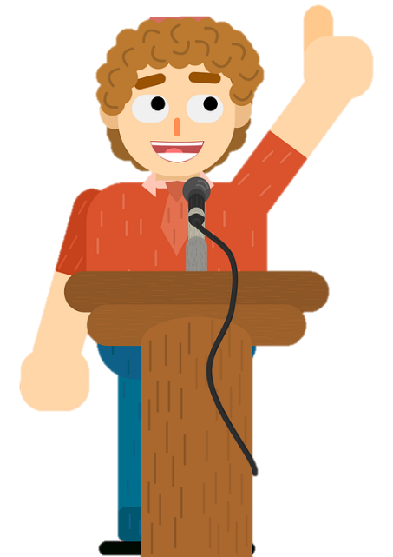
Focus on God’s Providence
Agree or disagree?
It is possible to both forgive and forget.
Agree | Disagree

Slide 12
Focus on God’s Providence
How is this passage an Old Testament parallel to Romans 8:28?
  And we know that in all things God works for the good of those who love him, who have been called according to his purpose.

Slide 13
Listen for forgiveness and comfort.
Genesis 50:21 (NIV) So then, don't be afraid. I will provide for you and your children." And he reassured them and spoke kindly to them.

Slide 14
Receive Forgiveness
Because he believed that God had been in control all along, what actions was Joseph able to take toward his brothers and their families?
It is often hard to offer forgiveness. Why is it sometimes hard for us to accept forgiveness from others?
What are some principles you’ve learned from Joseph’s life?

Slide 15
Receive Forgiveness
What parallels do you see between the life of Joseph and the life of Jesus? How is Joseph’s life a foreshadowing of the life and ministry of Christ?
How can our group help one another become people of forgiveness?

Slide 16
Application
Stay humble.
  God is stronger than you know. You are weaker than you know.
  Embracing your small part in His grand story is not only the biblical thing to do, but the healthy way to live.
  He’s in control so you can stop trying to be. Make a list of ways you have tried to be in control.

Slide 17
Application
Stop the hate.
  Stop hating people for hurting you.
  The price we pay for holding others to their past is steep.
  In the end, we punish ourselves for the actions of others.
  This is not the grace of God at work in us.
  Make a list of those for whom you hold a grudge and make it a prayer list.

Slide 18
Application
Seek grace.
  Seek the grace of God anew.
  We don’t mean to do it, but we travel back to Egypt so quickly.
  We go back to bondage. We forget that we are forgiven.
  Because of Him, we are enough. We do measure up.
  Make a list of reasons you have to celebrate God’s grace.

Slide 19
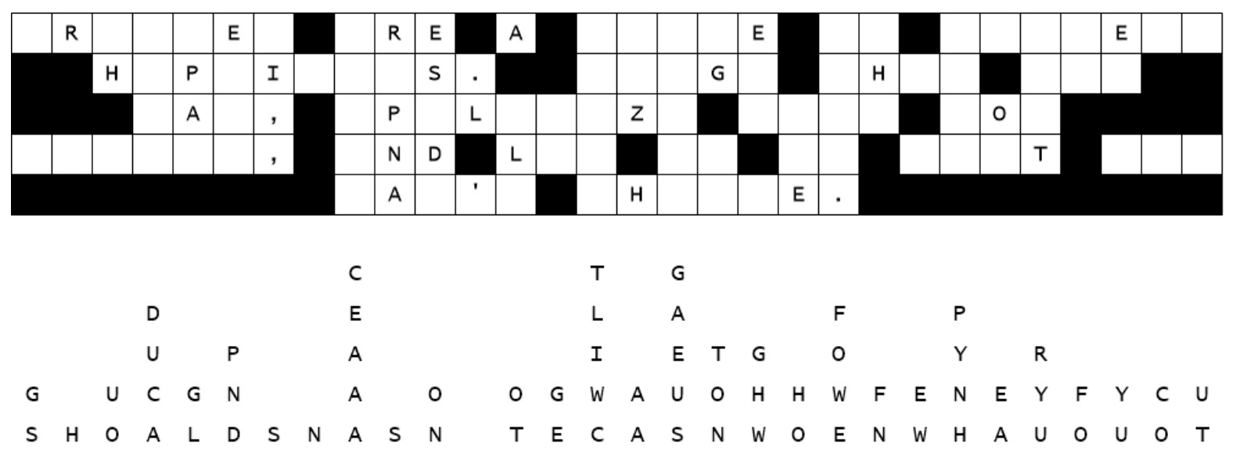
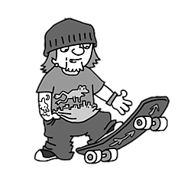
Family Activities
Not sure what happened. We need to get the letters back in place. Can you give us a hand? You can get free assistance at https://tinyurl.com/59e49994 And check out other cool stuff to do there also.

Slide 20
The Pitfall of
Guilt and Grudges
February 27

