Slide 1
The Pitfall of Betrayal
January 23

Slide 2


Video Introduction
View Video

Slide 3
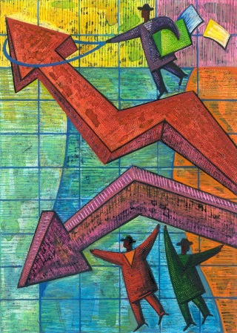
Remember that time …
Think of a situation where you were initially upset by what was going on, but it turned out for the good?
Difficulties are part of life …
  Today we look at a the life of Joseph
  We discover that God is at work, even in the midst of conflict

Slide 4
Listen for love and hate.
Genesis 37:1-5 (NIV) Jacob lived in the land where his father had stayed, the land of Canaan. 2 This is the account of Jacob. Joseph, a young man of seventeen, was tending the flocks with his brothers, the sons of Bilhah and the sons of Zilpah, his father's wives, and he brought their father a bad report about them. 3 Now Israel loved Joseph more than any of his

Slide 5

Listen for love and hate.
other sons, because he had been born to him in his old age; and he made a richly ornamented robe for him. 4 When his brothers saw that their father loved him more than any of them, they hated him and could not speak a kind word to him. 5 Joseph had a dream, and when he told it to his brothers, they hated him all the more.

Slide 6
A Dysfunctional Family
Why might a parent favor one child over another?
What reasons do you see for conflict between Joseph and his brothers?
What other kinds of things cause jealousy between siblings?
How does boasting get people like Joseph into trouble?

Slide 7

A Dysfunctional Family
Suppose you are one of the brothers. How do you feel about Joseph? What thoughts would you have?
Thinking of cause and effect, do you think hatred was the cause or the result of this conflict?
How can parents avoid fueling jealousy between their children?

Slide 8
Listen for plans of betrayal.
Genesis 37:19-24 (NIV) "Here comes that dreamer!" they said to each other. 20 "Come now, let's kill him and throw him into one of these cisterns and say that a ferocious animal devoured him. Then we'll see what comes of his dreams." 21 When Reuben heard this, he tried to rescue him from their hands. "Let's not take his life," he said. 22 "Don't shed any blood. Throw him into

Slide 9
Listen for plans of betrayal.
this cistern here in the desert, but don't lay a hand on him." Reuben said this to rescue him from them and take him back to his father. 23 So when Joseph came to his brothers, they stripped him of his robe--the richly ornamented robe he was wearing-- 24 and they took him and threw him into the cistern. Now the cistern was empty; there was no water in it.

Slide 10
The Peril of Hostility and Jealousy
Initially, how did the brothers propose to get rid of Joseph?
What intercessory role did Reuben play? What was his plan?
How might you respond when you’re betrayed by people close to you?

Slide 11
The Peril of Hostility and Jealousy
What makes jealousy such a powerful emotion?
How can you keep anger or jealousy from taking root in your life? How should we deal with feelings of jealousy?

Slide 12
Listen for what saves Joseph’s life.
Genesis 37:26-27 (NIV) Judah said to his brothers, "What will we gain if we kill our brother and cover up his blood? 27 Come, let's sell him to the Ishmaelites and not lay our hands on him; after all, he is our brother, our own flesh and blood." His brothers agreed.

Slide 13
God Is Still at Work
Who was Judah and what alternative proposal did he present to his brothers concerning Joseph?
The Ishmaelites
  Descendants of Abraham’s first child (Ishmael). Sara’s handmaid.
  Now three generations later.
  These were maybe distant cousins of the brothers, although the families probably weren’t close at all.

Slide 14
God Is Still at Work
What suggests that the brothers were worried about bearing the guilt of Joseph’s death?
How would Joseph expect his life to change once he was sold?
How can God be at work during pitfalls in people’s lives?
How can our group help one another when someone is faced with a setback or betrayal?

Slide 15
Application
Be honest with God.
  Many live in denial, refusing to admit that their heart was broken.
  Step one is to open up with God and to admit your hard feelings.

Slide 16
Application
Pray for a friend.
  Most of us know someone who feels a deep sense of betrayal.
  Begin praying for them and look for signs that God is at work in helping them heal. Be ready to step in as part of the answer to that prayer.

Slide 17
Application
Begin a support group.
  As you meet others dealing with betrayal, consider starting an informal Bible study, perhaps a weekly coffee.
  Be sure to invite one or two people who have overcome their struggles who can help other

Slide 18
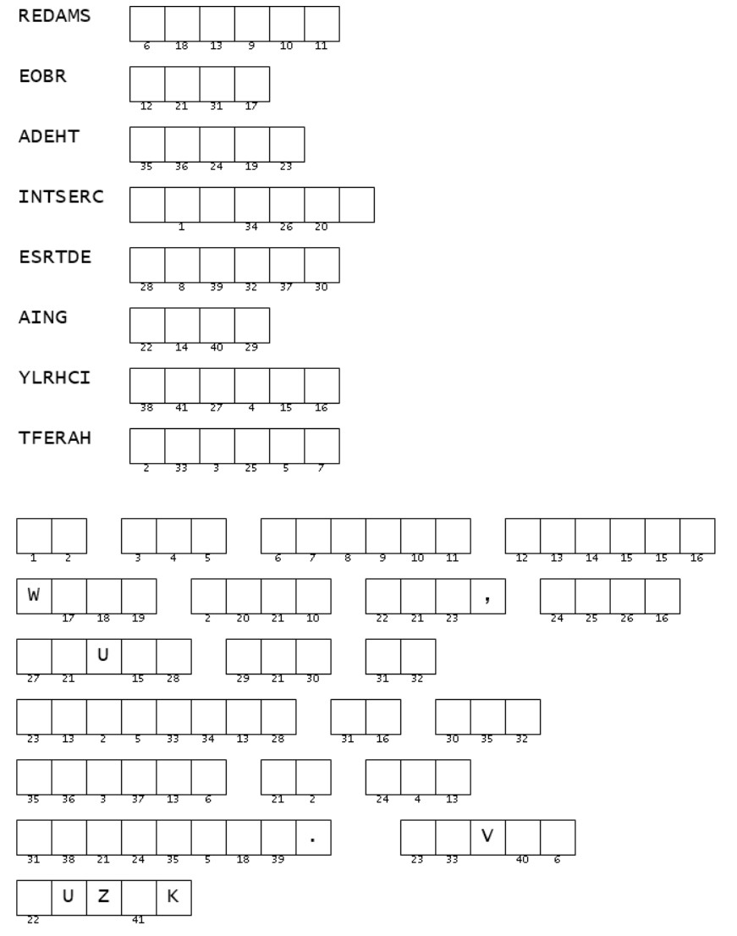

Family Activities
Hmmm … a possible case of espionage. Maybe I should contact Spiros the Spy. Looks like the key to the message is itself in code. If you need help go to https://tinyurl.com/4va8y62a Maybe you can find additional activities for your own intrigue.

Slide 19
The Pitfall of Betrayal
January 23

