Slide 1
The Nature of Sin
March 21

Slide 2

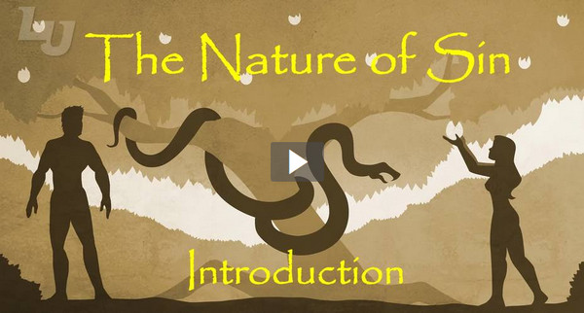
Video Introduction
View Video

Slide 3
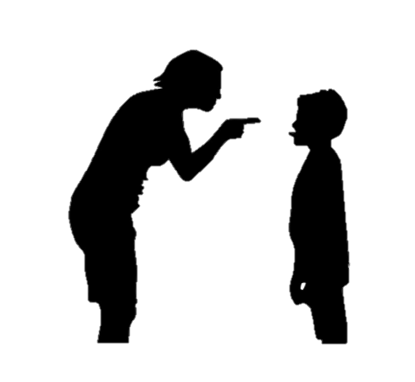
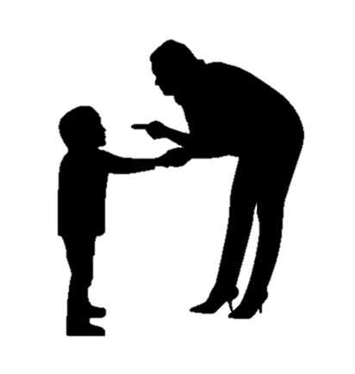

Do you remember?
What’s an early memory of being punished for doing something wrong?
Some people may have had more, some less of childhood punishment.
  The reality is, we are all sinners, and on our own, we can do nothing about it.

Slide 4
Listen for an implied accusation.
Isaiah 59:1-5 (NIV) Surely the arm of the LORD is not too short to save, nor his ear too dull to hear. 2 But your iniquities have separated you from your God; your sins have hidden his face from you, so that he will not hear. 3 For your hands are stained with blood, your fingers with guilt. Your lips have spoken lies, and your tongue mutters wicked

Slide 5
Listen for an implied accusation.
things. 4 No one calls for justice; no one pleads his case with integrity. They rely on empty arguments and speak lies; they conceive trouble and give birth to evil. 5 They hatch the eggs of vipers and spin a spider's web. Whoever eats their eggs will die, and when one is broken, an adder is hatched.

Slide 6
Sin Separates Us from God
What accusations did the people seem to be levying against the Lord?
According to the prophet, what was the true cause for the breach with the Lord?
How does sin separate us from God? Isn’t God’s presence everywhere? Isn’t He omnipresent?
What were some of the sins for which the people were guilty?

Slide 7
Sin Separates Us from God
Drawing on the metaphor of a snake, what would result from their sinful practices?
What evidence do you see in this world that everyone has sinned?
What were the circumstances when you become aware that you were a sinner?

Slide 8
Listen for the adverse effects of sin.
Isaiah 59:6-8 (NIV) Their cobwebs are useless for clothing; they cannot cover themselves with what they make. Their deeds are evil deeds, and acts of violence are in their hands. 7 Their feet rush into sin; they are swift to shed innocent blood.

Slide 9
Listen for the adverse effects of sin.
Their thoughts are evil thoughts; ruin and destruction mark their ways. 8 The way of peace they do not know; there is no justice in their paths. They have turned them into crooked roads; no one who walks in them will know peace.

Slide 10
Good Works Don’t Cover Sin
What was the point of Isaiah’s use of the spider’s web analogy?
How does verse 7 describe the state of life of the wicked?
What are some common ways people try to cover over their sinfulness?

Slide 11
Good Works Don’t Cover Sin
Consider these verses which speak to the fact that good works not the answer to the problem of our sinfulness
  Isaiah 64:6
  John 6:28
  Romans 3:20
  Roman s 9:31, 32
Galatians 2:16
Galatians 5:4
Ephesians 2:8, 9
Titus 3:5
Isaiah 57:12

Slide 12
Listen for where is righteousness.
Isaiah 59:9-13 (NIV) So justice is far from us, and righteousness does not reach us. We look for light, but all is darkness; for brightness, but we walk in deep shadows. 10 Like the blind we grope along the wall, feeling our way like men without eyes. At midday we stumble as

Slide 13
Listen for where is righteousness.
if it were twilight; among the strong, we are like the dead. 11 We all growl like bears; we moan mournfully like doves. We look for justice, but find none; for deliverance, but it is far away. 12 For our offenses are many in your sight, and our sins testify against us.

Slide 14
Listen for where is righteousness.
Our offenses are ever with us, and we acknowledge our iniquities: 13 rebellion and treachery against the LORD, turning our backs on our God, fomenting oppression and revolt, uttering lies our hearts have conceived.

Slide 15
God Must Intervene
Identify the various images Isaiah employed to describe the status and feelings of those in sin.
What makes these images an effective way to describe our lives in sin? List some examples of how people look for light but end up groping and stumbling through life?
This lesson has emphasized the reality of our sinful condition. Let’s anticipate God’s solution to our problem …

Slide 16
God Must Intervene
David wrote Psalm 51:3 (NIV) For I know my transgressions, and my sin is always before me.
He continues in verses 10 – 12
Create in me a pure heart, O God, and renew a steadfast spirit within me. Do not cast me from your presence or take your Holy Spirit from me. Restore to me the joy of your salvation and grant me a willing spirit, to sustain me.

Slide 17
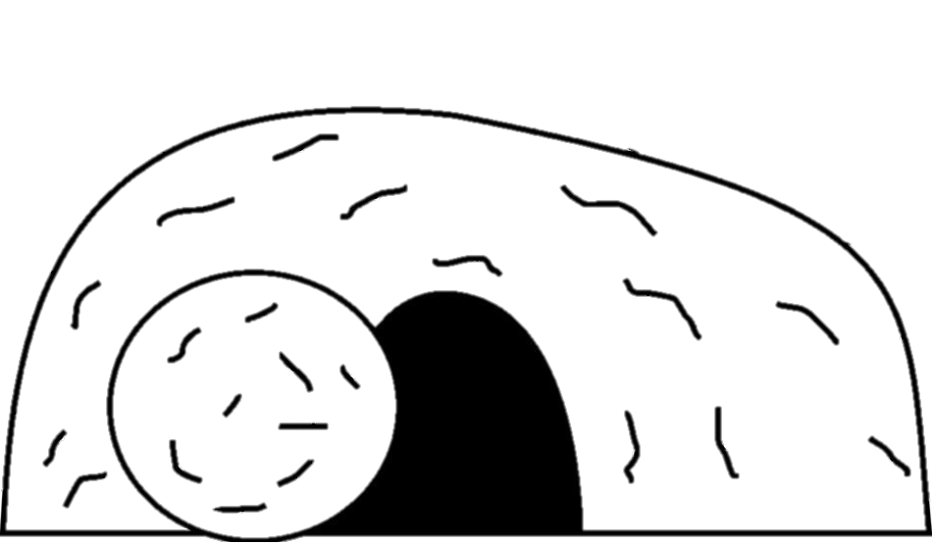

God Must Intervene
For what does he pray?
As we approach the Easter season, we can look forward to the answers to David’s prayer in our own lives.

Slide 18
Application
Confession.
  Admit you are a sinner who has fallen short of God’s standard.
  Confess your sin to Him and ask for forgiveness.
  He is faithful and just to forgive you.

Slide 19
Application
Prevention.
  Evaluate where you are most prone to give into temptation.
  Being tempted is not sin, but it can easily lead to sin.
  Draft some safeguards to help you avoid temptation in the first place.

Slide 20
Application
Accountability.
  Reach out to one or two believers (of the same gender) in whom you can confide.
  Talk through areas in which you are weak and ask them to hold you accountable and walk with you so that you will not fall into sin.

Slide 21
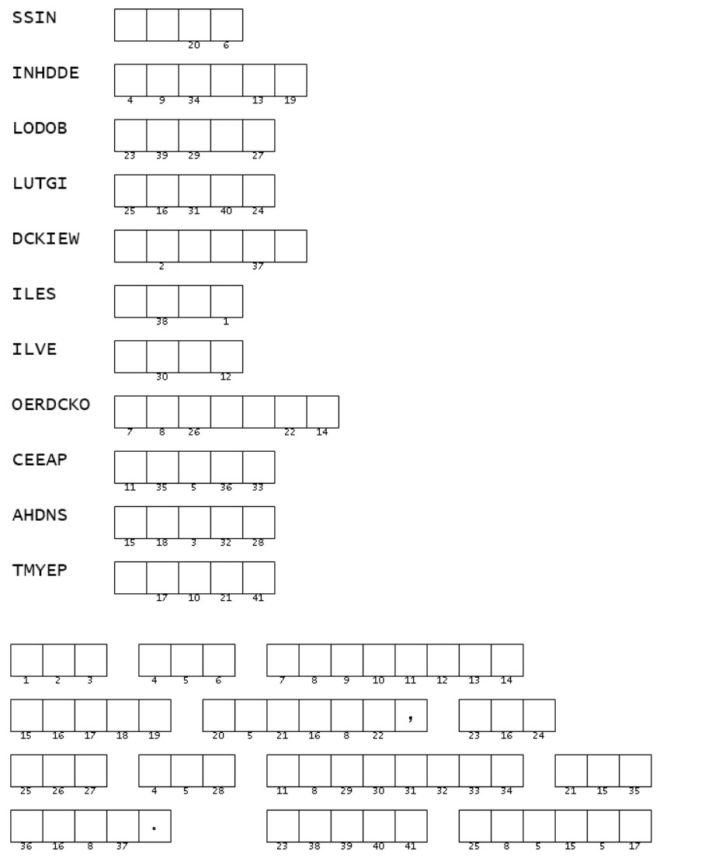
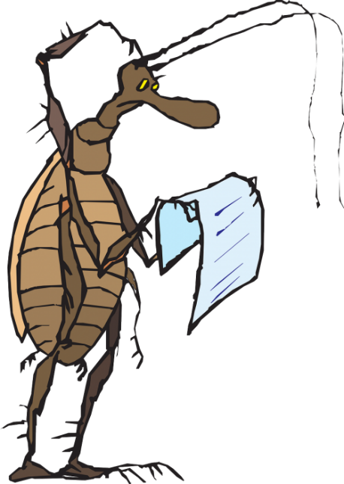
Family Activities
This puzzle is really bugging me. Can you figure out the mixed-up words to give you the numbers for the message? I’ll bet those words come from our Bible Study in Isaiah 59. Well, if you’re stuck, go to https://tinyurl.com/upnyjwr7 If you’d rather do the crossword, it’s there with other cool Family friendly stuff.

Slide 22
The Nature of Sin
March 21

