Slide 1
The Nature of God
March 7

Slide 2
Video Introduction
View Video

Slide 3
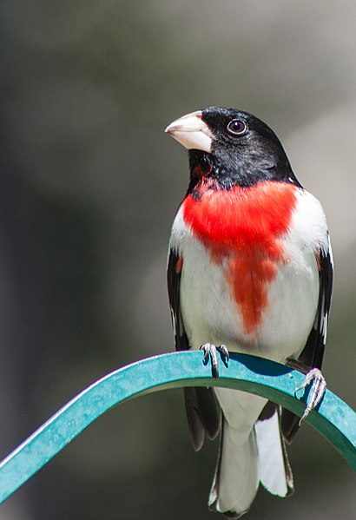
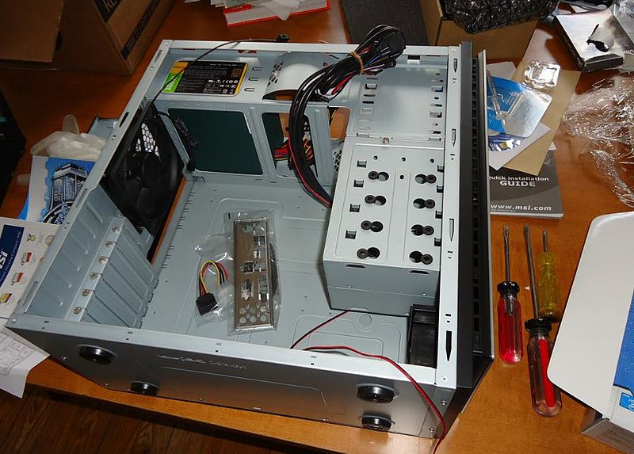
Admit it, now …
When have you looked for answers for something beyond your understanding?
Serie, Alexa, or Google can tell us lots of things, but not everything.
One theological fact beyond our understanding is the Trinity
God has revealed Himself to us as Father, Son, and Holy Spirit.
© 2014 Paul VanDerWerf

Slide 4
Listen for how Jesus answers.
John 14:8-11 (NIV) Philip said, "Lord, show us the Father and that will be enough for us." 9 Jesus answered: "Don't you know me, Philip, even after I have been among you such a long time? Anyone who has seen me has seen the Father. How can you say, 'Show us the Father'?

Slide 5
Listen for how Jesus answers.
Don't you believe that I am in the Father, and that the Father is in me? The words I say to you are not just my own. Rather, it is the Father, living in me, who is doing his work. 11 Believe me when I say that I am in the Father and the Father is in me; or at least believe on the evidence of the miracles themselves.

Slide 6
Know Jesus, Know the Father
What kind of attitudes or atmosphere do you think was present when Philip asked his question?
Why did Jesus seem surprised Philip felt a need for such a request?
What had Philip already seen that demonstrated the Father at work through Jesus?

Slide 7
Know Jesus, Know the Father
In what ways does Jesus show us what God is like? How does knowing Jesus’ actions and teachings help us know more about God?
Consider Philip …
It is easy to criticize him for lack of understanding
Actually, he was quite honest about what he was thinking and feeling
We need to be the same way with God … tell Him your doubts and concerns
Jesus wants to reassure you and remind you of His power at work in your life

Slide 8
Listen for Jesus’ introduction of the Spirit.
John 14:16-20 (NIV) And I will ask the Father, and he will give you another Counselor to be with you forever-- 17 the Spirit of truth. The world cannot accept him, because it neither sees him nor knows him. But you know him, for he lives with you and will be in you.

Slide 9
Listen for Jesus’ introduction of the Spirit.
I will not leave you as orphans; I will come to you. 19 Before long, the world will not see me anymore, but you will see me. Because I live, you also will live. 20 On that day you will realize that I am in my Father, and you are in me, and I am in you.

Slide 10
The Holy Spirit Is in Your Life
Who would the Father give to the believers in response to the request of the Son?
Why can believers receive Him but not those who are of the world? Why can’t unbelievers “see” Him (or see His working)?
What are some different words used by some of your translations for “counselor”?

Slide 11
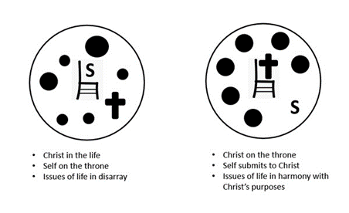
The Holy Spirit Is in Your Life
How does the Holy Spirit work in the life of a believer? What are the benefits of having the Holy Spirit in your life?

Slide 12
The Holy Spirit Is in Your Life
How are we taught by the Holy Spirit?
Note: He will be different from Jesus in that
The Spirit lives within the lives of all believers, everywhere, in all time and space
He is omnipotent, omnipresent, omniscient, eternal
Jesus, as a human, was confined in time and space

Slide 13
Listen for what the Spirit does in our lives.
John 14:23-26 (NIV) Jesus replied, "If anyone loves me, he will obey my teaching. My Father will love him, and we will come to him and make our home with him. 24 He who does not love me will not obey my teaching. These words you hear are not my own;

Slide 14
Listen for what the Spirit does in our lives.
they belong to the Father who sent me. 25 "All this I have spoken while still with you. 26 But the Counselor, the Holy Spirit, whom the Father will send in my name, will teach you all things and will remind you of everything I have said to you.

Slide 15
The Spirit Continues the Work of the Son
What kind of evidence affirms that a person loves the Lord?
What attitudes and actions will be motivated by our love for the Lord?
What effect does loving obedience have on one’s relationship to the Father and the Son?

Slide 16
The Spirit Continues the Work of the Son
Verse 26 says the Holy Spirit will teach us. How does the Holy Spirit teach us?
How does it make you feel to know that God abides with (lives within) you and the Spirit helps you understand His Word?

Slide 17
Application
Pray.
Give thanks to God for being a God who reveals Himself to us.
Thank Him for coming to us in Jesus Christ and for giving us His Holy Spirit to work in us and through us.

Slide 18
Application
Study.
Compare two passages: Genesis 1:1-2 and John 1:1-18.
Underline where you see the Father, the Son, and the Holy Spirit in these passages.
Make note of the similarities and differences in how the three Persons of the Trinity are described.

Slide 19
Application
Display.
Just as the world around us reveals God, we are called to reveal Him to those around us.
Trust the Holy Spirit to give you the opportunity and the words to point others to Jesus.

Slide 20
Family Activities
This is a cool puzzle. Just look up the Bible Study passage and find the words with the clues. And there’s more stuff where this came from. Go to https://tinyurl.com/1rdbgysb

Slide 21
The Nature of God
March 7

