Slide 1
The Mission of Jesus
March 3

Slide 2

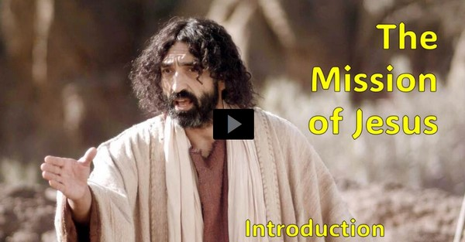
Video Introduction
View Video

Slide 3



You can’t forget …
When have you been surprised by a piece of good news?
Here’s the best good news ever – the Gospel!
  Jesus came to deliver the Good News of Salvation for all people.

Slide 4
Listen for an Old Testament quote.
Luke 3:1-6 (NIV) 1 In the fifteenth year of the reign of Tiberius Caesar--when Pontius Pilate was governor of Judea, Herod tetrarch of Galilee, his brother Philip tetrarch of Iturea and Traconitis, and Lysanias tetrarch of Abilene-- 2 during the high priesthood of Annas and

Slide 5
Listen for an Old Testament quote.
Caiaphas, the word of God came to John son of Zechariah in the desert. 3 He went into all the country around the Jordan, preaching a baptism of repentance for the forgiveness of sins. 4 As is written in the book of the words of Isaiah the prophet: "A voice of

Slide 6
Listen for an Old Testament quote.
one calling in the desert, 'Prepare the way for the Lord, make straight paths for him. 5 Every valley shall be filled in, every mountain and hill made low. The crooked roads shall become straight, the rough ways smooth. 6 And all mankind will see God's salvation.'"

Slide 7
John Prepared the Way
What purpose does Luke’s identifying political and religious leaders serve in preparing to discuss John’s ministry and to Luke’s Gospel account overall?

Slide 8
John Prepared the Way
Note the essence of John’s message?
  Prepare for God’s Good News
  The Messiah, the Sent One is coming
  Straighten the roads, make them level … the King is coming
  He is bringing salvation for all people

Slide 9
John Prepared the Way
What purpose did John’s preaching serve as far as Jesus was concerned?
What are some ways God prepares a person’s heart to hear about Jesus today?
John preached repentance. What is repentance?

Slide 10
John Prepared the Way
When we are confronted with a call to repent, why do we tend to accept or reject the invitation strongly
What connection is there between repentance and forgiveness?
Accept Strongly | Reject Strongly

Slide 11
Listen for a prophecy about Jesus.
Luke 4:14-19 (NIV) Jesus returned to Galilee in the power of the Spirit, and news about him spread through the whole countryside. 15 He taught in their synagogues, and everyone praised him. 16 He went to Nazareth, where he had been

Slide 12
Listen for a prophecy about Jesus.
brought up, and on the Sabbath day he went into the synagogue, as was his custom. And he stood up to read. 17 The scroll of the prophet Isaiah was handed to him. Unrolling it, he found the place where it is written: 18 "The Spirit of the Lord is

Slide 13
Listen for a prophecy about Jesus.
on me, because he has anointed me to preach good news to the poor. He has sent me to proclaim freedom for the prisoners and recovery of sight for the blind, to release the oppressed, 19 to proclaim the year of the Lord's favor."

Slide 14
Isaiah Prophesied Jesus’ Purpose
What do we learn about Jesus’s own practice as far as synagogue worship is concerned?
Jesus read from verses that in our Bibles is Isaiah. 61:1, 2. How do these verses summarize Jesus’s mission?
During this incident, in what ways did Jesus demonstrate the importance of knowing the Scriptures?

Slide 15
Isaiah Prophesied Jesus’ Purpose
In what different ways can we see the Spirit of God on Jesus throughout these events?

Slide 16
Listen for how Jesus shocked the crowd.
Luke 4:20-21 (NIV) Then he rolled up the scroll, gave it back to the attendant and sat down. The eyes of everyone in the synagogue were fastened on him, 21 and he began by saying to them, "Today this scripture is fulfilled in your hearing."

Slide 17
Jesus Declared Who He Was
Jesus claimed that that prophecy was fulfilled right there and then. Why might it have been a surprise to those who heard Him?
What does the statement mean concerning Jesus’s mission? What are the implications of Jesus proclaiming Himself to be the fulfillment of this prophecy?

Slide 18
Jesus Declared Who He Was
How can we as a group continue to carry out the mission of Jesus?
What are some popular, contemporary perceptions about the things Jesus did? Though accurate in some ways, where do they fall short in identifying the true mission of Jesus?
Perceptions | How they fail

Slide 19
Application
An Assessment.
  If Jesus’s mission is to deliver the good news of salvation for all people, then we must be about the same.
  Take an assessment of your life.
  Who, by your speech or behavior, you consider to be “off limits” from the message of the gospel?
  If so, pray and repent of those attitudes.

Slide 20
Application
A Mission Statement.
  In consideration of Jesus’s mission, compose a mission statement for your own life.
  While you might take into account your personal gifts, talents, and ambitions, remember that our mission must fall in the shadow of Jesus’s mission.

Slide 21
Application
A Summary.
  How comfortable are you with sharing the good news of Jesus with others?
  Take five minutes and write out a brief summary of the gospel.
  Carry this summary with you for the next week, reading it a few times each day.
  Ask God for an opportunity to verbally share it with someone else.

Slide 22

Family Activities
Looks like part of the key is missing. I hope that doesn’t prevent you from decrypting the message. The Baptist churches in Tuncipe feel this is something you need to know. Help is available at http://tinyurl.com/57z9d2mh

Slide 23
The Mission of Jesus
March 3

