Slide 1
The Ministry of Jesus
March 10

Slide 2
Video Introduction
View Video

Slide 3
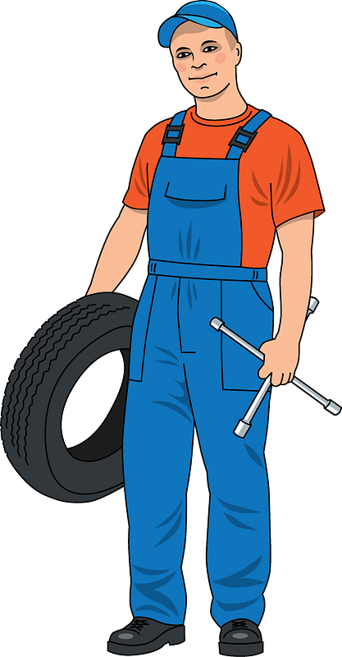
Remember that time?
When have you seen a simple fix turn into a major project?
Imperfections we see are often indicators of a greater issue.
Problems we encounter in life can be the direct or indirect result of the issue of sin.
Through His miracles and teaching, Jesus pointed us to the solution, a relationship with God

Slide 4
Listen for the demographic of the crowd.
Luke 6:17-19 (NIV) He went down with them and stood on a level place. A large crowd of his disciples was there and a great number of people from all over Judea, from Jerusalem, and from the coast of Tyre and Sidon, 18 who

Slide 5
Listen for the demographic of the crowd.
had come to hear him and to be healed of their diseases. Those troubled by evil spirits were cured, 19 and the people all tried to touch him, because power was coming from him and healing them all.

Slide 6
Jesus Brings Healing
Who are at least three groupings of people Jesus encountered?
What contemporary groups resemble the ones Jesus spoke to in this sermon? For what different reasons are people interested in Jesus Christ in our times?

Slide 7
Jesus Brings Healing
In Luke’s description of this event, what words or phrases tell us how Jesus’s healing power was conveyed to bring about healing?
How does this demonstrate Jesus’ power?
How does this demonstrate Jesus’ compassion?

Slide 8
Jesus Brings Healing
The passage highlights the importance of proximity to Jesus for receiving healing. How can we draw near to Jesus in our own lives?
What words of hope that Jesus offers can we share with our circle of acquaintances?

Slide 9
Listen for spiritual problems.
Luke 6:20-23 (NIV) Looking at his disciples, he said: "Blessed are you who are poor, for yours is the kingdom of God. 21 Blessed are you who hunger now, for you will be satisfied. Blessed are you who weep now, for you will laugh. 22 Blessed are

Slide 10
Listen for spiritual problems.
you when men hate you, when they exclude you and insult you and reject your name as evil, because of the Son of Man. 23 "Rejoice in that day and leap for joy, because great is your reward in heaven. For that is how their fathers treated the prophets.

Slide 11
Joy and Favor with God
How do you define the word “blessed”?
In the four beatitudes Luke recorded, who were the blessed ones and what blessed state was promised to them?
Blessed Ones | Blessed State Promised

Slide 12
Joy and Favor with God
How have you experienced the joy of following Jesus, even in seasons of difficulty? How would you describe being blessed by God?
Jesus pronounces blessings on the poor, hungry, and those who weep, implying a contrast with the rich, well-fed, and those who laugh now. How do these blessings challenge common societal values and notions of success?

Slide 13
Joy and Favor with God
The Beatitudes highlight the importance of humility, compassion, and reliance on God. How can we cultivate these virtues in our own lives?

Slide 14
Listen for Jesus’ expectations for treating enemies.
Luke 6:27-31 (NIV) "But I tell you who hear me: Love your enemies, do good to those who hate you, 28 bless those who curse you, pray for those who mistreat you. 29 If someone strikes you on one cheek, turn to him the other

Slide 15
Listen for Jesus’ expectations for treating enemies.
also. If someone takes your cloak, do not stop him from taking your tunic. 30 Give to everyone who asks you, and if anyone takes what belongs to you, do not demand it back. 31 Do to others as you would have them do to you.

Slide 16
Love as Jesus Loves
What different kinds of mistreatment did Jesus refer to in His commands? What actions does He say we are to take in each case?
Mistreatment | Response

Slide 17
Love as Jesus Loves
What’s your natural reaction to Jesus’ commands in these verses? How do you think most people in our culture would react to Jesus’ teaching in these verses?
What does it mean to "bless those who curse you"?

Slide 18
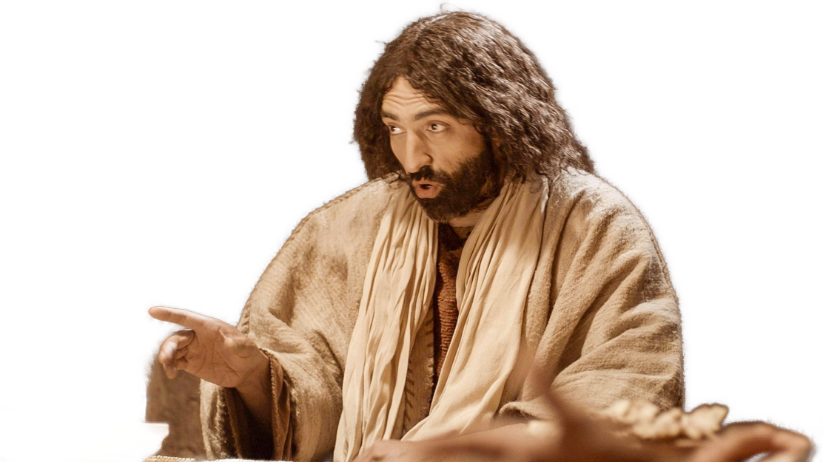
Love as Jesus Loves
What practical steps can we take to put these into action? How is it possible to do what Jesus expects?

Slide 19
Application
Commit to Pray.
Who in your life is difficult to love right now?
Commit to praying specifically for them each day this week.
Ask God to help you love that person and to demonstrate love to them.

Slide 20
Application
Commit to Memory.
Commit Ephesians 5:1-2 to memory this week.
Be imitators of God, therefore, as dearly loved children and live a life of love, just as Christ loved us and gave himself up for us as a fragrant offering and sacrifice to God.

Slide 21
Application
Commit to Action.
In a journal, perform an audit of your time and expenses this week.
Based on that audit, reflect on your own personal values.
Based on what you have learned about yourself, how do you personally define “blessing”?
Write out some ways those actions need to change to bring your definition in line with that of Jesus.

Slide 22
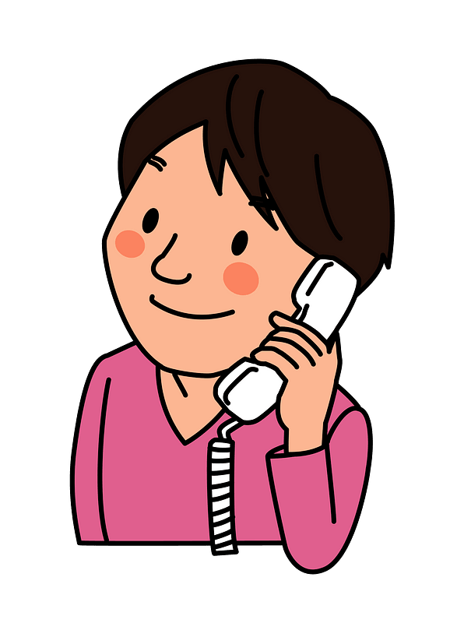
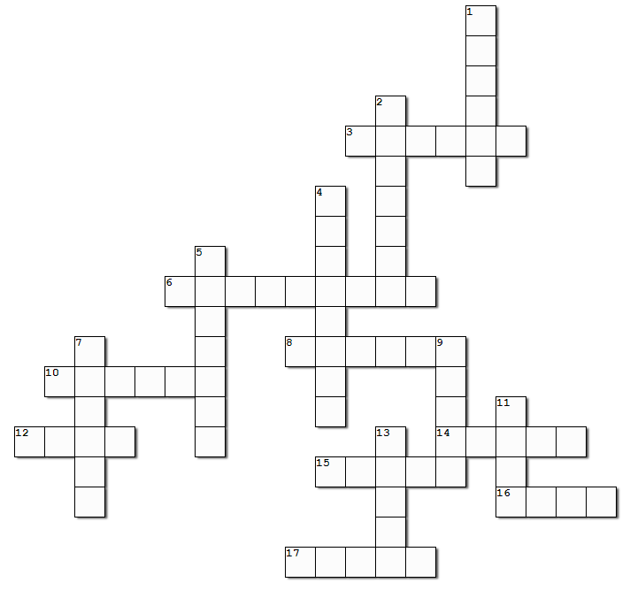
Family Activities
Good news! It’s the Crossword Puzzle. I couldn’t do the cryptogram, but I think I can handle this. If not, I’ll go to http://tinyurl.com/yjuwbt4u I guess we could also try the Double Puzzle …

Slide 23
The Ministry of Jesus
March 10
Credits
Jesus teaching: ©LUMO Project, www.LumoProject.com

