Slide 1
The Love Expressed in God’s Name
December 17

Slide 2
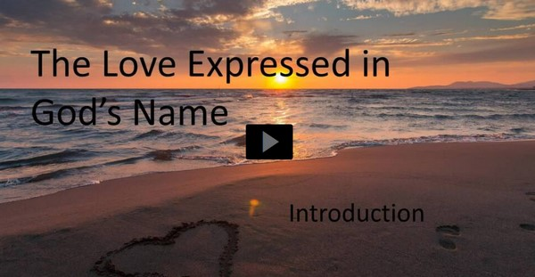
Video Introduction
View Video

Slide 3
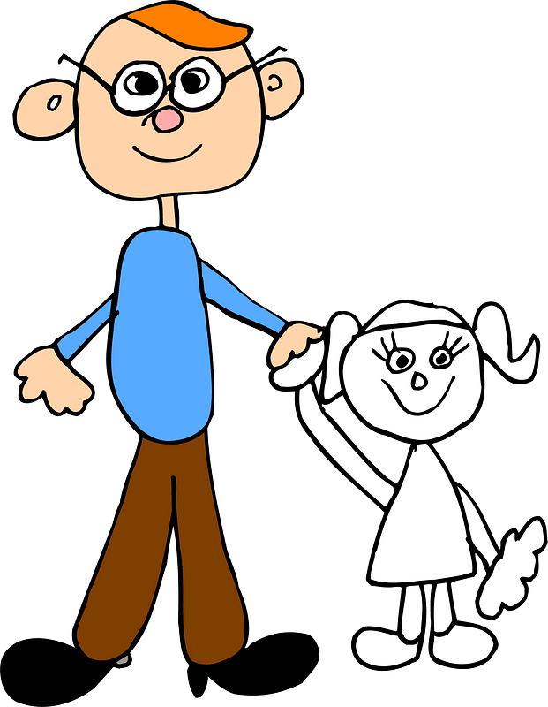
Think about it …
What are some characteristics and behaviors of a “good father?”
People’s praise for and worship of God is often affected by their view of their own fathers.
But God is unlike any earthly father, even the best fathers are imperfect.
Psalm 103 exhorts us to praise the Name of our perfect Heavenly Father.

Slide 4
Listen for benefits the psalmist received.
Psalm 103:1-5 (NIV) Praise the LORD, O my soul; all my inmost being, praise his holy name. 2 Praise the LORD, O my soul, and forget not all his benefits-- 3 who forgives all your sins and heals all your diseases, 4 who redeems your life from the pit and crowns you with love and compassion, 5 who satisfies your desires with good things so that your youth is renewed like the eagle's.

Slide 5
God Provides
When Moses asked God for His name, God told Moses, “I am The I Am” – He is “The God Who IS”. What then does it mean to bless or “praise His holy Name”?
What fatherly qualities appear in these verses? What benefits does He provide?
Which of these qualities are actions only God can do?

Slide 6
God Provides
We don’t deserve these things … so why does God do them?
How does noticing these regular actions of God help you relate to Him as your Father?
How do these realities about God help you feel renewed?

Slide 7
God Provides
God’s benefits are unforgettable.
They are so undeserved
They are such potent demonstrations of God’s power, love, and authority
So why do we sometimes forget them anyway?
How can we keep these benefits at the forefront of our memory?

Slide 8
Listen for the nature and character of God.
Psalm 103:8-13 (NIV) The LORD is compassionate and gracious, slow to anger, abounding in love. 9 He will not always accuse, nor will he harbor his anger forever; 10 he does not treat us as our sins deserve or repay us according to our iniquities. 11 For as high as

Slide 9
Listen for the nature and character of God.
the heavens are above the earth, so great is his love for those who fear him; 12 as far as the east is from the west, so far has he removed our transgressions from us. 13 As a father has compassion on his children, so the LORD has compassion on those who fear him;

Slide 10
God’s Compassion, Grace, Forgiveness
According to these verses, how does the Lord respond to the sinfulness of people?
How is God’s love and forgiveness depicted?
Verse 12 speaks of how far God removes our transgressions. Why is this important?
Then what is our role in this process?

Slide 11
God’s Compassion, Grace, Forgiveness
Sympathy
Empathy
Concern
Kindness
Consideration
Care
Kindheartedness
Benevolence
Note some synonyms for the word “compassion”.
What are some ways that God has demonstrated His compassion in your life?

Slide 12
Listen for comments on eternity.
Psalm 103:17-19 (NIV) But from everlasting to everlasting the LORD's love is with those who fear him, and his righteousness with their children's children-- 18 with those who keep his covenant and remember to obey his precepts. 19 The LORD has established his throne in heaven, and his kingdom rules over all.

Slide 13
God Never Abandons His People
According to these verses, to whom does the Lord give His blessings?
What does it mean to “fear God”? What does it not mean?
What does it mean? | What does it not mean?

Slide 14
God Never Abandons His People
Note what this passage says about our vital role in our grandchildren’s lives.
God’s love is extended to the children’s children of those who fear Him
How do you think this happens, even though each person in each generation decides for him/herself?

Slide 15
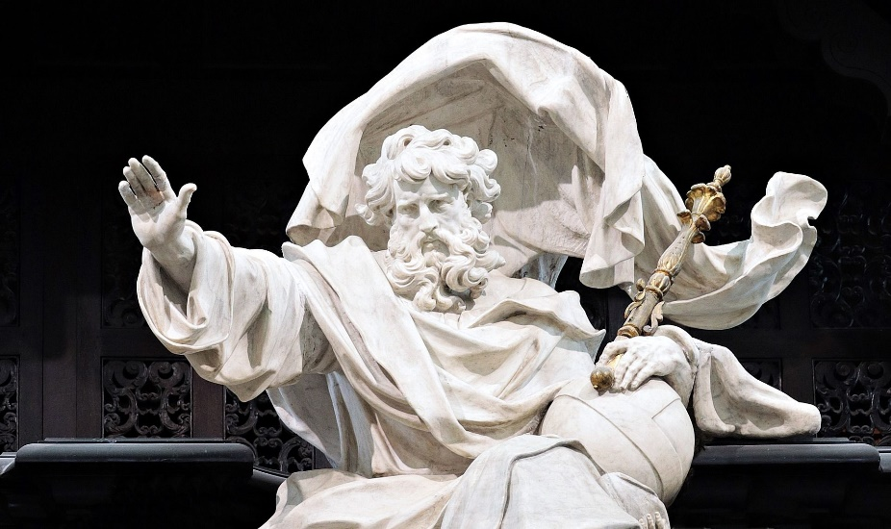
God Never Abandons His People
How does God’s throne being established in heaven give us strength and encouragement today?

Slide 16
Application
Recall.
Remember some of the benefits you’ve received from the Lord.
Jot them down. Read them several times this week.

Slide 17
Application
Recite.
Tell someone how you’ve experienced God’s compassion.
This testimony could be about your salvation or about some aspect of God’s forgiveness or provision.

Slide 18
Application
Relate.
Identify a friend or coworker who may be struggling with understanding God’s love.
Help this person relate God’s love to ways He has walked with you through difficult times.

Slide 19
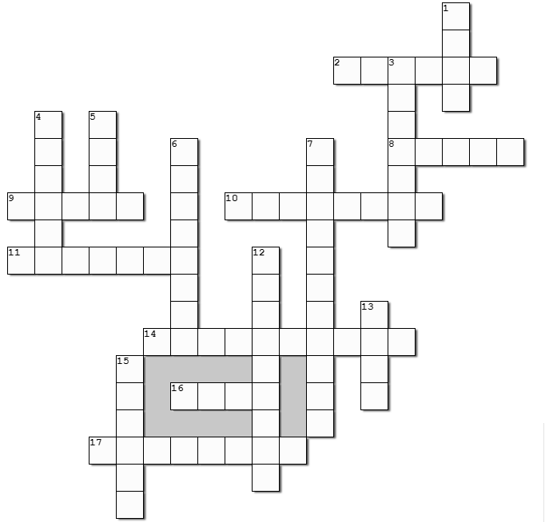
Family Activities
It’s true … this week it’s the Crossword ! It’s been a long time.
Great! I heard there’s help and more fun Family Activities at https://tinyurl.com/584w82fj

Slide 20
The Love Expressed in God’s Name
December 17

