Slide 1
The King Who
Reigns Forever
December 26

Slide 2


Video Introduction
View Video

Slide 3
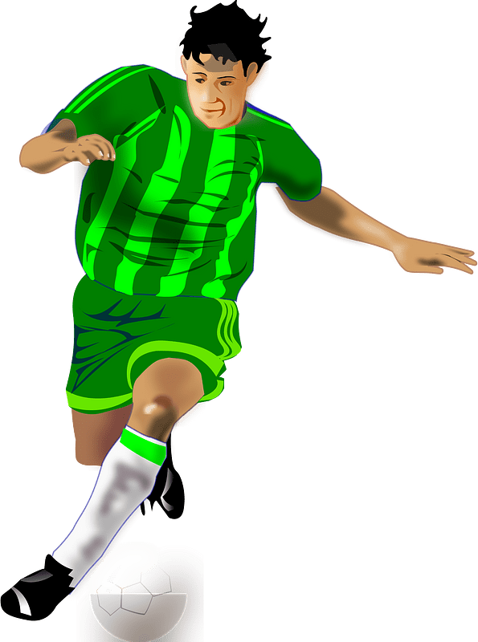


What do you think?
What kinds of dreams and expectations do people typically have for their children?
Consider what God’s expectations were when He sent Jesus to earth … as a baby … then as an adult.
  God’s plan was for Jesus to come to us as God in person.
  Jesus is the King who rules His kingdom now and forever.

Slide 4
Listen for lyrics from Handel’s Messiah.
Isaiah 9:6-7 (NIV) For to us a child is born, to us a son is given, and the government will be on his shoulders. And he will be called Wonderful Counselor, Mighty God, Everlasting Father, Prince of Peace. 7 Of the increase of his government

Slide 5

Listen for lyrics from Handel’s Messiah.
and peace there will be no end. He will reign on David's throne and over his kingdom, establishing and upholding it with justice and righteousness from that time on and forever. The zeal of the LORD Almighty will accomplish this.

Slide 6
Birth of a King Foretold.
What are the names given to the child of whom Isaiah spoke?
What further descriptions are given of the Ruler who will be provided by God for His people?

Slide 7
Birth of a King Foretold.
What are the implications or characteristics suggested by the names or titles we listed.
  Wonderful Counselor
  Mighty God
  Everlasting Father
  Prince of Peace

Slide 8
Birth of a King Foretold.
The Jews anticipated a political or military leader. What did they hope He would do?
In actuality, what kind of ruler was (is) Jesus?
In what ways do we need God’s counsel?
How do we hear or experience the wonderful counsel of God?
In what ways does the Messiah want to rule in our lives?

Slide 9
Listen for a birth announcement.
Luke 1:26-31 (NIV) In the sixth month, God sent the angel Gabriel to Nazareth, a town in Galilee, 27 to a virgin pledged to be married to a man named Joseph, a descendant of David. The virgin's name was Mary. 28 The angel went to her and said, "Greetings, you who are highly favored!

Slide 10
Listen for a birth announcement.
The Lord is with you." 29 Mary was greatly troubled at his words and wondered what kind of greeting this might be. 30 But the angel said to her, "Do not be afraid, Mary, you have found favor with God. 31 You will be with child and give birth to a son, and you are to give him the name Jesus.

Slide 11
Birth of a King Divinely Announced
Let’s list the who, when, where, etc. that are covered in a news story.
  Who:
  When:
  Where:

Slide 12
Birth of a King Divinely Announced
What was the message of the angel?
What emotions do you think Mary was feeling?
How was this divine announcement life-changing for Mary and for all of us?
Why is it important that Jesus was both fully God and fully man?

Slide 13
Listen for claims made.
Luke 1:32-33 (NIV) He will be great and will be called the Son of the Most High. The Lord God will give him the throne of his father David, 33 and he will reign over the house of Jacob forever; his kingdom will never end."

Slide 14
The King Is Jesus
Identify the various claims made concerning Jesus in these verses.
What is the significance of the names and titles given to this child?
  Son of the Most High
  Given the throne of David
  Kingdom includes the “House of Jacob”

Slide 15
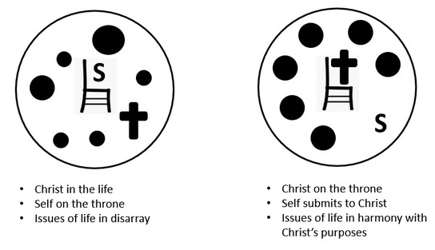
The King Is Jesus
Why is it so important that we remember the “forever” part of this passage?
What responsibilities do we have as members of the kingdom of God?

Slide 16
Application
Reflect:
  Take a moment and reflect on your life.
  How do you struggle with humility or being obedient to the Lord?
  How can you walk more in humility and obedience?

Slide 17
Application
Remember:
  As you put away Christmas decorations, replace them with a visible reminder of Jesus’ current reign as King,
  For example: a ceramic church or a small globe as a reminder to pray for missionaries.

Slide 18
Application
Reveal:
  Thinking about how Jesus is the King who reigns forever, how can you share this truth with someone this week?
  Plan to share the gospel with someone this week.

Slide 19
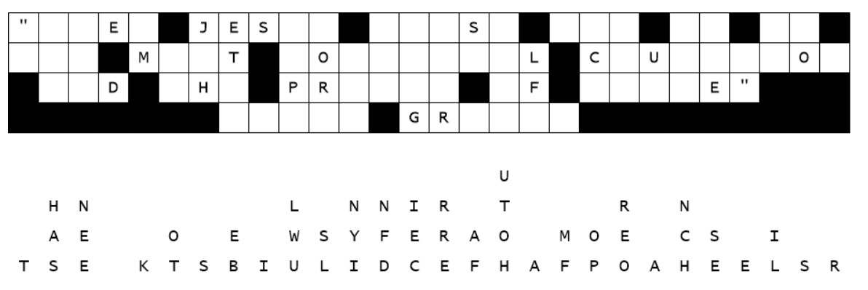

Family Activities
We have letters down at this location. Help is summoned from https://tinyurl.com/2p93n7sa Further activities are foreseen at this same site.

Slide 20
The King Who
Reigns Forever
December 26

