Slide 1
The Key to Contentment
9/15

Slide 2
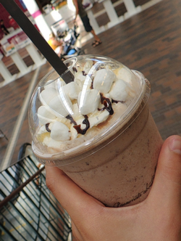
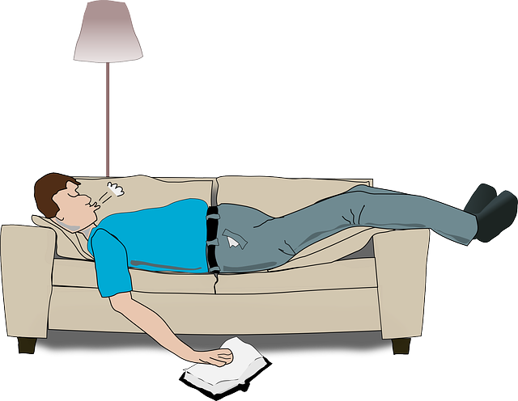
Admit it, now …
What experiences bring you the most contentment?
It’s easy to think that our stuff or our experiences dictate whether or not we are content
Actually true contentment comes through Christ alone.
Today we look at Paul’s teaching of the contentment that God gives.

Slide 3
Listen for how Paul is content.
Philippians 4:10-14 (NIV) I rejoice greatly in the Lord that at last you have renewed your concern for me. Indeed, you have been concerned, but you had no opportunity to show it. 11 I am not saying this because I am in need, for I have learned to be content whatever the circumstances. 12 I know what it is to be in need, and I know what it is to have

Slide 4
Listen for how Paul is content.
plenty. I have learned the secret of being content in any and every situation, whether well fed or hungry, whether living in plenty or in want. 13 I can do everything through him who gives me strength. 14 Yet it was good of you to share in my troubles.

Slide 5
God’s Strength and Provision
What prompted Paul to rejoice in the Lord?
How would you describe what it means to be content?
What are some enemies of contentment in today’s culture? Why do you think so many people are discontent?

Slide 6
God’s Strength and Provision
How do you think Paul could be so flexible in his approach to life’s circumstances?
How have you heard verse 13 used?
So, how should we understand it in light of verses 10-12?

Slide 7
Listen for how Paul had been supported.
Philippians 4:15-18 (NIV) Moreover, as you Philippians know, in the early days of your acquaintance with the gospel, when I set out from Macedonia, not one church shared with me in the matter of giving and receiving, except you only; 16 for even when I was in Thessalonica, you sent me aid again and again when I was in need.

Slide 8
Listen for how Paul had been supported.
Not that I am looking for a gift, but I am looking for what may be credited to your account. 18 I have received full payment and even more; I am amply supplied, now that I have received from Epaphroditus the gifts you sent. They are a fragrant offering, an acceptable sacrifice, pleasing to God.

Slide 9
Give from God’s Provision
What history did Paul have with receiving support from the Philippian Christians? What was his point in noting their faithfulness in giving in the past?
What did Paul say about giving being an act of worship?
How do we worship and praise God when we give our tithes and offerings?

Slide 10
Give from God’s Provision
The Philippian Christians helped Paul when he needed it; how are you able to help others in trouble?
What can you do to be ready for others when they need financial help?

Slide 11
Give from God’s Provision
How does giving financially make us partners in ministry, not just contributors?
What would the absence of an expression of gratitude do to Paul’s relationship with the church at Philippi?

Slide 12
Listen for a closing praise.
Philippians 4:19-20 (NIV) And my God will meet all your needs according to his glorious riches in Christ Jesus. 20 To our God and Father be glory for ever and ever. Amen.

Slide 13
Trust God to Supply Your Need
How did Paul respond to the Philippians’ generosity?
How would God reciprocate the believers’ generosity?
How will God honor a giving spirit?

Slide 14
Summary Video
View Video

Slide 15
Trust God to Supply Your Need
How do you differentiate between wants and needs?
Why do we sometimes misinterpret a want and see it more as a need?
Paul gave glory to God, praised Him. How can we do that in the context of our needs and wants?
Wants | Needs

Slide 16
Application
Choose contentment.
Evaluate your heart for signs of discontentment.
Ask yourself: Am I trusting in money more than in Jesus?
Do money and possessions bring me more joy than Jesus? Can I really say, “Christ is all I need?”

Slide 17
Application
Choose to trust.
Make a daily decision not to allow circumstances determine how content you will be in this life.
Memorize Philippians 4:12-13 to remind you simply to trust Christ for all things: “I have learned the secret of being content in any and every situation, whether well fed or hungry, whether living in plenty or in want. I can do all this through him who gives me strength.”

Slide 18
Application
Choose to give.
Give of your time, talent, or treasures.
Sometimes the cure for discontentment is to give to others.
Find those with needs and give to them. Let God use you as His answer to their prayers.

Slide 19
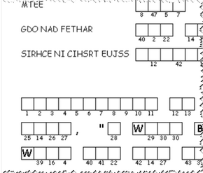
Family Activities
Hmmm … this double puzzle is harder than the crossword. Good thing I can find the solution and other Family Activities at https://tinyurl.com/yxepqez4.
What is a QR code, anyway? Maybe you can use it.

Slide 20
The Key to Contentment
9/15

