Slide 1
The Joy Arising from
Our Hope
July 5

Slide 2

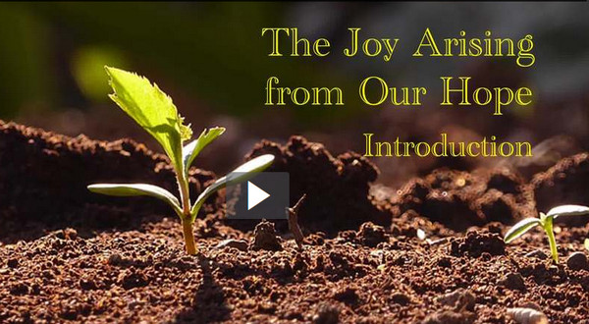
Video Introduction
View Video

Slide 3
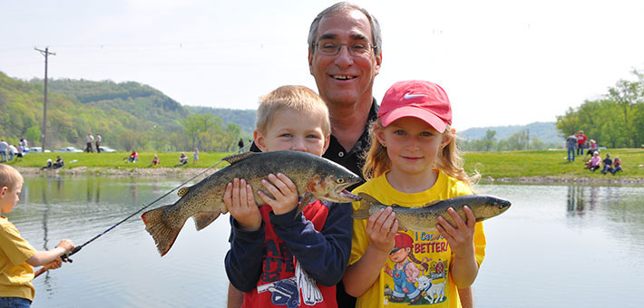
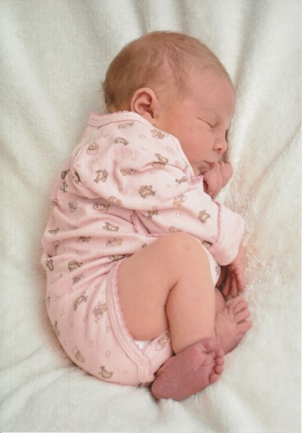

Think about it …
What are some things that bring great joy to you?
The coronavirus has caused hardship or at least inconvenience for most of us.
  How can a person experience joy in the midst of hardship?
  Today we study how suffering for Christ can deepen our walk with Him.

Slide 4
Listen for Peter’s view on suffering.
1 Peter 4:1-2 (NIV) Therefore, since Christ suffered in his body, arm yourselves also with the same attitude, because he who has suffered in his body is done with sin. 2 As a result, he does not live the rest of his earthly life for evil human desires, but rather for the will of God.

Slide 5
Think Like Christ
What did Peter say about the person who has suffered?
What kind of resolve did Jesus Christ have when he suffered?
How can we arm ourselves with the same attitude as Christ in the face of suffering?

Slide 6
Think Like Christ
What are some symptoms of living with a focus on human desires rather than on God’s will?
In what sense do you think “he who suffered in his body is done with sin”? In what different ways could we interpret this verse? Who is the “he”? Why or how “done”?
What steps would you recommend to a believer who admits he or she is not “done with sin”? The world’s attraction is just too strong.

Slide 7
Listen for how to respond to suffering.
1 Peter 4:12-14 (NIV) Dear friends, do not be surprised at the painful trial you are suffering, as though something strange were happening to you. 13 But rejoice that you participate in the sufferings of Christ, so that you may be

Slide 8
Listen for how to respond to suffering.
overjoyed when his glory is revealed. 14 If you are insulted because of the name of Christ, you are blessed, for the Spirit of glory and of God rests on you.

Slide 9
Rejoice in Christ
What purpose can trials or suffering serve?
What painful trials can believers go through in our society?
What even more painful trials do believers go through in some foreign countries?
We tend to do considerable hand wringing … shocked that such things could happen. How would Peter respond?

Slide 10
Rejoice in Christ
What hinders us from rejoicing when times are difficult?
What gives us cause to rejoice when facing suffering for righteousness sake? What is the nature of the blessing God gives to us?

Slide 11
Listen for how to do good and trust God.
1 Peter 4:15-19 (NIV) If you suffer, it should not be as a murderer or thief or any other kind of criminal, or even as a meddler. 16 However, if you suffer as a Christian, do not be ashamed, but praise God that you bear that name. 17 For it is time for judgment to begin with the family of God; and if it begins with us,

Slide 12
Listen for how to do good and trust God.
what will the outcome be for those who do not obey the gospel of God? 18 And, "If it is hard for the righteous to be saved, what will become of the ungodly and the sinner?" 19 So then, those who suffer according to God's will should commit themselves to their faithful Creator and continue to do good.

Slide 13
Give Glory to God
If believers do suffer, for what should they suffer and not suffer?
Speaking negatively and positively, what does Peter say about the Christian’s attitude toward suffering?
Do Not … | Do …

Slide 14
Give Glory to God
What should those who suffer according to God’s will do?
Why might it be within God’s will for someone to suffer?
Suppose you don’t know the “why” … what difference does it make if you know “Who” is holding your hand?

Slide 15
Application
Rejoice.
  Choose gratitude instead of complaint.
  Voice a prayer of thanks to the Lord no matter what you are currently facing.
  Make a list of ten things that have brought you joy today, and allow that practice to set the tone for a lifestyle of rejoicing in Christ.

Slide 16
Application
Memorize.
  To remind yourself to think with the mind of Christ, memorize 1 Peter 4:1-2:
  “Therefore, since Christ suffered in his body, arm yourselves also with the same attitude, because whoever suffers in the body is done with sin. As a result, they do not live the rest of their earthly lives for evil human desires, but rather for the will of God.”

Slide 17
Application
Listen.
  Talk with other believers about their trials and suffering.
  Listen for the ways God has deepened their walk with Him because of what they have experienced.
  Offer prayer and encouragement as needed.

Slide 18

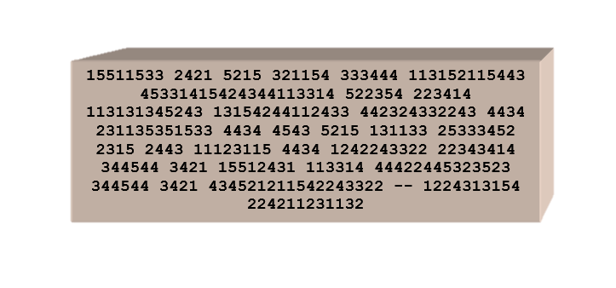
Family Activities
Heh, heh! Your Bible Study leader will want you to decrypt the message as soon as possible. You will experience JOY as you SUFFER through the process. Log on incognito to https://tinyurl.com/y8lbwjv6 to get help or find other Family Fun Activities.

Slide 19
The Joy Arising from
Our Hope
July 5

