Slide 1
The Inspiration for Worship
January 26

Slide 2

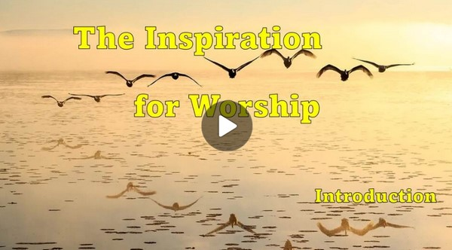
Video Introduction
View Video

Slide 3

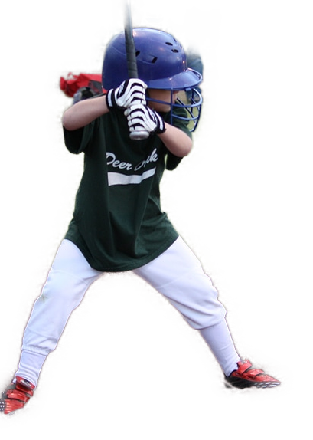

Can you remember?
As a kid, what things did someone encourage you to be good at?
God always encourages us to excellence.
  His goodness and love encourage us.
  His mercy and grace encourage us to worship Him

Slide 4
Listen for prayer requests.
Psalm 25:4-7 (NIV) Show me your ways, O LORD, teach me your paths; 5 guide me in your truth and teach me, for you are God my Savior, and my hope is in you all day long. 6 remember, O LORD, your great

Slide 5
Listen for prayer requests.
mercy and love, for they are from of old. 7 Remember not the sins of my youth and my rebellious ways; according to your love remember me, for you are good, O LORD.

Slide 6
God’s Love Shows His Mercy
Identify the various requests the psalmist makes of the Lord in these verses.
On what basis does he make those requests?
What do you think David meant by God’s “ways” and “paths”?
How does God make His ways, His paths known to us?

Slide 7
God’s Love Shows His Mercy
Where do you see evidence in the world today of God’s goodness in your life?
Why does David ask God to remember His mercy and steadfast love but not his sins?
How does this reflect God's character?

Slide 8
Listen for God’s goodness.
Psalm 25:8-11 (NIV) Good and upright is the LORD; therefore he instructs sinners in his ways. 9 He guides the humble in what is right and teaches them his way. 10 All the ways of the LORD are loving and faithful for those who keep the demands of his covenant. 11 For the sake of your name, O LORD, forgive my iniquity, though it is great.

Slide 9
God’s Goodness Provides Forgiveness
Note the two traits the psalmist assigned to God.
  Goodness
  Upright
List the actions which are motivated by these traits?

Slide 10

God’s Goodness Provides Forgiveness
Consider some synonyms of “humble” .
  Modest
  Unassuming
  Meek
  Unpretentious
You probably didn’t know that “arrogant” is an antonym

Slide 11


God’s Goodness Provides Forgiveness
How do these diagrams illustrate arrogance and humility?

Slide 12
God’s Goodness Provides Forgiveness
Discuss the difference of how a person receives God’s guidance if they trust God as opposed to those who do not trust God?
David pleads for forgiveness for the sake of God’s name. How is God’s reputation is connected to forgiveness.
Trusting God | Not Trusting God

Slide 13
Listen for goodness, reverence, and worship.
Psalm 25:12-15 (NIV) Who, then, is the man that fears the LORD? He will instruct him in the way chosen for him. 13 He will spend his days in prosperity, and his descendants

Slide 14

Listen for goodness, reverence, and worship.
will inherit the land. 14 The LORD confides in those who fear him; he makes his covenant known to them. 15 My eyes are ever on the LORD, for only he will release my feet from the snare.

Slide 15
Motivated to Worship God
What did the psalmist say the Lord would do toward those who fear Him?
What is the special relationship that exists between the God-fearer and the Lord?

Slide 16
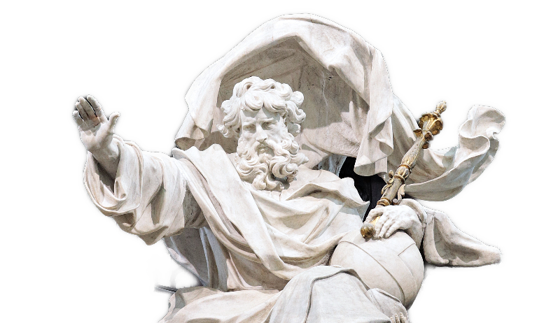
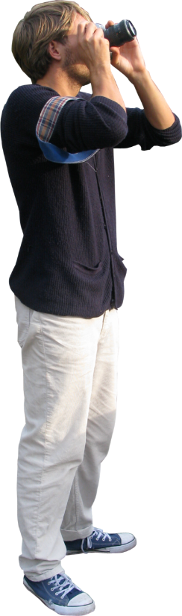
Motivated to Worship God
The psalmist makes a commitment.
  My eyes are ever on the Lord
  I trust that He will release my feet from the snare
What does it look like to always have our eyes on the Lord?

Slide 17

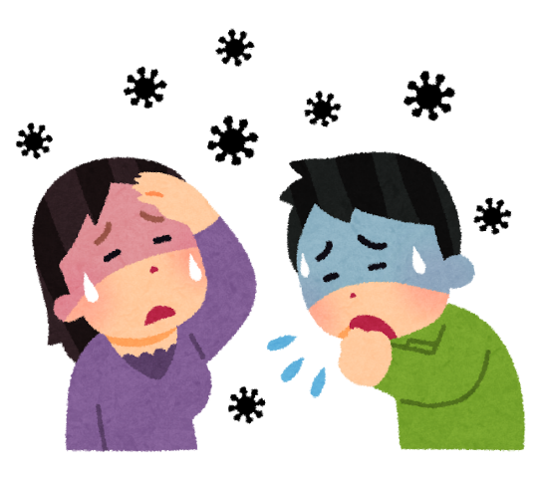
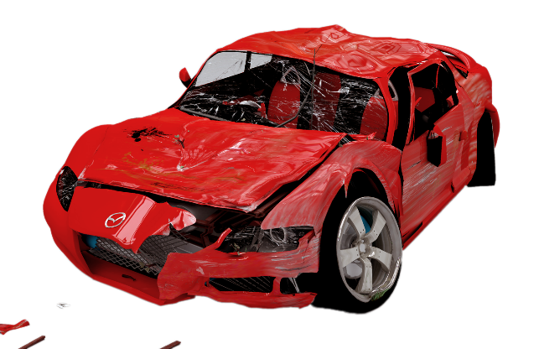
Motivated to Worship God
How do you “fix your eyes” on the Lord when facing difficulties, as mentioned in verse 15?

Slide 18
Application
The Starting Place.
  We are inspired to worship when we consider the love and forgiveness God has shown us in Christ.
  What are some of the ways God inspired you to worship this week?
  Make a list of how God has shown you love and forgiveness and thank Him for each one.

Slide 19
Application
The Growing Place.
  We respond in worship to His leadership in our lives as He lovingly guides and directs our paths.
  What ways has God led you in life?
  How did He lead you this past week? How did you respond to His leadership?

Slide 20
Application
The Sowing Place.
  We know that God’s compassion draws us in to worship.
  Do you know someone who doesn’t know Christ, or is far away from serving God that you could show compassion?
  Pray and ask the Lord to help you show others His love and compassion. Make plans to spend some time having coffee with someone you’ve prayed for.

Slide 21
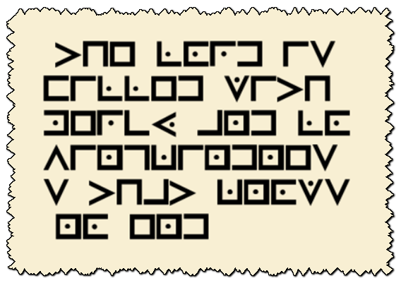
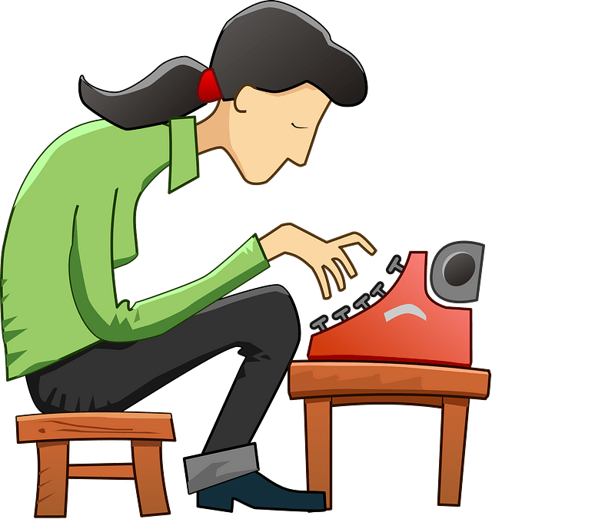
Family Activities
Our decoders have been at Jr. Hi winter retreat. We need your help. Use the key and the sample “HELLO WORLD” example to see how to decode. Need help? Go to https://tinyurl.com/ycxebhfw But wait ... There’s more. Check out other Family Activities!

Slide 22
The Inspiration for Worship
January 26

