Slide 1
The Importance of
God’s Name
December 3

Slide 2

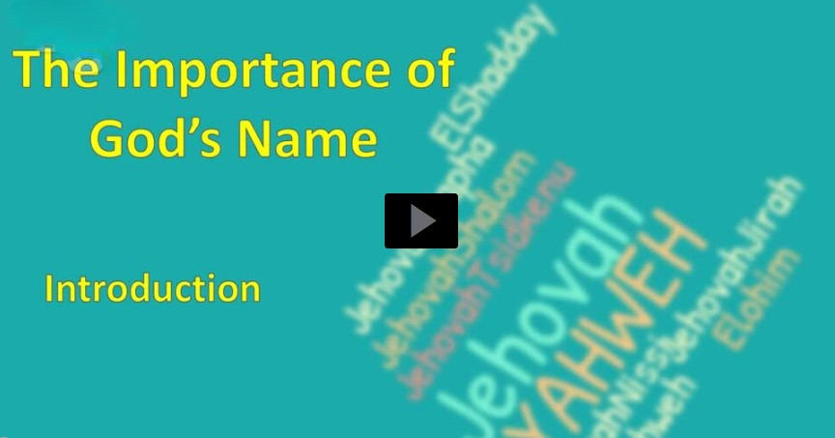
Video Introduction
View Video

Slide 3



What were they thinking?
Who in your circle of acquaintances (family, friends, work mates) has an interesting name or nickname?
God’s name is nothing to laugh about.
  His name reveals His power and authority.
  It shows He is a God we can completely trust.
“Slim”
Menachem Down
“Fuzzy”

Slide 4
Listen for why Moses was afraid.
Exodus 3:1-6 (NIV) Now Moses was tending the flock of Jethro his father-in-law, the priest of Midian, and he led the flock to the far side of the desert and came to Horeb, the mountain of God. 2 There the angel of the LORD appeared to him in flames of fire from within a bush. Moses saw that though the

Slide 5
Listen for why Moses was afraid.
bush was on fire it did not burn up. 3 So Moses thought, "I will go over and see this strange sight--why the bush does not burn up." 4 When the LORD saw that he had gone over to look, God called to him from within the bush, "Moses! Moses!" And Moses said, "Here I am."

Slide 6
Listen for why Moses was afraid.
"Do not come any closer," God said. "Take off your sandals, for the place where you are standing is holy ground." 6 Then he said, "I am the God of your father, the God of Abraham, the God of Isaac and the God of Jacob." At this, Moses hid his face, because he was afraid to look at God.

Slide 7
Approach with Awe
Recall Moses’ history up to now:
  Raised as son of Pharaoh’s daughter
  In defending a fellow Israelite, he commits 2nd degree murder against an Egyptian
  Fearing arrest, he flees to Midian, lives there 40 years, marries daughter of a priest
  Works as a shepherd

Slide 8
Approach with Awe
Where and how does God miraculously appear to Moses?
Why was Moses afraid to look at God?
Why is this a good attitude to have?
What are some things which distract us from tasks God wants us to take on?

Slide 9
Approach with Awe
Prior to this, Moses probably thought shepherding was his new purpose or calling in life. What does this tell you about God’s plans for your life?
Why might God reserve a special call until someone is of a certain age, rather than calling you to that task as a younger adult?

Slide 10
Listen for God’s response to the people’s cries.
Exodus 3:9-12 (NIV) And now the cry of the Israelites has reached me, and I have seen the way the Egyptians are oppressing them. 10 So now, go. I am sending you to Pharaoh to bring my people the Israelites out of Egypt." 11 But Moses said to God, "Who am I, that I should

Slide 11
Listen for God’s response to the people’s cries.
go to Pharaoh and bring the Israelites out of Egypt?" 12 And God said, "I will be with you. And this will be the sign to you that it is I who have sent you: When you have brought the people out of Egypt, you will worship God on this mountain."

Slide 12
Trust God to Do What He Says
We read that God had heard the cry of His people in their distress. When do we need God to see us, hear us, be concerned about us, rescue us and those around us?

Slide 13
Trust God to Do What He Says
Note God’s challenge to Moses and Moses’ response:
  I’m sending you to Pharaoh
  You must bring my people the Israelites out of Egypt.
  Who am I? You want me?

Slide 14
Trust God to Do What He Says
Moses had two basic options … accept or reject God’s call. What would have been the consequences of each option?
Consequences Accept God’s Call | Consequences Reject God’s Call

Slide 15
Trust God to Do What He Says
What are some of the fears you think Moses was feeling?
Why does God put certain challenges before us?

Slide 16
Listen for the revelation of God’s name.
Exodus 3:13-15 (NIV) Moses said to God, "Suppose I go to the Israelites and say to them, 'The God of your fathers has sent me to you,' and they ask me, 'What is his name?' Then what shall I tell them?" 14 God said to Moses, "I AM WHO I AM. This is what you are to say to the Israelites:

Slide 17
Listen for the revelation of God’s name.
'I AM has sent me to you.'" 15 God also said to Moses, "Say to the Israelites, 'The LORD, the God of your fathers--the God of Abraham, the God of Isaac and the God of Jacob--has sent me to you.' This is my name forever, the name by which I am to be remembered from generation to generation.

Slide 18
God’s Name Shows God’s Character
How does God identify Himself to Moses, what name does He tell Moses to give? How is the name God uses significant?

Slide 19
God’s Name Shows God’s Character
Jesus is likewise “The God Who IS” and is still contrasted to lots of things which try to be substitute deities or idols in our lives.
  He loves us
  He died for us and rose again
  He lives in our lives to bless us, empower us
  The idols in our lives do not!

Slide 20
God’s Name Shows God’s Character
Moses is also told he is being sent by “the God of your fathers--the God of Abraham, the God of Isaac and the God of Jacob”. Why would this be important for Moses and the people to know?
How does this fit in with “This is my name forever … to be remembered from generation to generation”?

Slide 21
Application
Listen.
  Listen to God’s voice.
  Put yourself in a place where you are most likely to be able to hear Him speak.
  Prayerfully seek His guidance about how you can glorify Him.

Slide 22
Application
List.
  Pause and examine your situation.
  List ways you can be God’s ambassador where you are, so that others can come to know Him.

Slide 23
Application
Look.
  Discover additional opportunities to take God’s name to people outside your current influence.
  This could mean serving in your community or even going on an overseas mission trip.

Slide 24


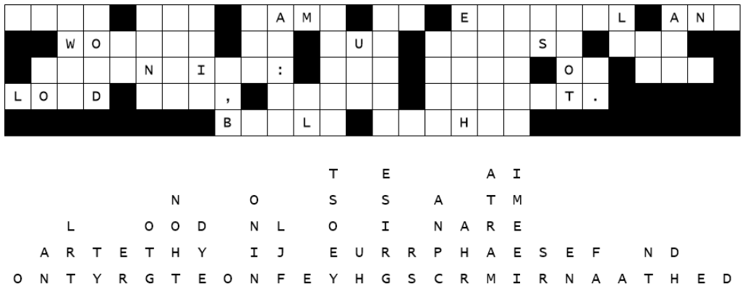
Family Activities
Aliens have cyber
zapped our message.
We need your help.
Technical support
is available at https://tinyurl.com/2p8c7k2z Do not panic. The
crossword and the
color page have not
been compromised.

Slide 25
The Importance of
God’s Name
December 3

