Slide 1
The Importance of Character
July 27

Slide 2


Video Introduction
View Video

Slide 3
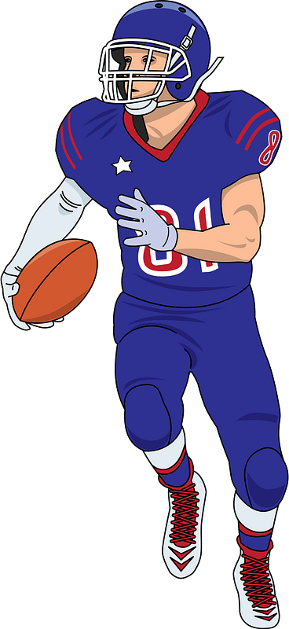

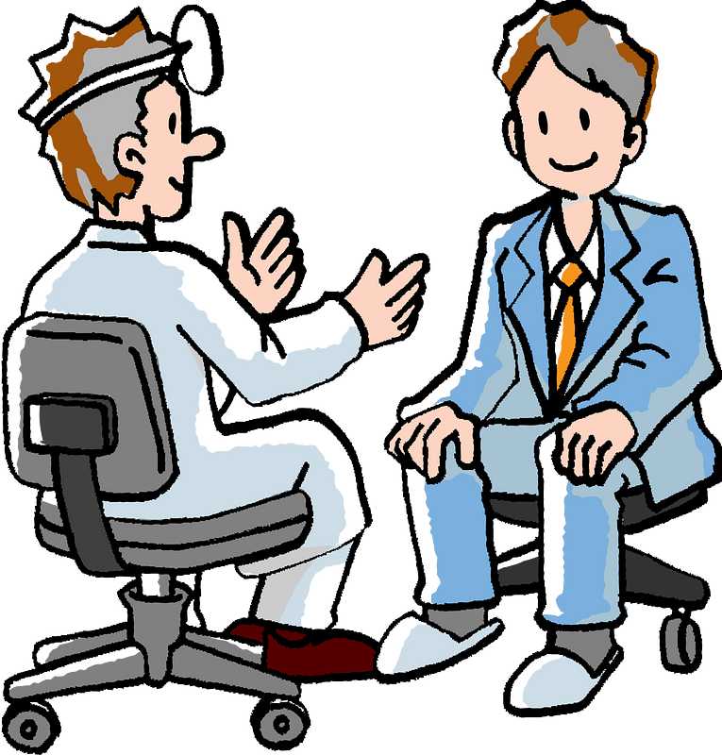
What do you think?
Who are some positive role models in our culture today?
Positive role models will be popular and have upright character.
  Only God equips us for Christlike character.

Slide 4
Listen for what God has given.
2 Peter 1:1-3 (NIV) Simon Peter, a servant and apostle of Jesus Christ, To those who through the righteousness of our God and Savior Jesus Christ have received a faith as precious as ours: 2 Grace and peace be yours in

Slide 5
Listen for what God has given.
abundance through the knowledge of God and of Jesus our Lord. 3 His divine power has given us everything we need for life and godliness through our knowledge of him who called us by his own glory and goodness.

Slide 6
What God Has Done
Who is the writer of the letter, and how did he choose to identify himself?
Who are the recipients?
According to verse 3, what is the source of the power we need for life and godliness?
What does it mean that we’ve been called “by His own glory and goodness”?

Slide 7
What God Has Done
How should this calling shape our personal character?
How can you see the development of Christian character by reading the biography of a well-known Christian you admire? What does it look like?

Slide 8
What God Has Done
Why is growing in godly character a lifelong journey and not a one-time event?
How can this group encourage one another in the development of character over time?

Slide 9
Listen for a sequence of attributes.
2 Peter 1:4-8 (NIV) Through these he has given us his very great and precious promises, so that through them you may participate in the divine nature and escape the corruption in the world caused by evil desires. 5 For this very reason, make every effort to add to your faith goodness; and to goodness, knowledge; 6 and to

Slide 10
Listen for a sequence of attributes.
knowledge, self-control; and to self-control, perseverance; and to perseverance, godliness; 7 and to godliness, brotherly kindness; and to brotherly kindness, love. 8 For if you possess these qualities in increasing measure, they will keep you from being ineffective and unproductive in your knowledge of our Lord Jesus Christ.

Slide 11
What We Are to Do
According to verse 4, what has God given us, and what are we meant to escape?
Why is escaping “the corruption in the world caused by evil desires” essential to developing godly character?

Slide 12

What We Are to Do
Peter lists a series of qualities in verses 5–7. Why do you think he emphasizes that we should “make every effort” to develop these?

Slide 13
What We Are to Do
Consider how these qualities (faith, goodness, knowledge, self-control, perseverance, godliness, mutual affection, love) are connected to each other.
What natural progression do you see in them?

Slide 14
Listen for a reward.
2 Peter 1:9-11 (NIV) But if anyone does not have them, he is nearsighted and blind, and has forgotten that he has been cleansed from his past sins. 10 Therefore, my brothers, be all the more eager to

Slide 15
Listen for a reward.
make your calling and election sure. For if you do these things, you will never fall, 11 and you will receive a rich welcome into the eternal kingdom of our Lord and Savior Jesus Christ

Slide 16

Blessings that Come
What is the spiritual condition of those who lack the characteristics listed in verses 5-7?
Why do you think Peter links the absence of these qualities to forgetting that one has been cleansed from past sins?

Slide 17
Blessings that Come
What causes such spiritual blindness? What does it mean to be "nearsighted and blind"? How might a lack of character affect spiritual perception?
Peter promises that if we “do these things,” we will never fall. What might “these things” look like in everyday life, and why do they lead to stability?

Slide 18
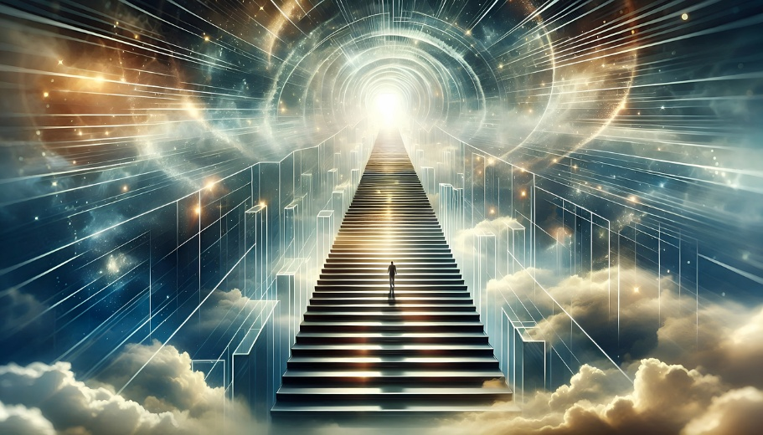
Blessings that Come
How is verse 11 ("a rich welcome into the eternal kingdom") related to the life we live now? How does character development prepare us for eternity?

Slide 19
Application
Determine.
  Before anything else, decide if you really believe that a change of character is possible.
  Don’t give verbal assent to something you’re not quite ready to accept as possible.

Slide 20
Application
Develop.
  Examine the virtue catalog in 2 Peter 1:5-7.
  Pick one quality on which you would be willing to allow God to work.
  Come up with an action plan to grow in that area.
  After you’ve made progress there, select a second one and do the same.

Slide 21
Application
Dialogue.
  Have a conversation with someone close to you.
  Consider someone who doesn’t have anything to lose by telling you the truth.
  Ask them to identify your character flaws.

Slide 22
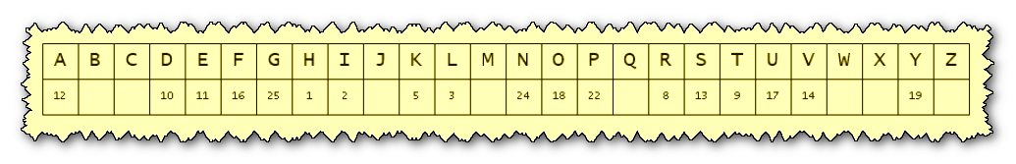

Family Activities
This is the key you’ll need to decrypt the message from the Baptist consulate in Centhe Sofebar. Christians there want to challenge us to develop the character traits Peter listed. Tech help and the color page can be found at https://tinyurl.com/thmmpujd

Slide 23
The Importance of Character
July 27

