Slide 1
The Identity of Jesus
March 17

Slide 2

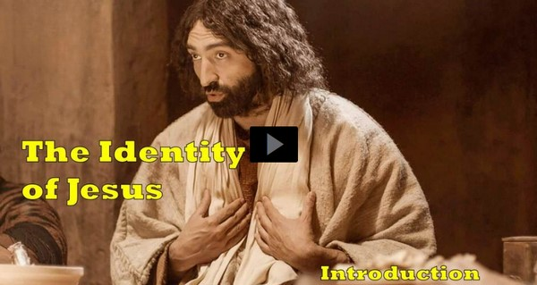
Video Introduction
View Video

Slide 3



Think about it …
What are some of the roles you fill at home, work, and in your community?
We often identify who we are by what we do.
  Actually “who I am” is connected to someone else.
  It is Jesus’ identity that is foundational to who I am.

Slide 4

Listen for a survey.
Luke 9:18-19 (NIV) Once when Jesus was praying in private and his disciples were with him, he asked them, "Who do the crowds say I am?" 19 They replied, "Some say John the Baptist; others say Elijah; and still others, that one of the prophets of long ago has come back to life."

Slide 5
Perceptions of Jesus’ Identity
Why might Luke have considered it important to introduce this event in the context of Jesus engaging in private prayer?
What were some popular ideas the people held about who Jesus was?
Why did Jesus first ask the disciples who others thought He was instead of immediately asking them who they thought He was?

Slide 6
Perceptions of Jesus’ Identity
What are some common misconceptions about Jesus in our world? How would you answer Jesus today if He asked, "Who do crowds say I am?“
Why do you think people have so many misunderstandings about Jesus?

Slide 7
Listen for another survey.
Luke 9:20-22 (NIV) "But what about you?" he asked. "Who do you say I am?" Peter answered, "The Christ of God." 21 Jesus strictly warned them not to tell this to anyone. 22 And he said, "The

Slide 8
Listen for another survey.
Son of Man must suffer many things and be rejected by the elders, chief priests and teachers of the law, and he must be killed and on the third day be raised to life."

Slide 9
Identity in Death and Resurrection
Consider Peter’s answer. What did it mean to call Jesus The Christ of God? What significance does this declaration hold in understanding Peter's perception of Jesus and his mission?
What was it that convinced Peter (and probably at least some of the others) that this rabbi they followed was the Messiah?

Slide 10
Identity in Death and Resurrection
What was it that convinced you that Jesus is who He claims to be?
What kind of future did Jesus predict for Himself?
How would you have felt if you had heard Jesus’ instructions as one of his disciples?

Slide 11
Listen for a seeming paradox.
Luke 9:23-26 (NIV) Then he said to them all: "If anyone would come after me, he must deny himself and take up his cross daily and follow me. 24 For whoever wants to save his life will lose it, but whoever loses his life for me will save it. 25 What good

Slide 12
Listen for a seeming paradox.
is it for a man to gain the whole world, and yet lose or forfeit his very self? 26 If anyone is ashamed of me and my words, the Son of Man will be ashamed of him when he comes in his glory and in the glory of the Father and of the holy angels.

Slide 13
Who Is Jesus to You ?
What are the demands Jesus makes of any who would be His disciple?
What does this mean in a practical sense, to deny oneself?
What do you think Jesus meant by trying to “save your life”?
What did he mean by losing your life for Him? Is it martyrdom or more? In what ways can you do this?

Slide 14
Who Is Jesus to You ?
Why do you think Jesus didn’t make it easier and more attractive to follow Him? Wouldn’t this type of approach keep people away?
So in what sense do people who do this “save” their lives?

Slide 15
Who Is Jesus to You ?
Be aware that showing you are not ashamed of Jesus is more than wearing a “Jesus T-shirt.”
  It will mean your attitudes and actions reflect God’s rule in your life.
  People will see in you the abundant life that God provides.

Slide 16
Application
Your Thoughts.
  In your own words, write out the answer to life’s most important question: “Who do you say that I am?”

Slide 17
Application
Research Opinions.
    Perform an internet search for “identity of Jesus” and note the varying opinions you find there.
    How do those opinions match up to the various answers the disciples gave to Jesus?

Slide 18
Application
Opinions of Others.
  Consider the people in your inner circle.
  Make it a point to ask them their thoughts of who Jesus is.
  You might be surprised at some of the answers you receive.

Slide 19
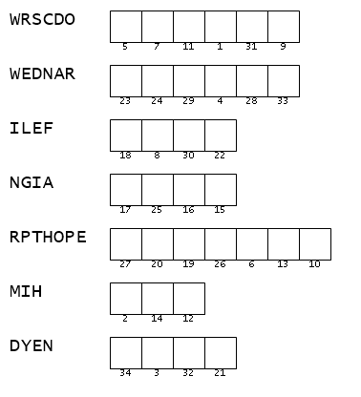

Family Activities
I brought this key to a secret message back in this diplomatic bag from Isnionswasiacos. Unscramble the words that originated in your Bible Study. Use the numbers to get the Get help at http://tinyurl.com/42r26pvu Also the crossword puzzle can be found … for you ladies over on the right side !

Slide 20
The Identity of Jesus
March 17

