Slide 1
The Greatest Sin
September 21

Slide 2


Video Introduction
View Video

Slide 3
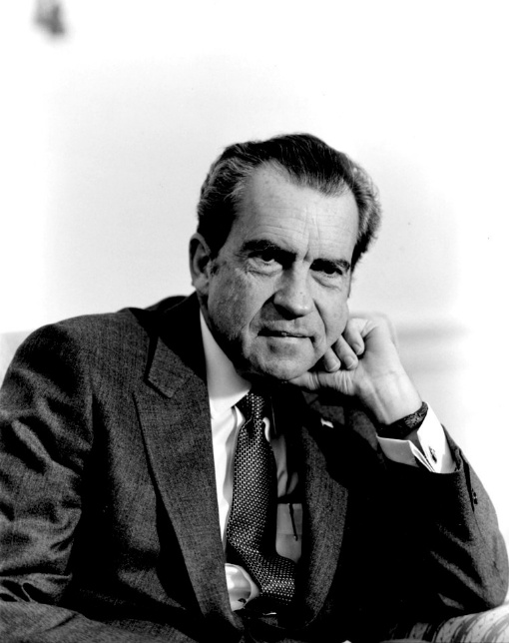
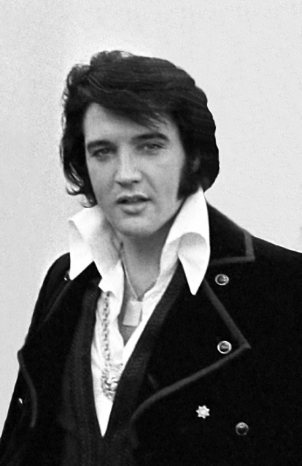
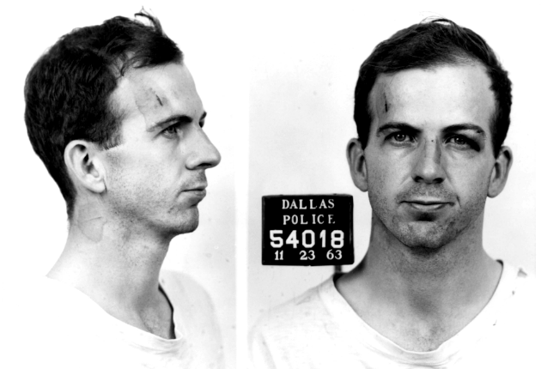
Make a list …
Who are some people in history forever linked with controversy?
Some of the controversies may have left the person “unforgivable”.
  Today we look at a sin Jesus said was unforgivable.
  That greatest sin is that of never trusting Jesus or unbelief.

Slide 4

Listen for astonishment.
Matthew 12:22-23 (NIV) Then they brought him a demon-possessed man who was blind and mute, and Jesus healed him, so that he could both talk and see. 23 All the people were astonished and said, "Could this be the Son of David?"

Slide 5
The Power of God
What situation did Jesus address?
What are some ways you see Satan at work in the world today?
How did the people respond to what they saw?
When have you been amazed by a display of God’s power?

Slide 6
The Power of God
What are the implications of the title “Son of David”? What seems to be the attitude of the people who ask this question?
When Jesus spoke of Himself, He used the title “Son of Man”. Why do you suppose He used this term instead of referring to Himself as the “Messiah”?

Slide 7
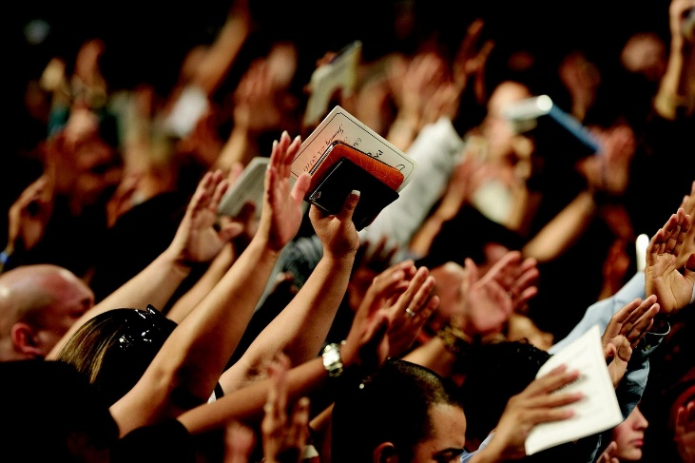

The Power of God
On a bigger scale, how do you see the kingdom of God overcoming the evil one in today’s world?

Slide 8
Listen for Jesus’ logic.
Matthew 12:24-29 (NIV) But when the Pharisees heard this, they said, "It is only by Beelzebub, the prince of demons, that this fellow drives out demons." 25 Jesus knew their thoughts and said to them, "Every kingdom divided against itself will be ruined, and every city or

Slide 9
Listen for Jesus’ logic.
household divided against itself will not stand. 26 If Satan drives out Satan, he is divided against himself. How then can his kingdom stand? 27 And if I drive out demons by Beelzebub, by whom do your people drive them out? So then, they will

Slide 10
Listen for Jesus’ logic.
be your judges. 28 But if I drive out demons by the Spirit of God, then the kingdom of God has come upon you. 29 "Or again, how can anyone enter a strong man's house and carry off his possessions unless he first ties up the strong man? Then he can rob his house.

Slide 11
The Presence of God’s Spirit
How did the Pharisees respond upon hearing what Jesus had done? How did they try to counter what the people said about Jesus and detract from what He had done for the man?
What parables or sayings did Jesus offer to emphasize that attributing Christ’s work to Satan was illogical and inconsistent?

Slide 12
The Presence of God’s Spirit
How did Jesus’ logic show the Pharisee’s argument to be illogical?
What are some ways our culture responds to the works of Christ?
What did Jesus say to show the significance of His ability to drive out demons? What rationale did Jesus give for casting out demons?

Slide 13
Listen for unforgiveness.
Matthew 12:30-32 (NIV) "He who is not with me is against me, and he who does not gather with me scatters. 31 And so I tell you, every sin and blasphemy will be forgiven men, but the blasphemy

Slide 14
Listen for unforgiveness.
against the Spirit will not be forgiven. 32 Anyone who speaks a word against the Son of Man will be forgiven, but anyone who speaks against the Holy Spirit will not be forgiven, either in this age or in the age to come.

Slide 15
Unbelief Means No Forgiveness
What good news does Jesus declare?
What is the exception as far as forgiveness is concerned?
Jesus has been casting out evil spirits by the power of God’s Holy Spirit. The Pharisees have rejected the idea that this is the work of the Holy Spirit. How did this “blaspheme” the Holy Spirit?

Slide 16
Unbelief Means No Forgiveness
So how do people today reject the work of the Holy Spirit?
How does this passage give someone hope when they feel that God could never forgive them?

Slide 17
Belief Means Forgiveness
Good News !!!
  Confession, repentance, and receiving by faith God’s redeeming work on the cross can bring you forgiveness
If you are worried that maybe, you committed the unpardonable sin …
  You haven’t !

Slide 18
Application
Get off the unpardoned list.
  Have you resisted the Holy Spirit drawing you to Jesus?
  Jesus is the way to heaven.
  Embrace the forgiveness of sin provided for by the life, death, burial, and resurrection of Jesus.
  Talk to your group leader.

Slide 19
Application
Give up the critical attitude.
  It’s so easy to possess a critical spirit, just like the Pharisees.
  Sit quietly and ask God to examine your heart for a critical spirit.
  Is there a sin for which you need to repent or a person with whom you need to reconcile?

Slide 20
Application
Have your lips freed.
  Jesus freed the demon-possessed man’s lips so he could give God the glory.
  Who do you need to talk with about what Jesus has done in your life?
  Schedule a time to meet with this person and share what Jesus can do.

Slide 21


Family Activities
This message just in from our local operative network in Gianiaginof: The underground Christian community wants to remind their fellow believers in the West that God is still in control. You will need to help us because our decoding team is at a fall middle school retreat. Our tech support team can be contacted at https://tinyurl.com/2masdmyv. More Fun Family Activities are also available.

Slide 22
The Greatest Sin
September 21

