Slide 1
The Greatest Return
October 12

Slide 2

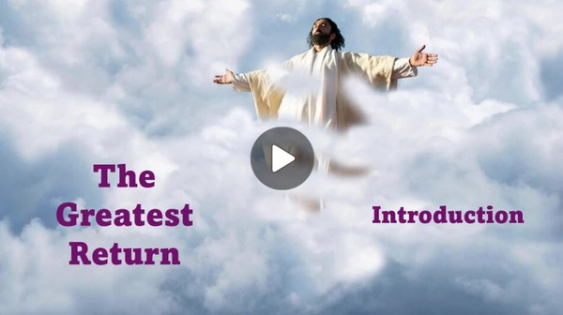
Video Introduction
View Video

Slide 3


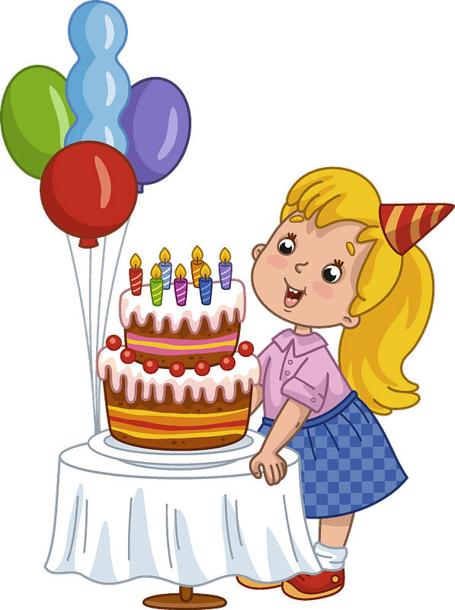
Remember how it was?
As a child or a young person, what events did you eagerly anticipate?
In the spiritual realm the one great event to which we look forward is Jesus' return.
The Christians in Thessalonica were worried the status of loved ones who had passed
Today we consider the truth that Jesus will return one day.
We are admonished to be ready

Slide 4
Listen for all that announces Christ’s return.
1 Thessalonians 4:16-18 (NIV) For the Lord himself will come down from heaven, with a loud command, with the voice of the archangel and with the trumpet call of God, and the dead in Christ will rise first. 17 After that,

Slide 5
Listen for all that announces Christ’s return.
we who are still alive and are left will be caught up together with them in the clouds to meet the Lord in the air. And so we will be with the Lord forever. 18 Therefore encourage each other with these words.

Slide 6
Jesus Will Return
What are the three methods of announcing Christ's return?
Why will it not be missed or overlooked by the whole world?

Slide 7
Jesus Will Return
Some believers within the local church had died since Paul had visited with them.
Those still alive were confused.
Would these dead believers miss the resurrection at Jesus return?
How does Paul reassure them?

Slide 8
Jesus Will Return
What does this suggest how Christians should mourn the death of a fellow believer? How can these words help a person who is grieving over loved ones who have died?
What will the living experience when Christ returns?
What makes you think that the Lord’s return could happen in our lifetime?

Slide 9
Jesus Will Return
How can these words help a person who is grieving over Christian loved ones who have died?
Note the end of the passage about being with the Lord forever … someone said that people who don't enjoy Jesus' presence now might not be comforted by the thought of eternity with Him!

Slide 10

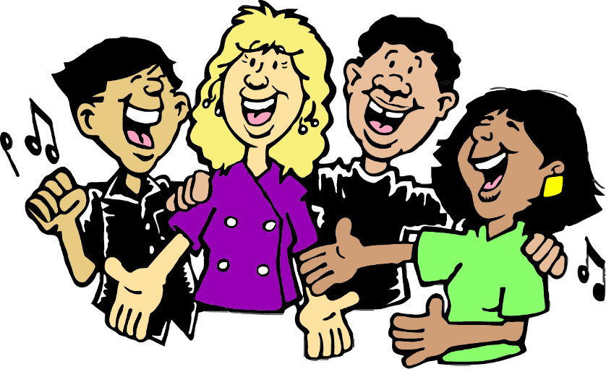
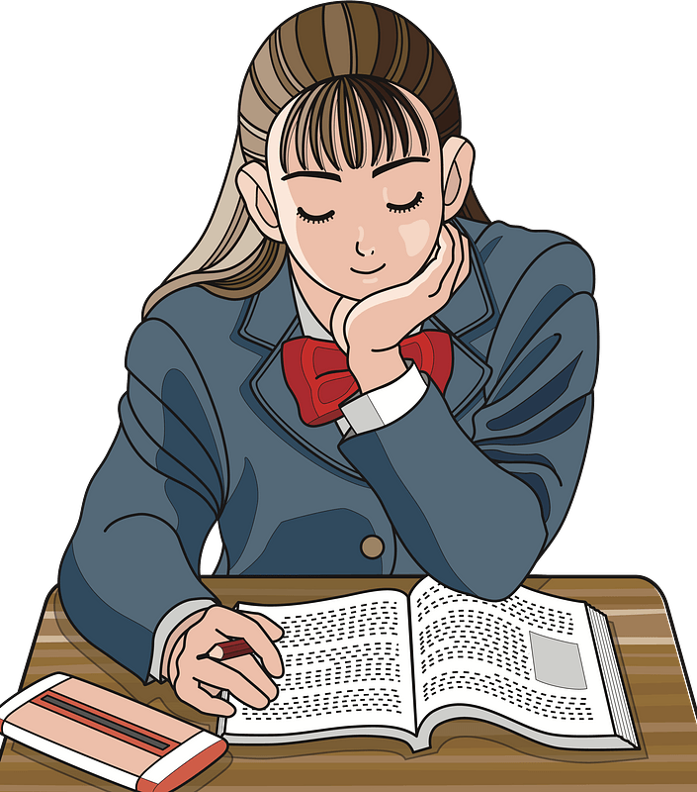
Jesus Will Return
How can we seek to increase our joy in Jesus company here on earth?

Slide 11
Listen for a timetable.
1 Thessalonians 5:1-3 (NIV) Now, brothers, about times and dates we do not need to write to you, 2 for you know very well that the day of the Lord will come like a thief in the night. 3 While people are saying, "Peace and safety," destruction will come on them suddenly, as labor pains on a pregnant woman, and they will not escape.

Slide 12
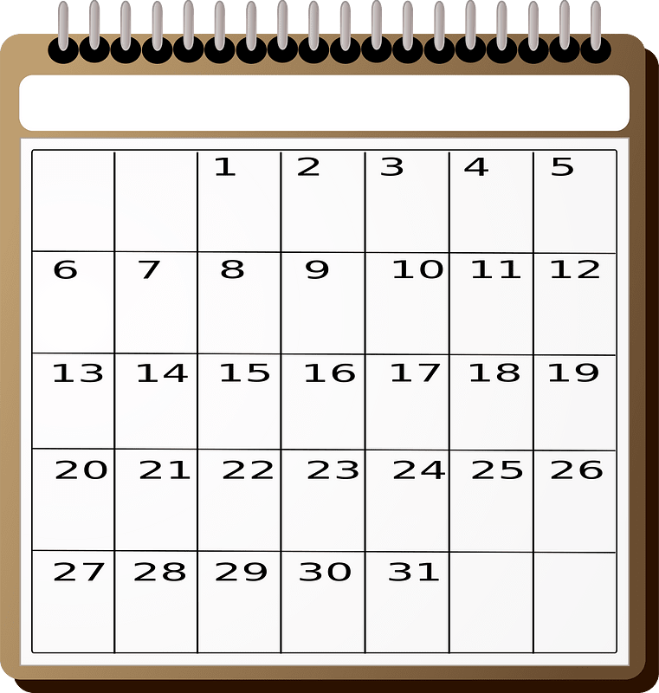
Specific Time Unknown
Pual says there’s no need to write about the exact time of Christ’s return. Why do you think he stressed this point? Why doesn’t God intend for us to know?

Slide 13
Specific Time Unknown
Verse 2 compares the coming of the Lord to “a thief in the night.” What parts of this metaphor suggest about how we should prepare for Christ’s return?
Thief in the Night at Your House | Christ’s Return
Know he’s coming, not when Prepare for possibility Set a watch for his coming You know he’s coming, be ready

Slide 14
Specific Time Unknown
In verse 3, Paul mentions people saying, “Peace and safety,” just before sudden destruction comes. How do we see that in our world today?
What might this warning mean for us today? For unbelievers? For believers?

Slide 15
Specific Time Unknown
How can we balance living with hope for Christ’s return and being responsible with our present lives? What practical steps can we take to be ready, even though we don’t know when He will come?

Slide 16
Listen for contrasts
1 Thessalonians 5:4-8 (NIV) But you, brothers, are not in darkness so that this day should surprise you like a thief. 5 You are all sons of the light and sons of the day. We do not belong to the night or to the darkness. 6 So then, let us not be like others, who are

Slide 17
Listen for contrasts
asleep, but let us be alert and self-controlled. 7 For those who sleep, sleep at night, and those who get drunk, get drunk at night. 8 But since we belong to the day, let us be self-controlled, putting on faith and love as a breastplate, and the hope of salvation as a helmet.

Slide 18
Diligently Wait
Note these three contrasting metaphors Paul used to refer to spiritual virtues essential to living in anticipation of the Lord’s return. Describe the application of each.
Metaphor | Meaning
Darkness vs Light Asleep vs Alert Self-controlled vs Drunk

Slide 19
Diligently Wait
How can we help one another navigate through a world growing increasingly dark?
What are some threats to the church standing united in a world wrapped in darkness?
How are faith and love like a breastplate?
How is salvation like a helmet?

Slide 20
Application
Be alert.
Look at your calendar.
Regardless of what you’ve got planned for the week ahead, consider each day as if Jesus could return.
What would you change?

Slide 21
Application
Be self-controlled.
Take time in the middle of each day next week to see how you’re doing.
Redirect or reorder your calendar if you’ve gotten off track.

Slide 22
Application
Warn others.
Consider how you can winsomely remind others this week that Jesus is coming back.
You might consider beginning the conversation with a question:
“What would you say to Jesus if He came back for you this week?”

Slide 23
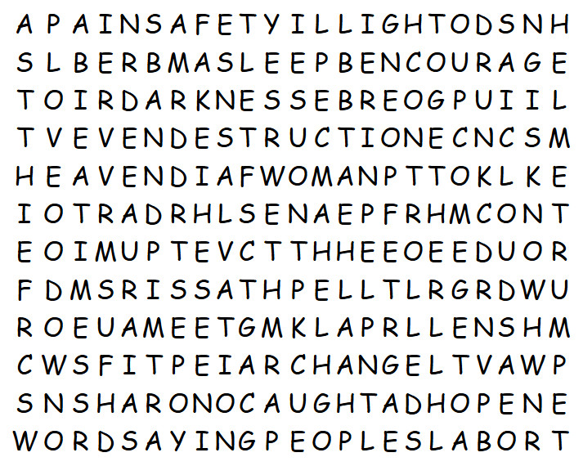
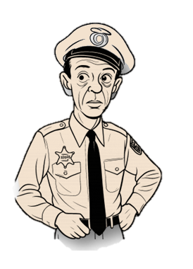
Family Activities
Well, golly! Would ya look at that, Andy? I found “Woman” and “Sharon” first thing! Maybe that’s a sign I oughta keep my eyes peeled for a gal named Sharon, huh? And let me tell ya, there’s a whole mess of other words you can find, too—all straight from the Good Book! If you need a little help, just head on over to https://tinyurl.com/bdhpzarb . There’s all sorts of more wonderful things over there, I tell ya!

Slide 24
The Greatest Return
October 5

