Slide 1
The Greatest Need
September 14

Slide 2

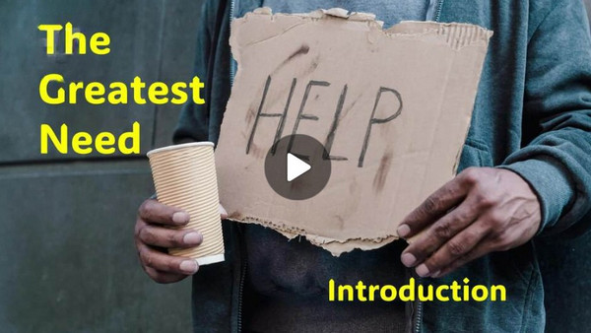
Video Introduction
View Video

Slide 3
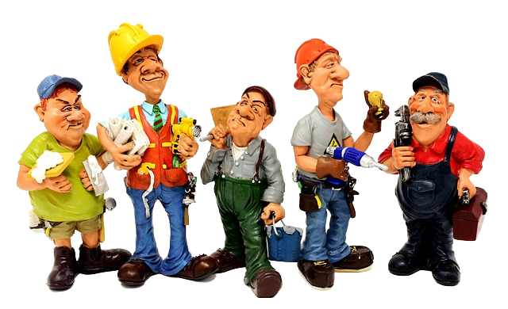
Great or Terrible?
When is DIY a great idea and when is it a terrible idea?
Great Idea | Terrible Idea

Slide 4
Great or Terrible?
When is DIY a great idea and when is it a terrible idea?
Some things we can do on our own. Some of you may even have taken on one of the items on the “Terrible Idea” list, but …
Taking care of our sin problem is not a DIY possibility.
Only Jesus can take care of our need for forgiveness

Slide 5
Listen for a miracle performed.
Luke 5:17-19 (NIV) One day as he was teaching, Pharisees and teachers of the law, who had come from every village of Galilee and from Judea and Jerusalem, were sitting there. And the power of the Lord was present for him to heal the sick. 18 Some men came carrying a

Slide 6
Listen for a miracle performed.
paralytic on a mat and tried to take him into the house to lay him before Jesus. 19 When they could not find a way to do this because of the crowd, they went up on the roof and lowered him on his mat through the tiles into the middle of the crowd, right in front of Jesus.

Slide 7
Power to Meet Physical Needs
How did Luke describe the crowd that was listening to Jesus?
Who came to see Jesus, and why did they come?
What hurdles did not deter their faith in Jesus?
In what ways did the paralytic and his friends demonstrate faith in Christ?

Slide 8
Power to Meet Physical Needs
What do you find significant about the men letting their friend down in the middle of the crowd?
In this part of the story, what stands out to you most—the paralyzed man, his friends, the crowd, or Jesus? Why?

Slide 9
Power to Meet Physical Needs
Why might we try to come to Jesus secretly where nobody can see us?
How can we bring our “paralyzed” friends to Jesus, even if they are unwilling?

Slide 10
Listen for mumblings of the scribes and pharisees.
Luke 5:20-21 (NIV) When Jesus saw their faith, he said, "Friend, your sins are forgiven." 21 The Pharisees and the teachers of the law began thinking to themselves, "Who is this fellow who speaks blasphemy? Who can forgive sins but God alone?"

Slide 11
Taking Care of the Greatest Need
Why do you think Jesus declared the man’s forgiveness first?
In what ways do people today try to deal with their guilt or need for forgiveness apart from Jesus?
Why did the Pharisees and teachers think that Jesus’ words to the paralytic man were blasphemous?

Slide 12
Taking Care of the Greatest Need
The religious leaders said, “Who can forgive sins but God alone?” How were they both right and wrong at the same time?
Right | Wrong

Slide 13
Listen for proof of Jesus’ authority.
Luke 5:22-26 (NIV) Jesus knew what they were thinking and asked, "Why are you thinking these things in your hearts? 23 Which is easier: to say, 'Your sins are forgiven,' or to say, 'Get up and walk'? 24 But that you may know that the Son of Man has authority on earth to forgive sins...." He said to the paralyzed

Slide 14
Listen for proof of Jesus’ authority.
man, "I tell you, get up, take your mat and go home." 25 Immediately he stood up in front of them, took what he had been lying on and went home praising God. 26 Everyone was amazed and gave praise to God. They were filled with awe and said, "We have seen remarkable things today."

Slide 15
Power and Authority Verifies Divinity
What did Jesus show by responding to what the Pharisees were thinking?
Why is it easier to say, “Your sins are forgiven” than to tell a paralyzed person, “You are healed”?
What was Jesus proving about Himself whenever He healed diseases and forgave sinners?

Slide 16
Power and Authority Verifies Divinity
What difference does it make to us today that Jesus not only has power over sickness, but also the authority to forgive sins?
How does this incident illustrate the conditions under which forgiveness is given?

Slide 17
Application
Identify with the paralytic man.
How do you identify with the paralytic man?
What fears or sins paralyze you?
Ask God to reveal these things to you.
Then turn them over to Him and walk forward in faith.

Slide 18
Application
Identify with the religious leaders.
In what ways are you like the religious leaders?
How have your actions and attitudes kept others from seeing who Jesus is?
Ask God to reveal these things to you.
Then turn them over to Him and walk forward in faith.

Slide 19
Application
Identify with the friends.
In what ways are you like the friends?
Identify someone in your community who needs help with a physical need.
Provide for them in Jesus’s name.

Slide 20

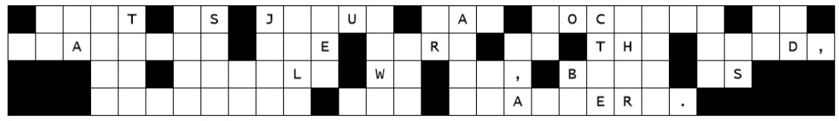

Family Activities
Boop-Beep … That doofus, Darth Nuisance has messed with your church billboard. The maintenance crew needs your help. If you need help, go to https://tinyurl.com/4w7edex2 Also available are other fun family activities

Slide 21
The Greatest Need
September 14

