Slide 1
The Greatest Name
September 7

Slide 2

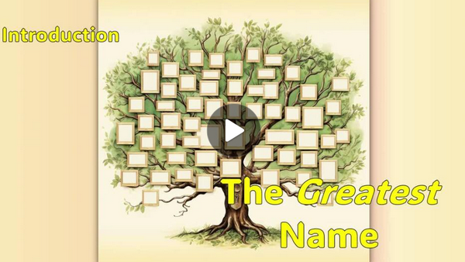
Video Introduction
View Video

Slide 3



In Your Humble Opinion …
In your opinion, who is the greatest of all time in one of these fields:
Sports | Books/Authors | Movies

Slide 4
In Your Humble Opinion …
In your opinion, who is the greatest of all time in one of these fields:
Probably we’ll not find agreement for any category.
But the One great name over all is Jehovah God
Today we consider the reality that there is only one God
Only His name deserves glory and exaltation.

Slide 5
Listen for description of the Servant.
Isaiah 42:1-4 (NIV) "Here is my servant, whom I uphold, my chosen one in whom I delight; I will put my Spirit on him and he will bring justice to the nations. 2 He will not shout or cry out, raise his voice in the streets. 3 A bruised

Slide 6

Listen for description of the Servant.
he will not break, and a smoldering wick he will not snuff out. In faithfulness he will bring forth justice; 4 he will not falter or be discouraged till he establishes justice on earth. In his law the islands will put their hope."

Slide 7
Behold, God’s Servant
God, through His prophet calls attention to “my Servant”. List words and phrases in verse 1 that describe this “Servant”.
What hope do these verses give you about the Servant’s mission?
How does verse 3 encourage you in your walk with God?

Slide 8
Behold, God’s Servant
Looking at God's justice and faithfulness described in verses 1-4, what specific qualities make Him worthy of our honor and worship?
What does this passage show about the way God’s chosen servant (the Messiah) brings justice to the nations?

Slide 9
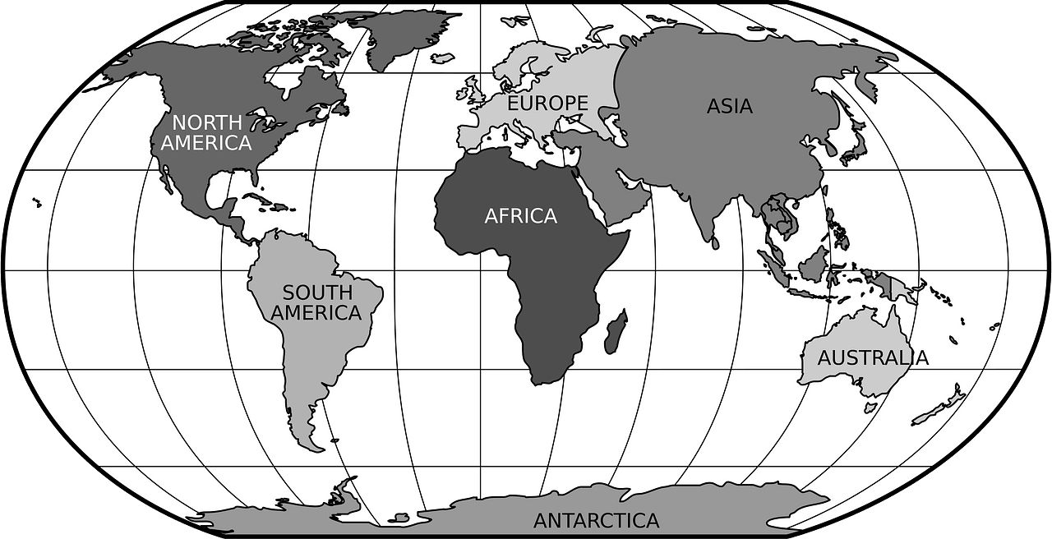
Behold, God’s Servant
How does Jesus’ mission reveal God’s worthiness to receive glory and honor from all nations?

Slide 10
Listen for assurances.
Isaiah 42:5-8 (NIV) This is what God the LORD says-- he who created the heavens and stretched them out, who spread out the earth and all that comes out of it, who gives breath to its people, and life to those who walk on it: 6 "I, the LORD, have called you in righteousness;

Slide 11
Listen for assurances.
I will take hold of your hand. I will keep you and will make you to be a covenant for the people and a light for the Gentiles, 7 to open eyes that are blind, to free captives from prison and to release from the dungeon those who sit in darkness. 8 "I am the LORD; that is my name! I will not give my glory to another or my praise to idols.

Slide 12
The Work of God’s Servant
What do these verses reveal about God’s role as the Creator compared to every other so-called “god” or idol?
Which of the metaphors about God’s work in the world have you seen play out in others’ lives?
Why do you think God says, “I will not give my glory to another or my praise to idols”?

Slide 13
The Work of God’s Servant
In what ways do you see people giving glory to idols instead of to God?
What evidence does this passage give us that Jehovah alone has the power to accomplish His purposes in the world?
How does knowing that God alone created the heavens and the earth affect the way we respond to Him in worship?

Slide 14
Listen for music instruction.
Isaiah 42:9-12 (NIV) See, the former things have taken place, and new things I declare; before they spring into being I announce them to you." 10 Sing to the LORD a new song, his praise from the ends of the earth, you who go down to the sea, and all that is in it, you islands, and all who

Slide 15
Listen for music instruction.
live in them. 11 Let the desert and its towns raise their voices; let the settlements where Kedar lives rejoice. Let the people of Sela sing for joy; let them shout from the mountaintops. 12 Let them give glory to the LORD and proclaim his praise in the islands.

Slide 16
Glory from All People
Where does the activity of the Lord fit into human history?
What assurance concerning His promises for the future comes from acknowledging what He has done in the past?
What does the prophet instruct the peoples of every tribe, nation, and region to do?

Slide 17
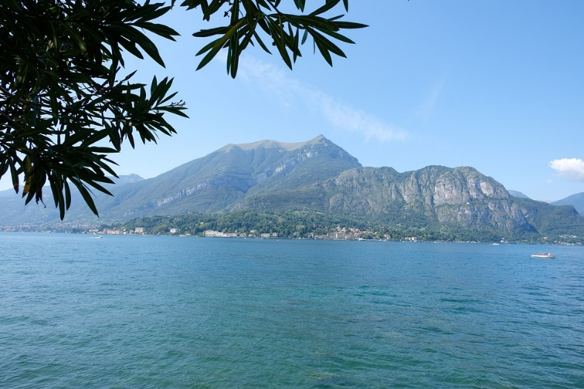
Glory from All People
Verses 10-12 call for universal praise - from the earth, the sea, the islands, and all who live in them. Why does God deserve praise from all creation?

Slide 18
Application
Memorize.
Commit Philippians 2:9-11 to memory.
Reflect on those words.
Ask God to show how you can live under His lordship each day.

Slide 19
Application
Write.
The Bible speaks of a new song.
Write a hymn, poem, or spoken word poem to thank the Lord.
Thank the Lord for His faithfulness in the past and His promises for the future.
Share this work with others or use it in your personal worship to glorify God.

Slide 20
Application
Encourage.
There are many bruised people in our communities.
Someone you know is going through a hard time.
Send this person a note of encouragement with a promise from God of His faithfulness.

Slide 21
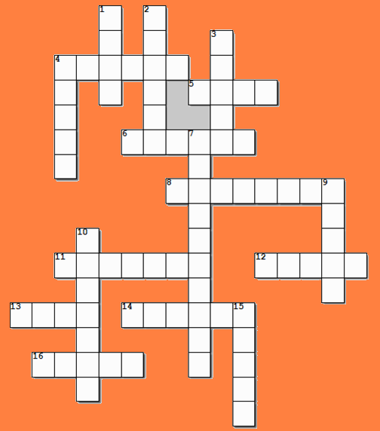
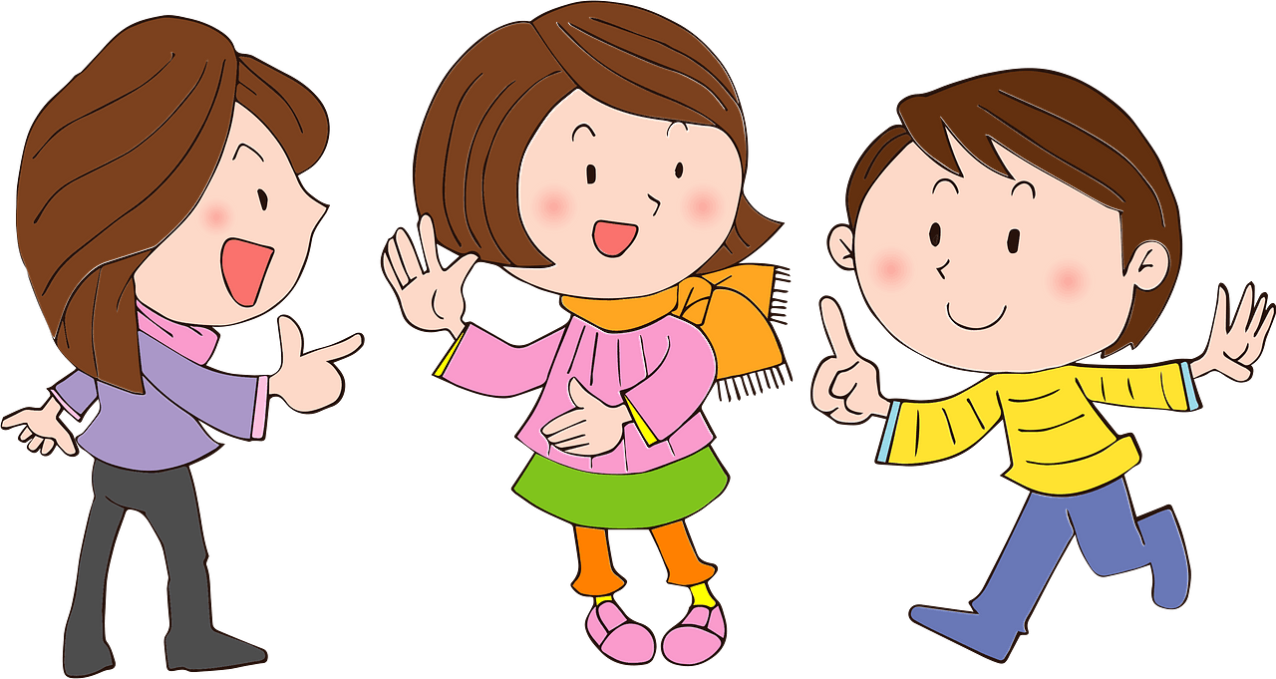
Family Activities
Yes there are. The words and clues are from our Bible passage. And there’s a link to other stuff for the whole family
Are there clues?
I sure hope so?

Slide 22
The Greatest Name
September 7

