Slide 1
The Greatest Gift
September 28

Slide 2

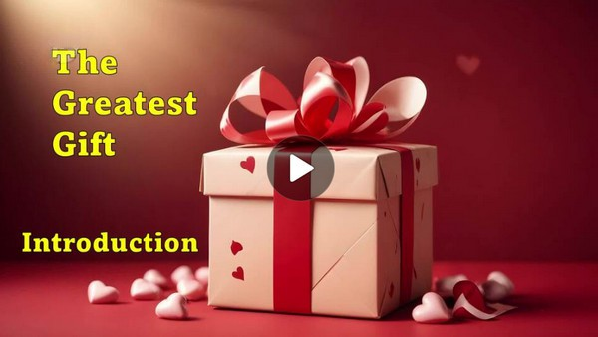
Video Introduction
View Video

Slide 3
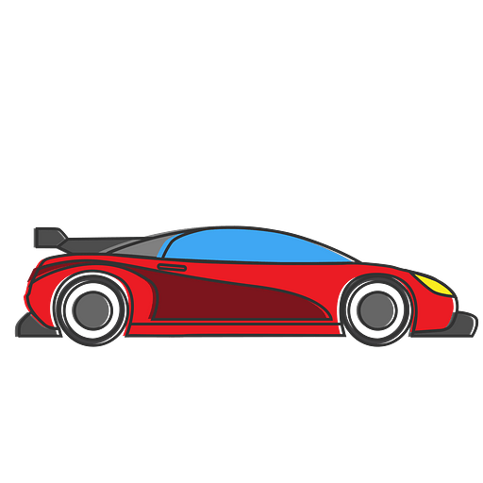
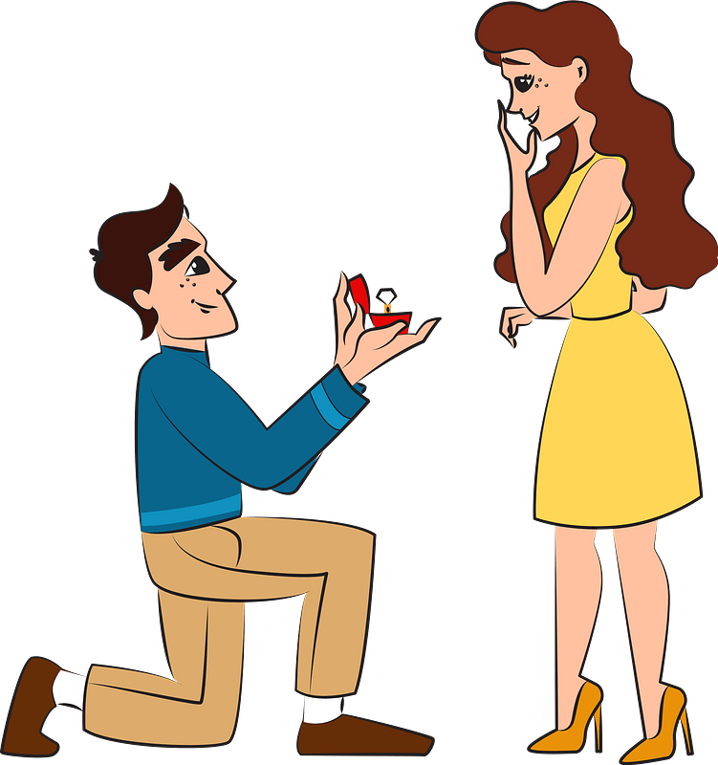
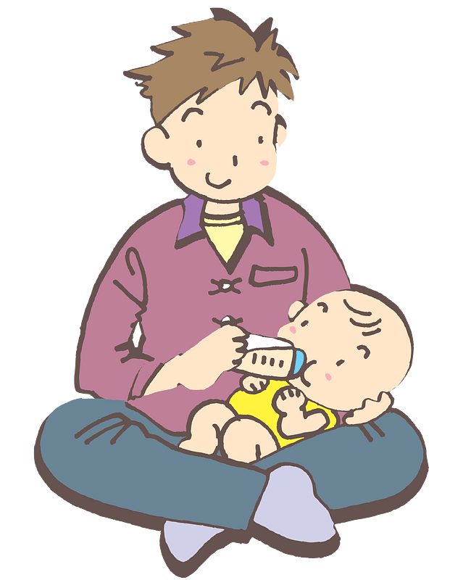
It was epic …
What is the best gift you’ve received from another person?
We enjoy special gifts from one another.
  But, we can receive no greater gift than a relationship with God.

Slide 4

Listen for a demonstration of love.
Romans 5:6-8 (NIV) You see, at just the right time, when we were still powerless, Christ died for the ungodly. 7 Very rarely will anyone die for a righteous man, though for a good man someone might possibly dare to die. 8 But God demonstrates his own love for us in this: While we were still sinners, Christ died for us.

Slide 5
Gift of a Loving Relationship
What are words and phrases which describe when Christ died?
Paul said we were powerless, helpless. What feelings or kinds of situations do you associate with being powerless?
That was our condition, our situation when Christ died to provide our salvation.

Slide 6
Gift of a Loving Relationship
What does verse 7 say about God's love for us?
But … Jesus sacrificed his life for us when we were dirty, despicable sinners!!
When might someone risk their life to protect someone who is important to them?

Slide 7
Gift of a Loving Relationship
How does Christ’s sacrifice contrast to the heroic acts of normal people?
What does this imply about God’s love for us?
How can this kind of love be reflected in our lives towards others around us?

Slide 8
Listen for a reason to rejoice
Romans 5:9-11 (NIV) Since we have now been justified by his blood, how much more shall we be saved from God's wrath through him! 10 For if, when we were God's enemies, we were reconciled to him through the death of

Slide 9
Listen for a reason to rejoice
his Son, how much more, having been reconciled, shall we be saved through his life! 11 Not only is this so, but we also rejoice in God through our Lord Jesus Christ, through whom we have now received reconciliation.

Slide 10
Gift of Reconciliation
What aspect of Christ’s death justifies a person in God’s sight?
Here are some synonyms for the term “justified”
  Defensible
  Right
  Vindicated
  Accepted
  Correct

Slide 11
Gift of Reconciliation
So, what does it mean to be justified?
Paul said we were God’s “enemies”. What images come to mind when you hear the word “enemy”?
That’s us … we were the bad guys … we were fighting against God!

Slide 12
Gift of Reconciliation
What kinds of things can happen to captured enemies?
In contrast, God provides a means of salvation for us … because He loves us!
If God has demonstrated His love to us through Jesus’ death, what can we anticipate concerning our future relationship with God?

Slide 13
Listen for contrasts and parallels.
Romans 5:18-21 (NIV) Consequently, just as the result of one trespass was condemnation for all men, so also the result of one act of righteousness was justification that brings life for all men. 19 For just as through the disobedience of the one man the many were made sinners, so also through the

Slide 14
Listen for contrasts and parallels.
obedience of the one man the many will be made righteous. 20 The law was added so that the trespass might increase. But where sin increased, grace increased all the more, 21 so that, just as sin reigned in death, so also grace might reign through righteousness to bring eternal life through Jesus Christ our Lord.

Slide 15
Gift of Eternal Life
How does an awareness of sin result in a greater awareness of the need for grace?
Who are each of the “one man” Paul talks of?

Slide 16
Gift of Eternal Life
Let’s determine the contrasts made. Fill in the chart.
 | Adam | Christ
Action
Result
Recipients

Slide 17
Gift of Eternal Life
If eternal life means “eternal union with God”, how does having eternal life affect my day to day life?
What does it mean to you that where sin multiplied, grace multiplied even more?

Slide 18
Application
Gifts to be opened.
  Gifts aren’t gifts until they’re received and opened.
  Have you received the gift of being made right with God?
  If you haven’t, you can begin the relationship with Jesus right now
  Admit you are a sinner in need of a Savior.
  Believe Jesus died for your sin and rose to life again.
  Confess Him as Lord and Savior.

Slide 19
Application
Steps to reconciliation.
  God took big steps to reconcile us to Himself.
  Who are the people with whom you need to reconcile?
  What steps can you take to begin that process?
  Get started this week.

Slide 20
Application
A message to deliver.
  Tell others about God’s amazing gift of reconciliation.
  Make an appointment in the next week or two.
  Share your faith story with a family member, friend, or neighbor

Slide 21
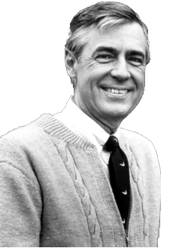
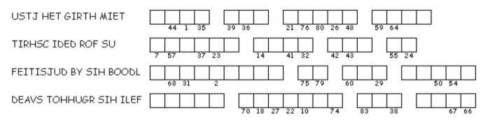
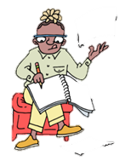

Family Activities
Hello, neighbor. This kind lady could really use some help. She’s trying to put together a special message by unscrambling the phrases and using the numbers to place the letters where they belong. If you’d like to help her—and maybe enjoy some more family activities together—you can visit this link: https://tinyurl.com/2pfdfccn .
I’m glad we can be helpers for each other.

Slide 22
The Greatest Gift
September 28

