Slide 1
The Greatest Command
October 5

Slide 2

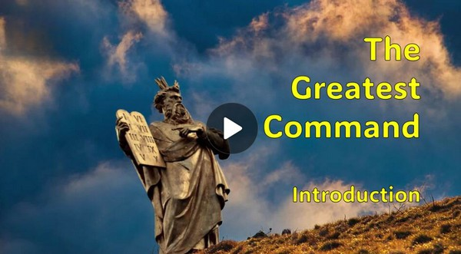
Video Introduction
View Video

Slide 3
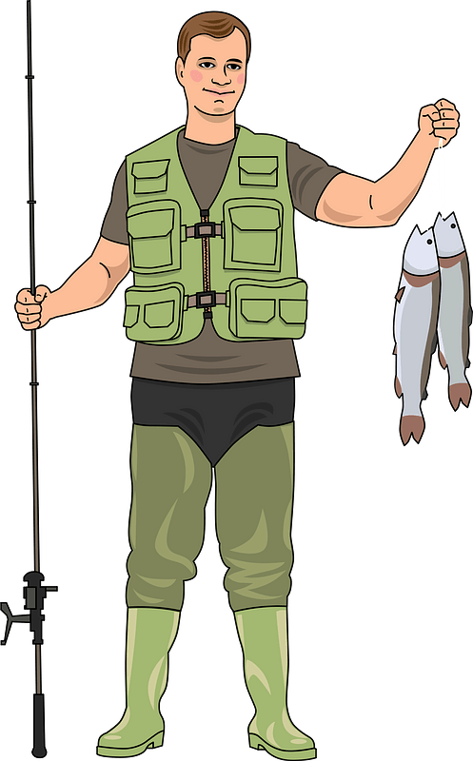
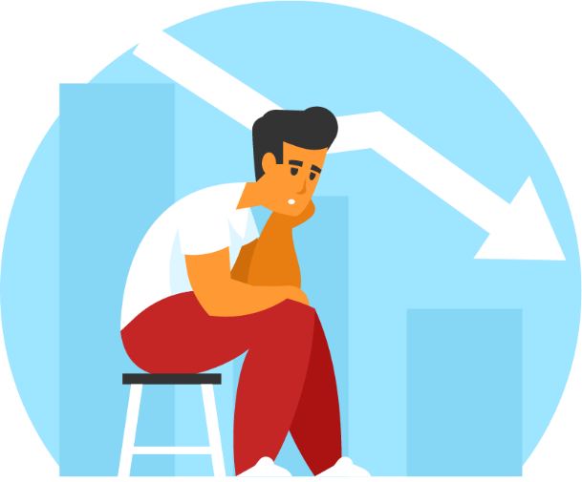
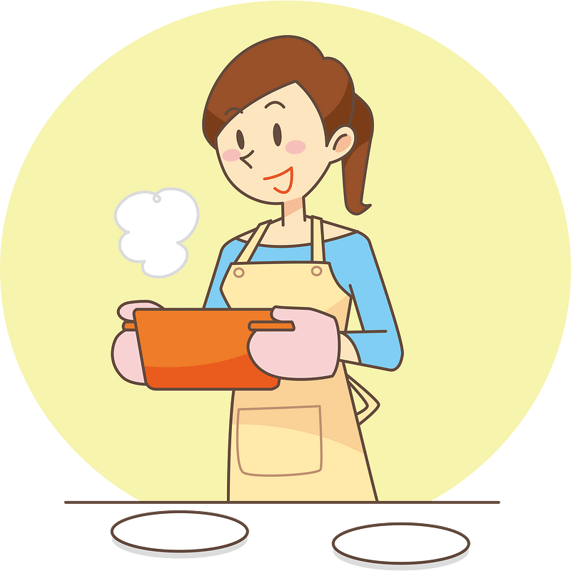
“Let me tell you …”
When people ask you for advice, what is the one thing you like to tell them?
Today we look at spiritual advice.
Our obedience to God is seen in our love for Him and for others.

Slide 4
Listen for Jesus’ answer.
Mark 12:28-30 (NIV) One of the teachers of the law came and heard them debating. Noticing that Jesus had given them a good answer, he asked him, "Of all the commandments, which is the most important?" 29 "The most

Slide 5

Listen for Jesus’ answer.
important one," answered Jesus, "is this: 'Hear, O Israel, the Lord our God, the Lord is one. 30 Love the Lord your God with all your heart and with all your soul and with all your mind and with all your strength.'

Slide 6
Love God with All Your Being
Note the job description of a scribe?
A teacher of the law
Trained in writing skills
Experts in reading, recording, interpreting, teaching God’s written word
Evolved into pharisaical practice of strict interpretation and practices of the law
Ended up with practices and traditions considered more important than the law itself

Slide 7
Love God with All Your Being
Now … why do you think the scribe questioned Jesus?
What was Jesus’ answer to what is the most important commandment?
Why do you think Jesus quoted Scripture to answer the question instead of replying with His own words?

Slide 8
Love God with All Your Being
What does it mean to love God with all your heart, soul, mind, and strength?
What role does the mind play in loving God? How can we grow in that area?
What does it mean to love God with all your strength? How can our physical energy, resources, or talents be part of that love?

Slide 9
Love God with All Your Being
How can we practice the greatest commandment in everyday life?
Consider that we come in contact with people all the time who are searching, maybe the same as the scribe in the story.
They just never come right out and declare it
This man did not do so directly … he came at it rather obliquely
He may well have been looking for true purpose in life
Many people in our circle of acquaintances are likewise looking for purpose

Slide 10
Listen for an additional command.
Mark 12:31 (NIV) The second is this: 'Love your neighbor as yourself.' There is no commandment greater than these."

Slide 11
Love Your Neighbor as Yourself
Jesus said the second most important commandment was to love your neighbor as yourself. What do you think it means to “love your neighbor as yourself”?
Why is the order of these commandments appropriate?

Slide 12
Love Your Neighbor as Yourself
What are some ways you can determine which is more apparent in your life – love for self or love for others?
Recall that when asked “Who is my neighbor?” Jesus told the story of the Good Samaritan. How does that tell us we are to “love as yourself”?
What are some ways we can show love for our “neighbors”?

Slide 13
Listen for Jesus’ evaluation of the scribe.
Mark 12:32-34 (NIV) "Well said, teacher," the man replied. "You are right in saying that God is one and there is no other but him. 33 To love him with all your heart, with all your understanding and with all your strength, and to love your

Slide 14
Listen for Jesus’ evaluation of the scribe.
neighbor as yourself is more important than all burnt offerings and sacrifices." 34 When Jesus saw that he had answered wisely, he said to him, "You are not far from the kingdom of God." And from then on no one dared ask him any more questions.

Slide 15
Loving God Is the Greatest Command
What are the different parts of our being with which we are to love the Lord?
How can you demonstrate love for God with these different parts of our being?
How did the teacher of the law respond to Jesus’ answer?

Slide 16
Loving God Is the Greatest Command
What modern-day religious practices would be like the burnt offerings and sacrifices to which the teacher of the law referred?
Why is wholehearted love for the Lord more important than outward actions that Christians practice today?

Slide 17
Application
Put God first.
What are the areas of your life that rival the place only God should occupy?
Check your calendar and your bank statement.
Where do you spend your time and money?

Slide 18
Application
Seek God always.
To love God with your mind means you seek truth.
What are you reading that will help you love God with your mind?
Consider reading a book, like You Are a Theologian by J. T. English and Jen Wilkin, that will sharpen your understanding of biblical truth.

Slide 19
Application
Love God with your strength.
Find a person in need in your church or community and gather a group to help meet that need.
It could be yard work, maintenance, or even errands this person is incapable of completing.

Slide 20


Family Activities
The decrypt staff challenge you to a puzzler. Think you can put those letters back quicker than we can? Move those fallen letters straight up to their correct square to complete the message. If you wimp out, you can find other Fun Family Activities at https://tinyurl.com/bdhmf7vt

Slide 21
The Greatest Command
October 5

