Slide 1

Third Missionary Journey

Slide 2

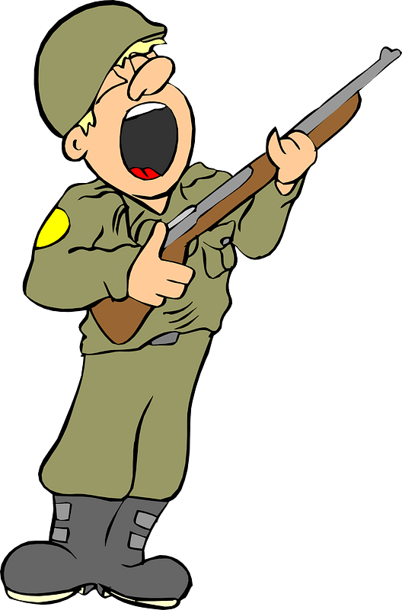

Remember that time ?
What were some situations where you had to say goodbye to someone leaving for an extended period?
Today we look at one of Paul’s goodbyes to a church he had planted.
  He spent two and a half years in Ephesus
  Time came when he had to move on and further his ministry.

Slide 3
1. THE THIRD MISSIONARY JOURNEY.

Slide 4

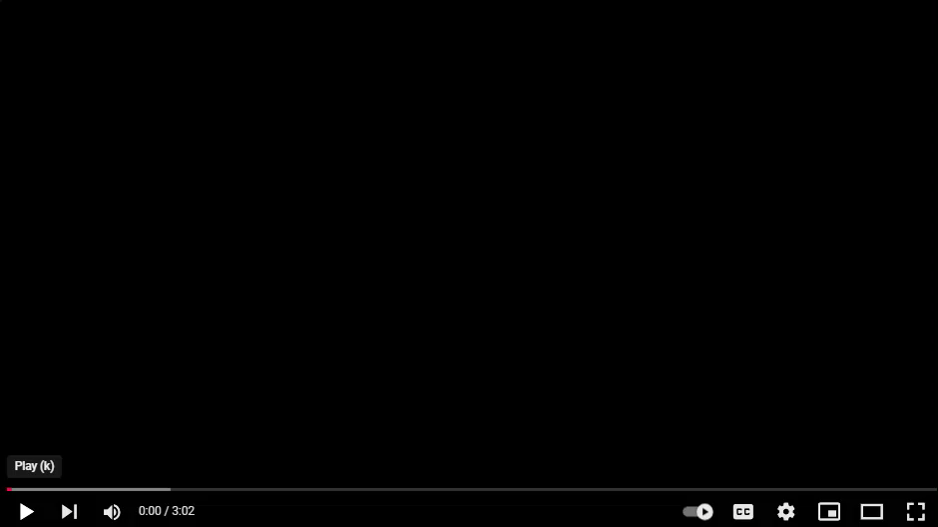

Slide 5

Listen for why there were tears.
Acts 20:36-38 (NIV) When he had said this, he knelt down with all of them and prayed. 37 They all wept as they embraced him and kissed him. 38 What grieved them most was his statement that they would never see his face again. Then they accompanied him to the ship.

Slide 6
The Third Missionary Journey
Paul is saying farewell. Note his relationship with the church members in Ephesus.
  They were close and had a great love for each other.
  They understood each other’s roles in the ministry of spreading the gospel
  They valued each other’s contributions

Slide 7
The Third Missionary Journey
Why do you think Paul and the Ephesian elders experienced such deep emotions in this goodbye?
The Ephesian elders were saddened by Paul’s words about not seeing him again. How might we handle farewells or separations when we don’t know if we’ll meet someone again?

Slide 8
The Third Missionary Journey
Deuteronomy 6:6-7 (NLT2) And you must commit yourselves wholeheartedly to these commands that I am giving you today. Repeat them again and again to your children. Talk about them when you are at home and when you are on the road, when you are going to bed and when you are getting up.
Paul knelt and prayed with them before leaving. Why do you think he chose to pray with them in this moment?
How can we leave a positive, lasting impact on children and grandchildren, anticipating their leaving home one day? How can our faith shape our perspective on those goodbyes?

Slide 9
2. ARREST / IMPRISONMENT / DEATH.

Slide 10
Listen for mayhem.
2 Corinthians 11:24-28 (NIV) Five times I received from the Jews the forty lashes minus one. 25 Three times I was beaten with rods, once I was stoned, three times I was shipwrecked, I spent a night and a day in the open sea, 26 I have been constantly on

Slide 11
Listen for mayhem.
the move. I have been in danger from rivers, in danger from bandits, in danger from my own countrymen, in danger from Gentiles; in danger in the city, in danger in the country, in danger at sea; and in danger from false brothers. 27 I have labored and

Slide 12
Listen for mayhem.
toiled and have often gone without sleep; I have known hunger and thirst and have often gone without food; I have been cold and naked. 28 Besides everything else, I face daily the pressure of my concern for all the churches.

Slide 13
Arrest – Imprisonment – Death
Look in your Bibles – 2 Cor. 11:24 – 28
_______ 1. How many times beaten with rods?
_______ 2. When Paul was attacked, left for dead.
_______ 3. How many lashes, 5 times?
_______ 4. What else happened 3 times?
_______ 5. What did he go without?
3
stoned
39
shipwreck
food
sleep
clothes

Slide 14
Arrest – Imprisonment – Death
Which of the hardships Paul lists do you think would be the hardest to bear? Why?
What can we learn about suffering from Paul?
Paul’s list of sufferings is extensive. How might reading about his experiences change our perspective on our own struggles?

Slide 15

Arrest – Imprisonment – Death
How can we develop a mindset that sees challenges as opportunities to grow in faith?
Consider once again
reviewing 101 Reasons
to Praise God

Slide 16
3. PAUL FINISHES HIS EARTHLY JOURNEY.

Slide 17
Listen for a sports analogy.
2 Timothy 4:6-7 (NIV) For I am already being poured out like a drink offering, and the time has come for my departure. 7 I have fought the good fight, I have finished the race, I have kept the faith.

Slide 18
Arrest – Imprisonment – Death
Paul described living his life as a “good fight. How can we discern what is worth “fighting for” in our own lives and faith?
Paul speaks about finishing the race. What does it mean to “finish well” in the Christian life?

Slide 19
Arrest – Imprisonment – Death
If you were to evaluate life’s spiritual journey as a race, what stages might we liken to portions of a running race in the Olympics … say a long relay race?
Who are some people we can mentor, encourage, or support to continue the “race” after us?

Slide 20

Arrest – Imprisonment – Death
Consider a prayer journal that can build a faith that endures throughout our lives.
  Write down requests
  Note the date
  People, ministries
  Note answer, with date
  Next time through,
  you can praise God
  for the answer

Slide 21
Application
Reread one of Paul’s letters this week.
Write down/journal some of the great wisdom from that letter.
Share that wisdom with someone else.

Slide 22
Application
If you’re not currently engaged in disciple-making, pray about who you might begin to pour into and begin doing so.
Explore opportunities locally, or talk with Missions Pastor Michael Curl about other mission trips

Slide 23


Family Discussion
Here’s an opportunity to discuss what missionaries encounter. How do they learn what is and isn’t appropriate? How is that important when you talk to them about Jesus?

Slide 24
Third Missionary Journey

