Slide 1
The God Who Rescues
November 24

Slide 2

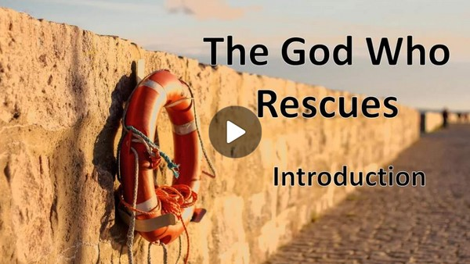
Video Introduction
View Video

Slide 3
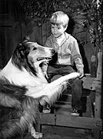
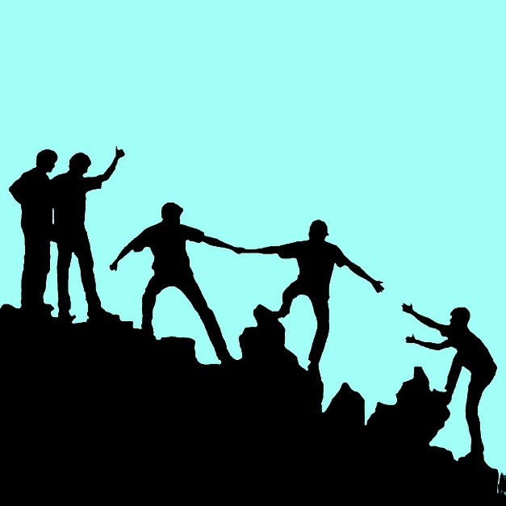
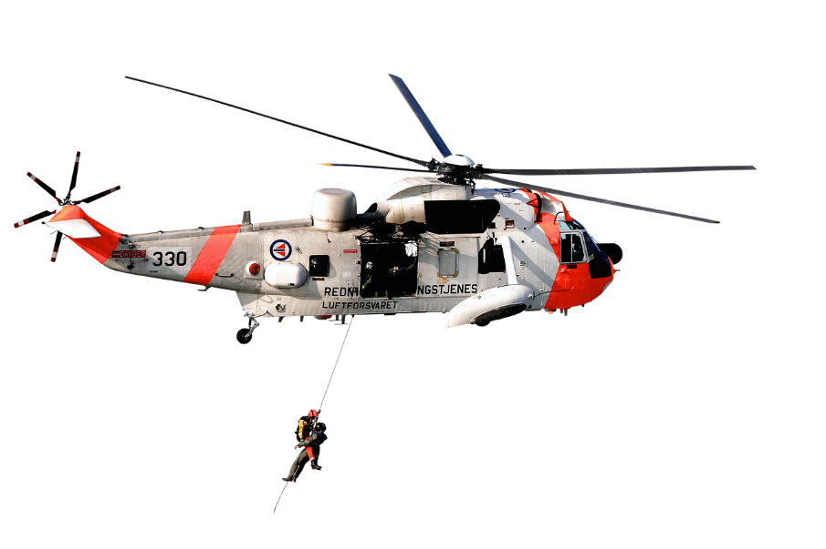
They were historical!
What are some rescue stories you remember hearing about or seeing?
Sometimes our need for rescue is not physical danger.
  Could be academic, emotional, or spiritual.
  Today we study a Psalm about how God rescues us.

Slide 4
Listen for why to praise God.
Psalm 30:1-5 (NIV) I will exalt you, O LORD, for you lifted me out of the depths and did not let my enemies gloat over me. 2 O LORD my God, I called to you for help and you healed me. 3 O LORD, you brought me up from the grave; you

Slide 5
Listen for why to praise God.
spared me from going down into the pit. 4 Sing to the LORD, you saints of his; praise his holy name. 5 For his anger lasts only a moment, but his favor lasts a lifetime; weeping may remain for a night, but rejoicing comes in the morning.

Slide 6
Rescued from Destruction
Note how the psalmist begins his hymn.
  Exalting God
  Declaring God’s rescue
  Praise for rescue from enemies

Slide 7
Rescued from Destruction
What reasons does the psalmist give for praising and thanking the Lord?
He appeals to his community of faith:
  Sing to the Lord
  Praise His holy name

Slide 8
Rescued from Destruction
When was a time you have felt God carrying you through a bad situation?
What does it mean to hold onto the promise of joy in the midst of sorrow?
What did he learn from experiencing God’s anger? God’s favor?

Slide 9
Rescued from Destruction
What are some specific ways we can practice gratitude in our own lives, even during challenging times?
What role does prayer play in seeking healing?

Slide 10
Listen for an attitude change.
Psalm 30:6-10 (NIV) When I felt secure, I said, "I will never be shaken." 7 O LORD, when you favored me, you made my mountain stand firm; but when you hid your face, I was dismayed. 8 To you, O LORD, I called; to the

Slide 11
Listen for an attitude change.
Lord I cried for mercy: 9 "What gain is there in my destruction, in my going down into the pit? Will the dust praise you? Will it proclaim your faithfulness? 10 Hear, O LORD, and be merciful to me; O LORD, be my help."

Slide 12
Rescued from Pride
Note the contrast signified in the word “but” in verse 7. What words and phrases describe the writer’s initial attitude?
How does he describe the change in his status?

Slide 13
Rescued from Pride
He cries out to God.
  To the Lord I cried for mercy.
  What gain does God have in my destruction?
  If I’m dead I can’t praise God.
  Hear me, be merciful to me, be my help.

Slide 14
Rescued from Pride
Why is it tempting for us to trust God only during certain times in our lives?
How does pride affect our relationship with God?
What does it mean to cry out to God with complete honesty?
In reality you go through the same sequence for your initial salvation experience
  Confess … Repent … Trust

Slide 15
Listen for another attitude change.
Psalm 30:11-12 (NIV) You turned my wailing into dancing; you removed my sackcloth and clothed me with joy, 12 that my heart may sing to you and not be silent. O LORD my God, I will give you thanks forever.

Slide 16
Rescue from Sorrow
Note what the Lord did for the psalmist.
  Turned his sorrowful crying into joyous dancing
  Removed the life clothed with anguish
  Dressed him with joy

Slide 17
Rescue from Sorrow
What was his commitment to the Lord going forward?
In verse 11, The psalmist celebrates that God has “turned [his] wailing into dancing.” How do you understand this image?

Slide 18
Rescue from Sorrow
Can you think of a time when God transformed a difficult season in your life into something unexpectedly joyful?
So, how can we hold onto faith during both good and difficult times? What practices help you remain connected to God regardless of circumstances?

Slide 19
Rescue from Sorrow
Talk to God in prayer … daily!
Practice the A.C.T.S. steps of prayer
  Adoration
  Confession
  Thanksgiving
  Supplications

Slide 20
Application
Pray with a thankful heart.
  Write down five things from which God has rescued you.
  Over the next five days, focus on one of those each day.
  Each time the situation comes to mind, thank God for being faithful to rescue you.

Slide 21
Application
Write a thank you note.
  Choose one of the times in your life in which God rescued you.
  Write a thank you note to the Father, expressing your gratitude for His care in stepping in to help you.

Slide 22
Application
Share your story with someone else.
  Choose someone close to you and share your story of God’s rescue.
  Pray that God would use your story to encourage someone else in his or her journey with Him.

Slide 23
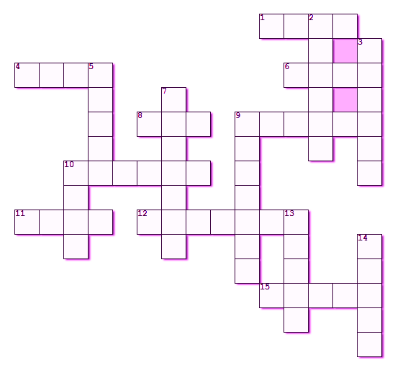
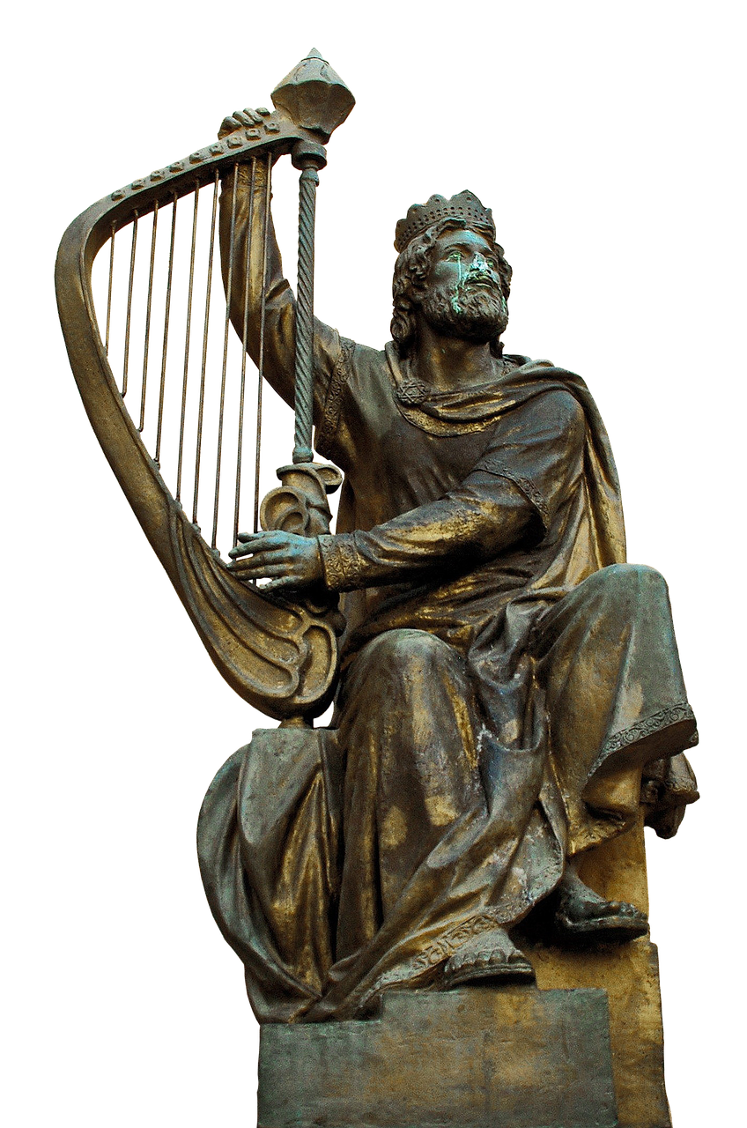

Family Activities
Study Psalm 30 and see how God rescued me. All the words and clues are in that Psalm. You can get help at https://tinyurl.com/mse6y22b And you ladies here in front can also find your favorite Word Search puzzle.

Slide 24
The God Who Rescues
November 24

