Slide 1

First Missionary Journeys

Slide 2
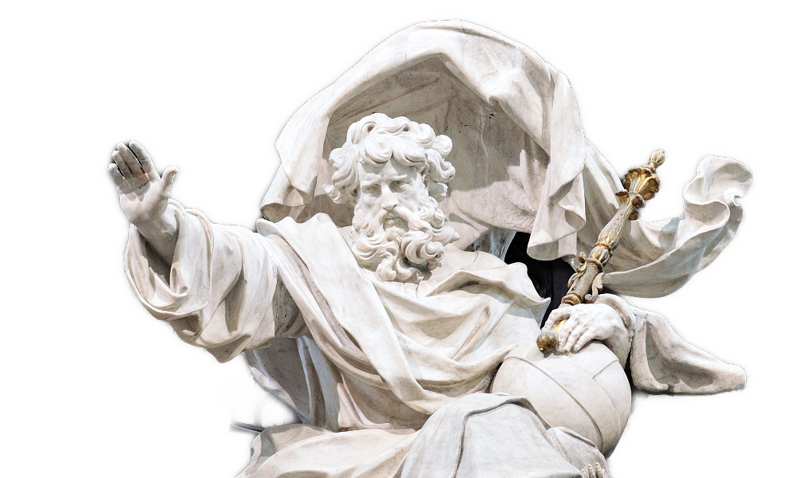

Just imagine …
Suppose God will be holding a business meeting later today … what kinds of things will be on the agenda for His meeting?
God’s agenda for the early church involved the spread of the Gospel.
  Consider how your agenda aligns with God’s agenda.

Slide 3
1. THE CALLING AND SENDING OF PAUL (SAUL) AND BARNABAS

Slide 4
Listen for a “hands on” application.
Acts 13:1-3 In the church at Antioch there were prophets and teachers: Barnabas, Simeon called Niger, Lucius of Cyrene, Manaen (who had been brought up with Herod the tetrarch) and Saul. [2] While they were

Slide 5

Listen for a “hands on” application.
worshiping the Lord and fasting, the Holy Spirit said, "Set apart for me Barnabas and Saul for the work to which I have called them." [3] So after they had fasted and prayed, they placed their hands on them and sent them off.

Slide 6
Paul and Barnabas Were Sent
What is stated in this passage about this church which suggests it is a good example of a church?
Note some of the specifics:
  Paul and Barnabas were called to a particular ministry
  God did the calling
  The church did the commissioning
there were prophets and teachers: Barnabas, Simeon called Niger, Lucius of Cyrene, Manaen (who had been brought up with Herod the tetrarch) and Saul. worshiping the Lord and fasting,

Slide 7
Paul and Barnabas Were Sent
How does a person recognize a call to be a missionary?
What indication do you see that the church leadership in Antioch was a diverse group?
In the church at Antioch there were prophets and teachers: Barnabas, Simeon called Niger, Lucius of Cyrene, Manaen (who had been brought up with Herod the tetrarch) and Saul.

Slide 8
Paul and Barnabas Were Sent
How would that diversity influence the direction of ministries?
What kinds of diversity can we see within churches in our society today?
Why is it important to appreciate diversity – and not try to only associate with those just like us (as a church or within a church)?
What diverse activities do you associate with the concept of “missions?”

Slide 9
2. THE FIRST MISSIONARY JOURNEY.

Slide 10
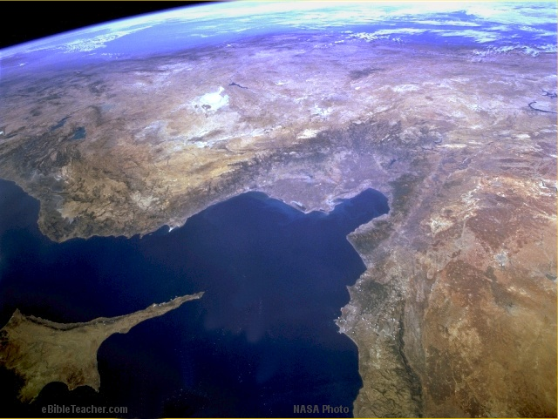
Paul-1st Missionary Journey
© EBibleTeacher.com
1st Missionary Journey
Acts 3 & 14
Modern Day Turkey
Antioch (Pisidian)
Iconium
Perga
Lystra
Attalia
Derbe
Antioch
Mediterranean Sea
Seleucia
Paphos
Salamas
Cyprus
Satellite Image - NASA
INDEX
Notes:
This shows the first missionary journey of Paul as described in Acts chapters 13 and 14.

Slide 11
Listen for good news.
Romans 1:16-17 (NIV) I am not ashamed of the gospel, because it is the power of God for the salvation of everyone who believes: first for the Jew, then for the Gentile. [17] For in the gospel a righteousness from God is revealed, a righteousness that is by faith from first to last, just as it is written: "The righteous will live by faith."

Slide 12
First Missionary Journey
Paul was bold in proclaiming the Gospel.
  It is powerful
  It contains the power of God for salvation
  It is for all cultures, all economic levels
  In the gospel, God’s righteousness is revealed
  It shows how you are saved by faith … initially and ongoing

Slide 13
First Missionary Journey
in the gospel a righteousness from God is revealed, a righteousness that is by faith from first to last
We read “a righteousness from God.” What does the word “righteous” mean?
  One of God’s attributes … God is righteous, just
  God declares believers positionally righteousness
    When we confess and repent of sin, and trust in God
  We are growing in experiential righteousness
What do you think Paul meant when he said, “The righteous shall live by faith”?

Slide 14
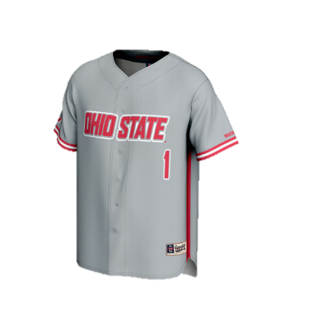

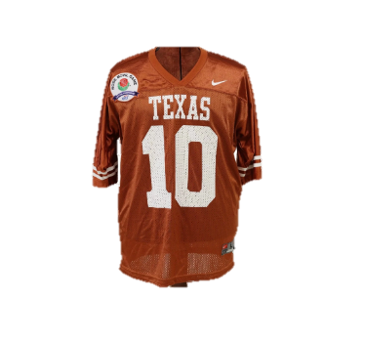
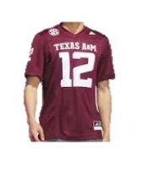
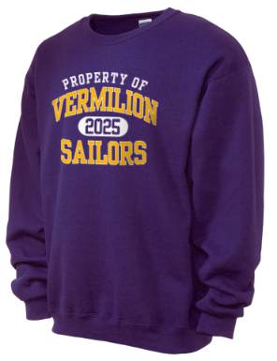
First Missionary Journey
In high school and college (and even afterwards) you are proud to wear your school colors and clothing with your school’s logo … why?
Why are some people not that proud and dedicated in the cause of sharing the gospel message?

Slide 15
3. THE SECOND MISSIONARY JOURNEY.

Slide 16



Slide 17
Paul-2nd Missionary Journey
2nd Missionary Journey
Rome
Philippi
Thess
Athens
Ephesus
Corinth
Mediterranean Sea
Israel
Caesarea
Jerusalem
Egypt
© EBibleTeacher.com
Notes:
This map shows Paul’s 2nd missionary journey as described in Acts chapter 15:36 - 18:22. The cities of Philippi, Ephesus, Corinth and Thessanolica were later sent letters by Paul.

Slide 18
Listen for Paul’s remarks on Thessalonica.
1 Thes. 2:7-12 (NIV) but we were gentle among you, like a mother caring for her little children. [8] We loved you so much that we were delighted to share with you not only the gospel of God but our lives as well, because you had become so

Slide 19
Listen for Paul’s remarks on Thessalonica.
dear to us. [9] Surely you remember, brothers, our toil and hardship; we worked night and day in order not to be a burden to anyone while we preached the gospel of God to you. [10] You are witnesses, and so is God, of how holy, righteous and blameless

Slide 20
Listen for Paul’s remarks on Thessalonica.
we were among you who believed. [11] For you know that we dealt with each of you as a father deals with his own children, [12] encouraging, comforting and urging you to live lives worthy of God, who calls you into his kingdom and glory.

Slide 21
Second Missionary Journey
List words and phrases which indicate Paul’s investment in the lives of the people at Thessalonica?
How can one lose sight of people’s needs by becoming too focused on church programs?
How can we keep our focus on ministering to people?
you remember, brothers, our toil and hardship; we worked night and day in order not to be a burden to anyone while we preached the gospel of God to you

Slide 22
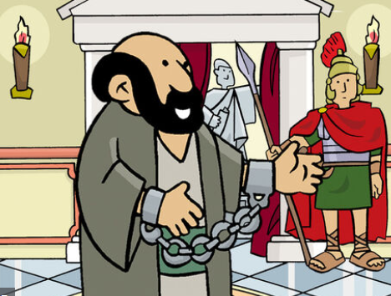
Second Missionary Journey
Although we might not go on missionary journeys like Paul, what can we learn from him that we should emulate in our lives?

Slide 23
Application
Begin praying that you will be obedient to the Holy Spirit’s promptings and direction
Prepare yourself by putting on the “Armor of God” (Ephesians 6:10-18)

Slide 24

Application
Pray for boldness in your love, words, and care towards others
Keep your passport up to
date to be ready to go if
God calls you to participate
in a mission trip

Slide 25
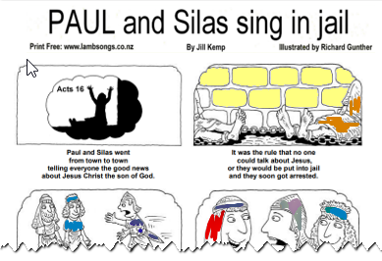

Family Activity
Somebody’s got to color that page. Might as well be you. But don’t let the pastor see you coloring during the sermon!

Slide 26
First Missionary Journeys

