Slide 1
The Gathering for Worship
February 23

Slide 2
Video Introduction
View Video

Slide 3
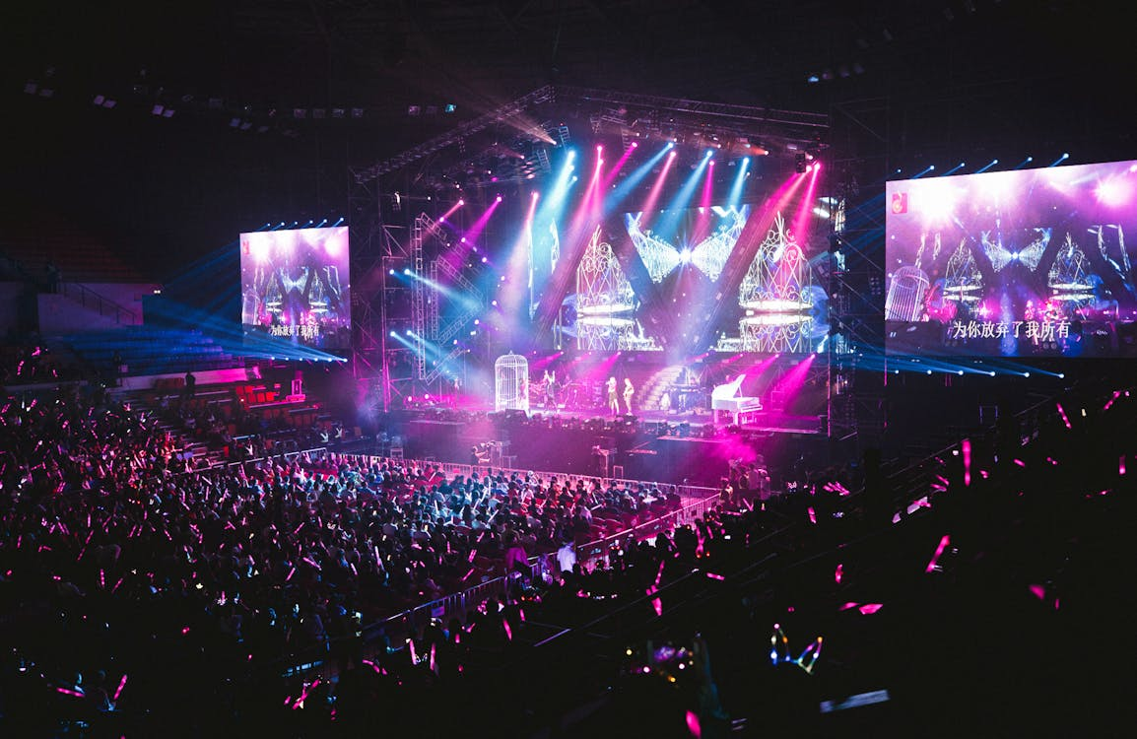
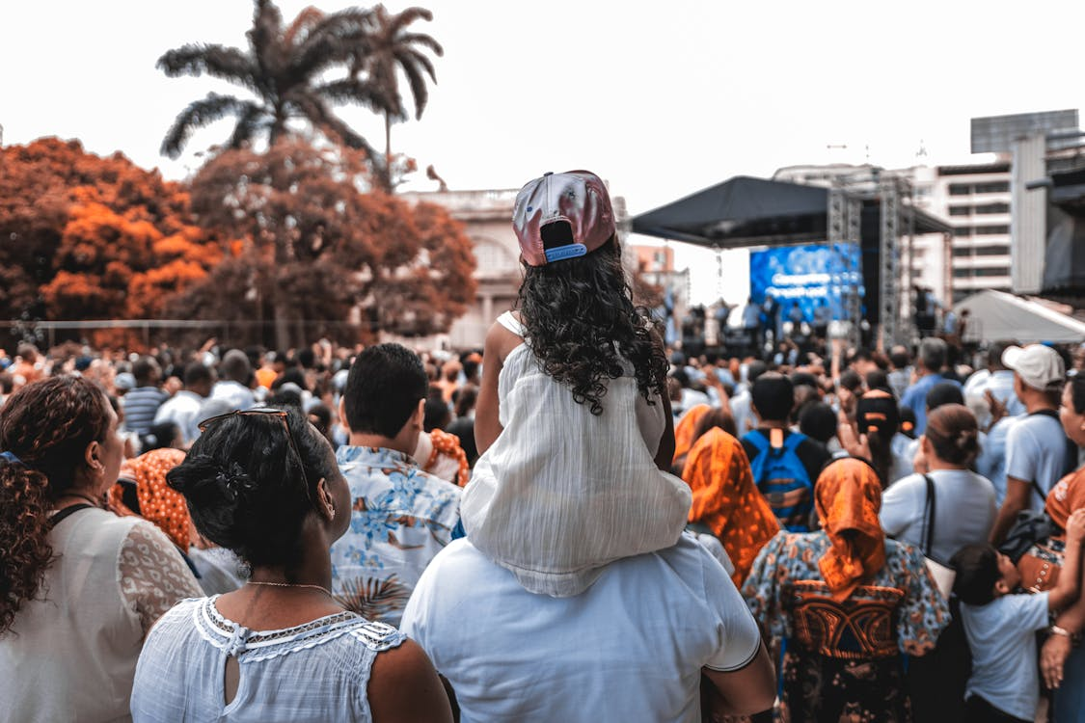
It was amazing …
What are some memorable large celebrations you have attended?
Somehow being there in person with all those other people makes it more memorable.
More exciting than just seeing it on TV
The same is true about worship – worshiping alongside others encourages us in our faith

Slide 4
Listen for an opportunity.
Hebrews 10:19-22 (NIV) Therefore, brothers, since we have confidence to enter the Most Holy Place by the blood of Jesus, 20 by a new and living way opened for us through the curtain, that is, his body, 21 and since we have a

Slide 5
Listen for an opportunity.
great priest over the house of God, 22 let us draw near to God with a sincere heart in full assurance of faith, having our hearts sprinkled to cleanse us from a guilty conscience and having our bodies washed with pure water.

Slide 6
Honoring Jesus
According to this passage, why can believers enter God's presence with boldness?
How is the "new and living way" superior to the old sacrificial system of worship?
Old Sacrificial System | “New and Living Way”

Slide 7
Honoring Jesus
According to the passage, what are the requirements worshipers must meet to come before God in spiritual worship?
How would we apply having a sincere heart to our approach to worship today?

Slide 8
Honoring Jesus
What keeps some people from drawing near to God?
How does the knowledge of "hearts sprinkled, cleansed from a guilty conscience" affect our worship?

Slide 9
Listen for responsibilities to others.
Hebrews 10:23-25 (NIV) Let us hold unswervingly to the hope we profess, for he who promised is faithful. 24 And let us consider how we may spur one another on toward love and good deeds. 25 Let us not give up meeting together, as some are in the habit of doing, but let us encourage one another--and all the more as you see the Day approaching

Slide 10
Encouraging Others
According to these verses, how can believers show their concern for one another, demonstrate unity?
What are some specific things we could do to show concern in the ways our passage says?

Slide 11
Encouraging Others
During the Covid pandemic, we were forced to worship and hear preaching and teaching at a distance using technology. In some cases all it took was a cell phone with Zoom to do this.
Why do you think some people have continued to “attend” in this distance format?

Slide 12
Encouraging Others
I can worship God just as well by turning my TV to religious programming as I can by going to church.
Agree | Disagree

Slide 13
Listen for sacrifice
Hebrews 13:12-15 (NIV) And so Jesus also suffered outside the city gate to make the people holy through his own blood. 13 Let us, then, go to him outside the camp, bearing the disgrace he bore. 14 For here we do not have an enduring city, but we are looking for the city that is to come. 15 Through Jesus, therefore, let us continually offer to God a sacrifice of praise--the fruit of lips that confess his name.

Slide 14
Praise and Thanksgiving
Consider the reference to "the city that is to come". It should shape our perspective on daily life and challenges.
Sing together “This World Is Not My Home”

Slide 15
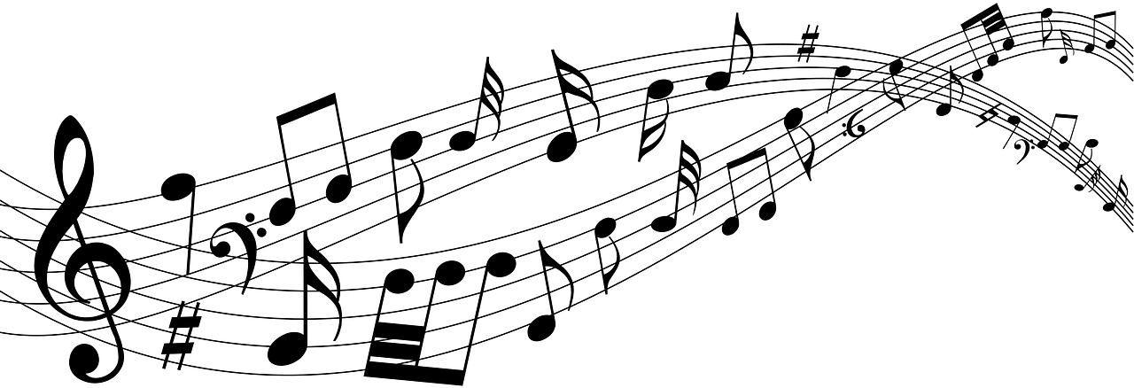
This World Is Not My Home
This world is not my home,
I’m just a-passing through,
My treasures are laid up
somewhere beyond the blue;
The angels beckon me from heaven’s open door,
And I can’t feel at home in this world anymore.

Slide 16
This World Is Not My Home
Refrain:
O Lord, You know I have no friend like You,
If heaven’s not my home, then, Lord, what will I do?
The angels beckon me from heaven’s open door,
And I can’t feel at home in this world anymore.

Slide 17
This World Is Not My Home
Just up in glory-land we’ll live eternally,
The saints on every hand are shouting victory,
Their songs of sweetest praise drift back from heaven’s shore,
And I can’t feel at home in this world anymore.

Slide 18
This World Is Not My Home
Refrain:
O Lord, You know I have no friend like You,
If heaven’s not my home, then, Lord, what will I do?
The angels beckon me from heaven’s open door,
And I can’t feel at home in this world anymore.

Slide 19
Praise and Thanksgiving
What does it mean to continually offer a "sacrifice of praise" to God? When is it a “sacrifice” to praise God? When does it feel most difficult to praise the Lord?
Why is offering the “sacrifice of praise” in these situations important?

Slide 20
Praise and Thanksgiving
The passage mentions "the fruit of lips that openly profess his name." What are some specific ways we can "profess his name" in our various life contexts?

Slide 21
Application
The Starting Place.
As you think about your own habits related to corporate worship, what are some ways you could grow in your participation in worship?
Spend time in prayer asking God to show you how you can grow in your participation in worship.

Slide 22
Application
The Growing Place.
Identify a worship setting that’s different than what you’re used to, perhaps in a cross-cultural setting.
Invite someone from the group to go with you (outside of your normal worship time) to experience corporate worship in a different way.

Slide 23
Application
The Sowing Place.
The verses that follow Hebrews 13:15 build on the truth that praise is on the lips of those who confess Jesus.
Praise, however, is only one mark of worship. Read Hebrews 13:16-19 and discover other evidence of a lifestyle of worship that naturally flow from the heart of a follower of Christ.
Put these principles into practice this week.

Slide 24
Family Activities
Have you seen a key code like this? We of the secret police in Wepu Lizim are cracking down on the so called “underground church.” You would not want to be found with this in your possession. Report your findings to https://tinyurl.com/m78h8bn6

Slide 25
The Gathering for Worship
February 23

