Slide 1
The Fear of God
December 4

Slide 2

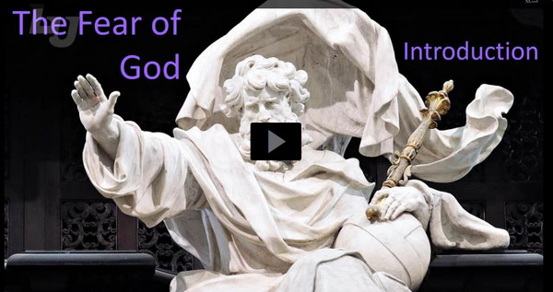
Video Introduction
View Video

Slide 3

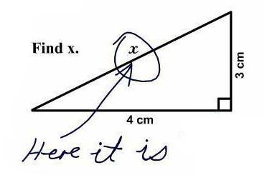
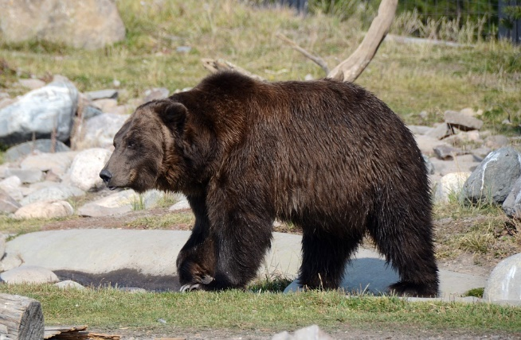

Be honest, now …
When has fear served a good purpose in your life?
Fear can be a good thing to protect us.
  The Bible says the “fear of God is the beginning of wisdom.”
  The fear of God gives us the foundation to face all other fears
$$a^{2}+b^{2}=c^{2}$$

Slide 4
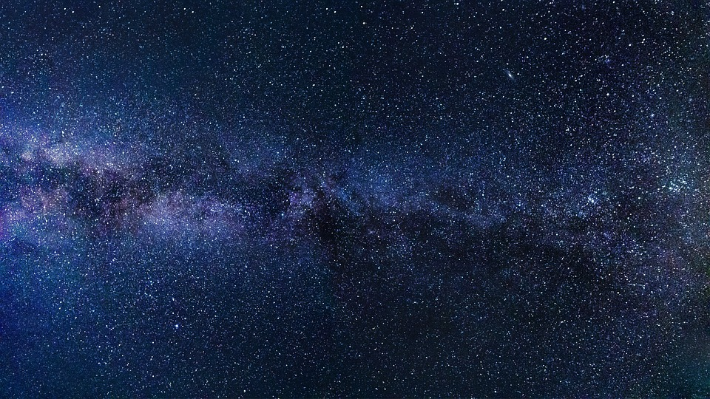
How many?
How many stars do you think there are? Millions? Billions? Trillions?
Scientists believe that there are on the order of 10²⁴ stars in our Universe.
  1,000,000,000,000,000,000,000,000.
Some scientists believe that number is likely a gross underestimation!

Slide 5

Listen to what the passage says about these 10²⁴ stars.
Psalm 33:6-9 (NIV) By the word of the LORD were the heavens made, their starry host by the breath of his mouth. 7 He gathers the waters of the sea into jars; he puts the deep into storehouses. 8 Let all the earth fear the LORD; let all the people of the world revere him. 9 For he spoke, and it came to be; he commanded, and it stood firm.

Slide 6
In Awe of The Creator
Note the declaration of how God populated the heavens, the skies?
  By His words.
  By the very breath of His mouth
  He spoke and it came into existence
  He commanded and it stood firm
How should all the inhabitants of the world respond to such a mighty God?

Slide 7
In Awe of The Creator
Actually,
we don’t create;
we innovate.
What does the fact that God created all things through His word alone say about His power?
Contrast what we consider “creativity” …
  Take an existing canvas and existing paints and “create” a picture
  Take an existing piece of wood and take away bits so that what is left is a recognizable image
  Take existing instruments and instruct them to play notes in a sequence that “creates” music

Slide 8
In Awe of The Creator
What questions are implied by accepting the reality of a Creator?
Why is God’s absolute authority an unpopular concept in our culture?
What, then, are the advantages of submitting to God’s authority?

Slide 9
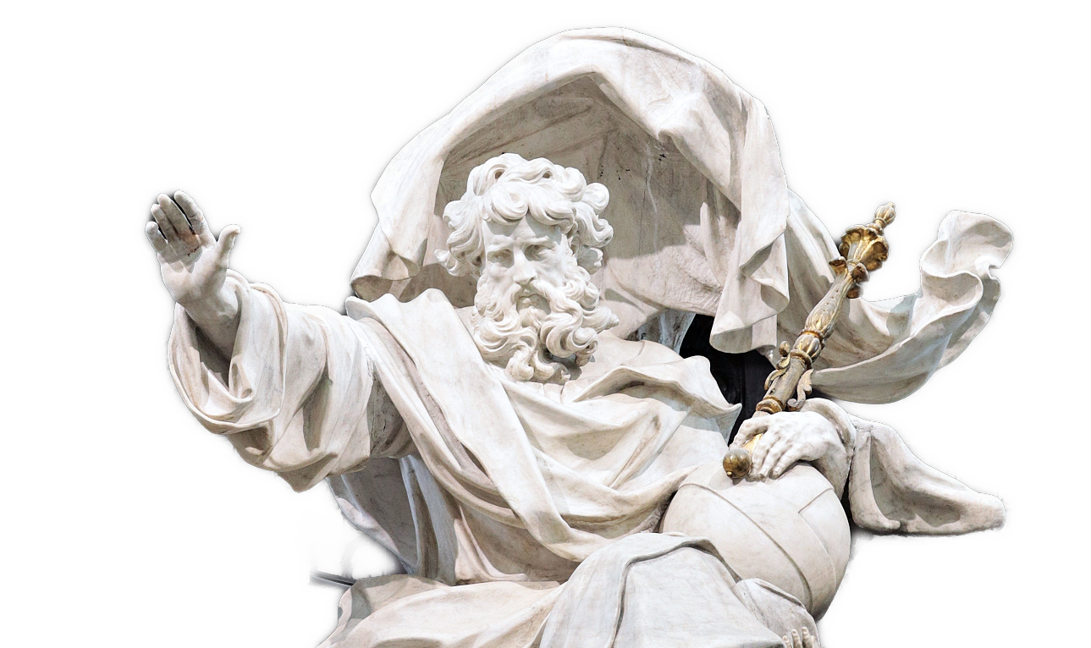
In Awe of The Creator
How can we both love and fear God … how can these emotions coexist?

Slide 10
Listen for how God interacts with the people of the earth.
Psalm 33:10-15 (NIV) The LORD foils the plans of the nations; he thwarts the purposes of the peoples. 11 But the plans of the LORD stand firm forever, the purposes of his heart through all generations. 12 Blessed is the nation whose God is the LORD, the people

Slide 11
Listen for how God interacts with the people of the earth.
he chose for his inheritance. 13 From heaven the LORD looks down and sees all mankind; 14 from his dwelling place he watches all who live on earth-- 15 he who forms the hearts of all, who considers everything they do.

Slide 12
Surrender to Jesus as Lord
What contrast was given between the plans and purposes of humankind and the plans and purposes of the Lord?
Why is it so hard to put God’s plans above our own? Why do you think we so easily rely on our own strength rather than trust in the Lord?

Slide 13
Surrender to Jesus as Lord
What truths about God make it easier for you to surrender to His plans?
What do you think our attitude toward our goals and plans reveals about our view of God?

Slide 14
Listen for how God watches over those who fear Him
Psalm 33:18-22 (NIV) But the eyes of the LORD are on those who fear him, on those whose hope is in his unfailing love, 19 to deliver them from death and keep them alive in famine.

Slide 15
Listen for how God watches over those who fear Him
We wait in hope for the LORD; he is our help and our shield. 21 In him our hearts rejoice, for we trust in his holy name. 22 May your unfailing love rest upon us, O LORD, even as we put our hope in you.

Slide 16
God Is Our Shield and Protector
How does the Lord treat those who trust in Him instead of in themselves?
Recall David’s description in Psalm 23
Keeps him from want Gives rest Provides water and food | Protects Goes with him through danger Gives healing

Slide 17
God Is Our Shield and Protector
What expectations does the Lord have of the actions to be taken by His people?
Verse 20 says “We wait in hope for the Lord” What do you think it means to “wait” on the Lord?
How can we learn better the practice of waiting on the Lord?

Slide 18
Application
Pray.
  Read through Psalm 33, making it your own prayer.
  Reflect on the greatness of God and confess any attitude that did not reflect an awe and holy fear of God.

Slide 19
Application
Memorize.
  Choose a verse about the fear of God and memorize it to continually remind yourself of your relationship with God and the benefits of a proper attitude toward Him.
  Here are two verses to consider:
    “The fear of the Lord is the beginning of knowledge” (Prov. 1:7).
    “Don’t be wise in your own eyes; fear the Lord and turn away from evil” (Prov. 3:7).

Slide 20
Application
Trust.
  Surrender your plans to God.
  Trust Him, in His great power and love, to lead you as He sees best.

Slide 21
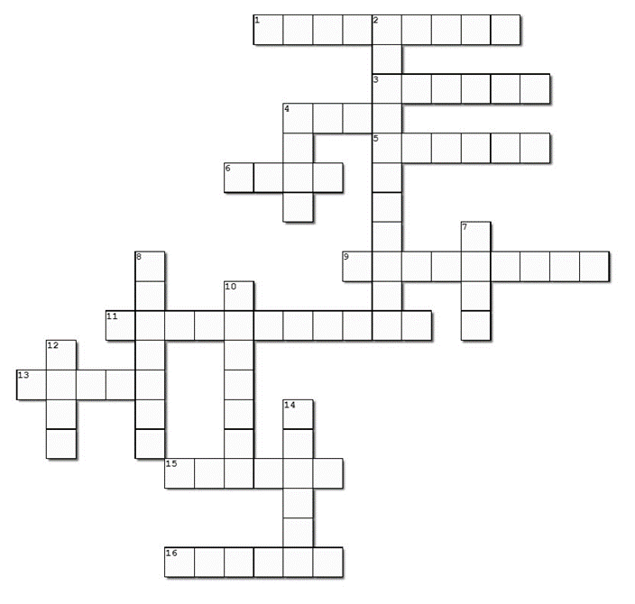

Family Activities
Well, here it is. And remember, the words are found in the Bible passage for today’s lesson. Oh, yes … help and other fun activities are at https://tinyurl.com/mvupr79x
So, I said, “When will we ever have the Crossword again?”

Slide 22
The Fear of God
December 4

