Slide 1
The Endurance of
Our Hope
June 28

Slide 2

Video Introduction
Watch Video

Slide 3
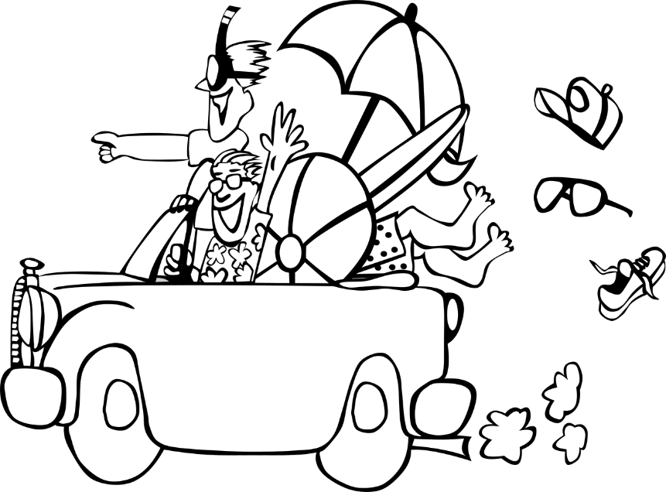


Be honest, now …
When has your endurance really been tested?
Our endurance is severely tested when problems persist for extended periods.
  Suffering can be physical, emotional, financial, or in many other ways.
  Today we consider how we can endure suffering because of our hope in Christ.
All of our employees are assisting other clients. …

Slide 4
Listen for how to treat others.
1 Peter 3:8-12 (NIV) Finally, all of you, live in harmony with one another; be sympathetic, love as brothers, be compassionate and humble. 9 Do not repay evil with evil or insult with insult, but with blessing, because to this you were called so that you may inherit a blessing. 10 For, "Whoever would love life

Slide 5
Listen for how to treat others.
and see good days must keep his tongue from evil and his lips from deceitful speech. 11 He must turn from evil and do good; he must seek peace and pursue it. 12 For the eyes of the Lord are on the righteous and his ears are attentive to their prayer, but the face of the Lord is against those who do evil."

Slide 6
Love and Bless
In what ways are believers to act toward one another?
Remember that musical harmony is when people sing different notes but still sound good together. How does this apply to our personal relationships?
How are believers to respond to those who intend evil toward them?

Slide 7
Love and Bless
What advice from the Old Testament did Peter give?
What motivation does this Old Testament passage give for living this way?
Why are these teachings difficult to live out?
What concrete actions can we use to promote harmony?

Slide 8
Listen for why to be encouraged.
1 Peter 3:13-14 (NIV) Who is going to harm you if you are eager to do good? 14 But even if you should suffer for what is right, you are blessed. "Do not fear what they fear; do not be frightened."

Slide 9
Hope in Suffering
What did Peter write about suffering for what is right?
In what ways have you seen people suffer as a result of their faith in Christ?
So, how could suffering for doing right be a blessing?

Slide 10
Hope in Suffering
Peter said, “do not fear what they fear.” What do you suppose “they” fear?
Why is it more important to do right than to fear these things?
When do sufferings and difficulties give us the opportunity to share our faith?

Slide 11
Listen for a challenge.
1 Peter 3:15-17 (NIV) 15 But in your hearts set apart Christ as Lord. Always be prepared to give an answer to everyone who asks you to give the reason for the hope that you have. But do this with gentleness and respect, 16 keeping a clear conscience,

Slide 12
Listen for a challenge.
so that those who speak maliciously against your good behavior in Christ may be ashamed of their slander. 17 It is better, if it is God's will, to suffer for doing good than for doing evil.

Slide 13
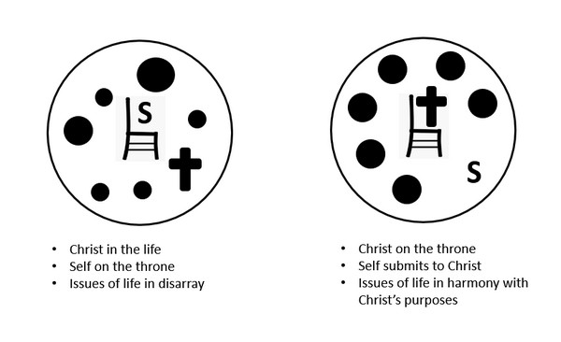
Giving an Answer
What is the meaning of “set apart Christ as Lord”?
Why is this a critical decision
for the believer?

Slide 14
Giving an Answer
Why do you think Peter thought it was important to be ready to be able to respond to inquirers about hope?
What relevance does this have for contemporary believers?
How do we begin to understand and to prepare to explain your hope in Christ?

Slide 15
Application
Surrender.
  Choose to see your life and circumstances from God’s perspective.
  Acknowledge the lordship of Christ and trust Him regardless of the actions of others.

Slide 16
Application
Bless.
  Think about someone who may have treated you like an enemy.
  Consider if you have treated another person like an enemy
  For either situation, seek to bless that person with love, compassion, and humility.

Slide 17
Application
Defend.
  Ask the Lord for opportunities to display and defend the hope that is in you.
  When the Lord opens that door, be ready to verbally testify of your hope in Christ.

Slide 18
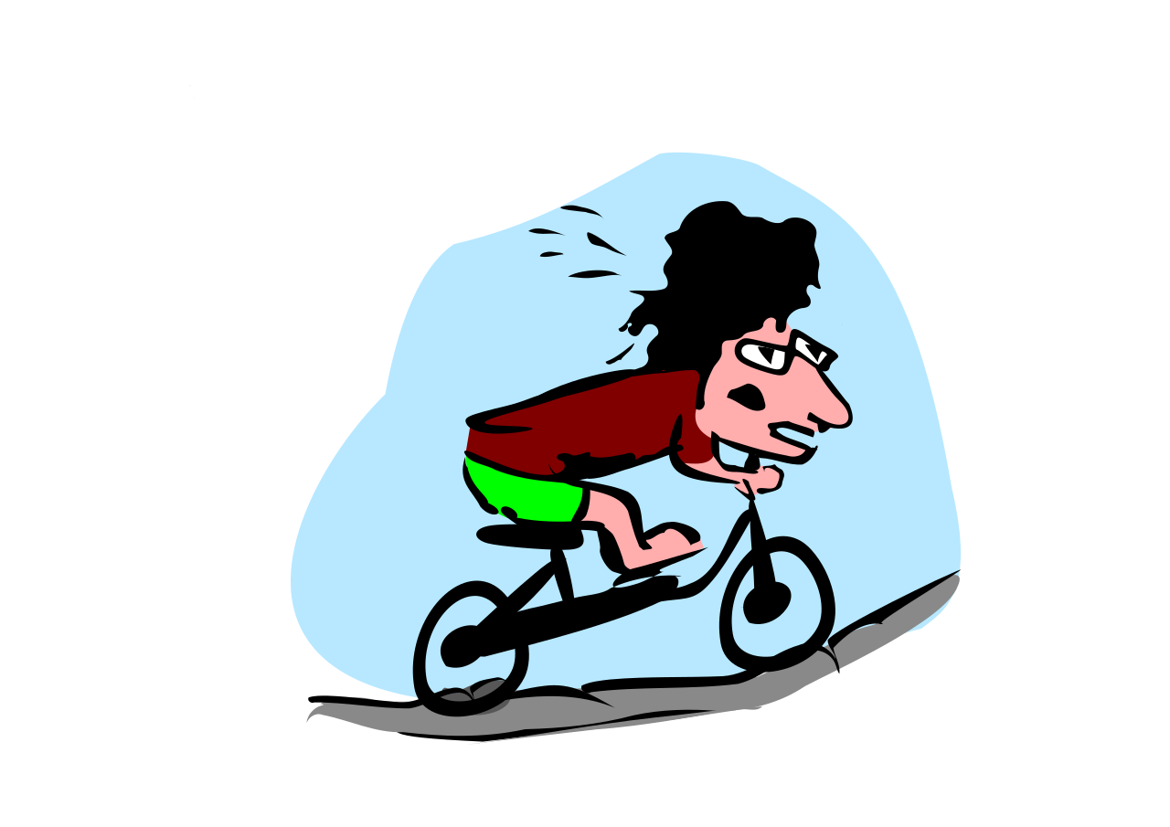
Family Activities
This endurance stuff is HARD! You can learn more about the Endurance of Our Hope with some fun Family Activities. Check out https://tinyurl.com/y8frzae4 .

Slide 19
The Endurance of
Our Hope
June 28

