Slide 1
The Death of Jesus
March 24

Slide 2

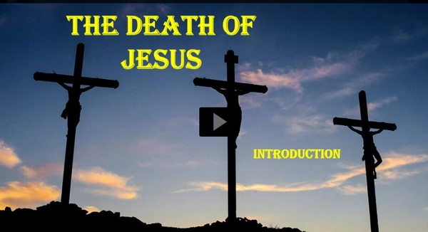
Video Introduction
View Video

Slide 3


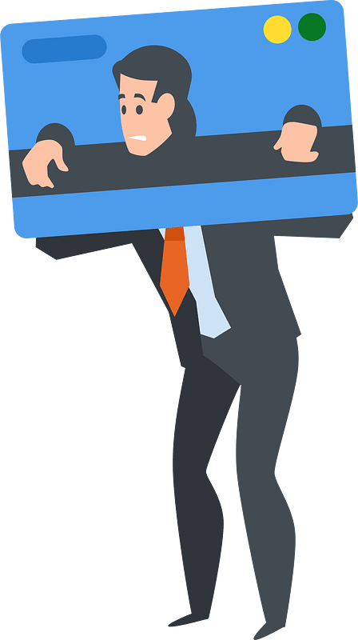
Seemed like a good idea …
What is a debt you have taken on that seemed worth it at the time?
One debt we all have but cannot pay … the judgment for our sinful condition.
  Jesus died to pay the debt of our sin.

Slide 4

Listen for a cast of characters.
Luke 23:32-34 (NIV) Two other men, both criminals, were also led out with him to be executed. 33 When they came to the place called the Skull, there they crucified him, along with the criminals--one on his right, the other on his left. 34 Jesus said, "Father, forgive them, for they do not know what they are doing." And they divided up his clothes by casting lots.

Slide 5
Forgiving Words from the Cross
Note the names used for the place of crucifixion.
  “The Skull”
  Calvary – which means “skull” --- and many of our Easter songs speak lovingly about “Calvary”
  Golgotha – also means “skull”

Slide 6
Forgiving Words from the Cross
What other people show up in this scene? What were they doing, saying?
How did Jesus respond to His abusers? What do Jesus’ words reveal about His character?
To whom do you think Jesus was offering forgiveness?
What kinds of things do you find easy to forgive?

Slide 7
Forgiving Words from the Cross
What kinds of things are more difficult to forgive?
How can Jesus’ love motivate us to be able to forgive people?
What kinds of words and phrases would you use to explain to a child or grandchild the meaning of God’s forgiveness?

Slide 8
Listen for who are saved.
Luke 23:35-43 (NIV) The people stood watching, and the rulers even sneered at him. They said, "He saved others; let him save himself if he is the Christ of God, the Chosen One." 36 The soldiers also came up and mocked him. They offered him wine vinegar 37 and said, "If you are the king of the Jews, save yourself."

Slide 9
Listen for who are saved.
There was a written notice above him, which read: THIS IS THE KING OF THE JEWS. 39 One of the criminals who hung there hurled insults at him: "Aren't you the Christ? Save yourself and us!" 40 But the other criminal rebuked him. "Don't you fear God," he said, "since you are under the same

Slide 10
Listen for who are saved.
sentence? 41 We are punished justly, for we are getting what our deeds deserve. But this man has done nothing wrong." 42 Then he said, "Jesus, remember me when you come into your kingdom." 43 Jesus answered him, "I tell you the truth, today you will be with me in paradise."

Slide 11
A Saving Word from the Cross
Who were the three groups who taunted Jesus on the cross and what did their taunts have in common?
Why did Jesus not save Himself from such a horrible and tragic death?
One of the two criminals defended Jesus. What was his defense? More importantly, what request did he make of Jesus?

Slide 12
A Saving Word from the Cross
Note the specifics of Jesus’ promise:
  The certainty of the promise I assure you
  The time of the promise Today
  The limit of the promise (singular) you
  (who have believed)
  The Person of the promise will be with me
  The place of the promise in paradise – heaven, a definite place

Slide 13
Listen for a final word.
Luke 23:44-49 (NIV) It was now about the sixth hour, and darkness came over the whole land until the ninth hour, 45 for the sun stopped shining. And the curtain of the temple was torn in two. 46 Jesus called out with a loud voice, "Father, into your hands I commit my spirit." When he had said this, he breathed his last. 47 The centurion, seeing

Slide 14
Listen for a final word.
what had happened, praised God and said, "Surely this was a righteous man." 48 When all the people who had gathered to witness this sight saw what took place, they beat their breasts and went away. 49 But all those who knew him, including the women who had followed him from Galilee, stood at a distance, watching these things.

Slide 15
A Final Word
What two phenomena did Luke identify as occurring as Jesus died?
What do you think was the significance of the darkness?
What about the veil in the temple being ripped in two … of what significance is this?

Slide 16
A Final Word
When has God done something dramatic that really got your attention?
Consider the reality of what God has accomplished …
  Overcome the problem of sin in the world
  Forgiveness of sins for all who receive Christ

Slide 17
A Final Word
The lives of all who were involved were changed
  Our lives are changed!
This Truth is powerful!
  It continues to change lives as we faithfully communicate it

Slide 18
Application
Commit to Memory.
  Memorize 1 Corinthians 1:18b : “It is the power of God to us who are being saved.”
  It reminds you of the great reversal that came as a result of the cross

Slide 19
Application
Commit to Prayer.
  Commit to pray daily this week for one person close to you who has not yet believed in the death and resurrection of Jesus.
  Pray specifically that God would open their eyes to the work of Jesus on his or her behalf.

Slide 20
Application
Commit to Study.
  What is one specific area of your life in which you are currently feeling anxious?
  Spend fifteen minutes journaling about how the cross of Christ ought to influence your confidence and actions in that situation.

Slide 21

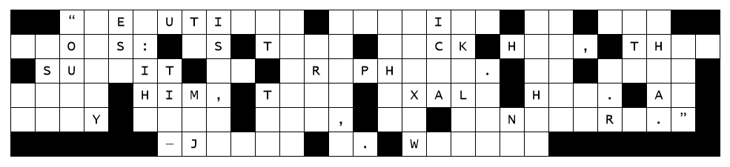
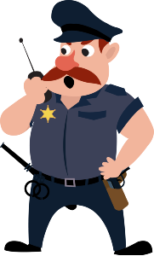
Family Activities
Uh-oh … another case of letters down. Call in the Bible Study group. They’re good at fixing these things. They can check for help at https://tinyurl.com/22u8ykzs

Slide 22
The Death of Jesus
March 24

