Slide 1
The Culmination of Our Hope
July 12

Slide 2
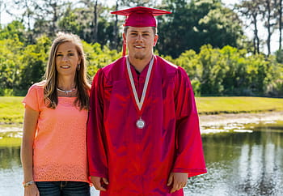
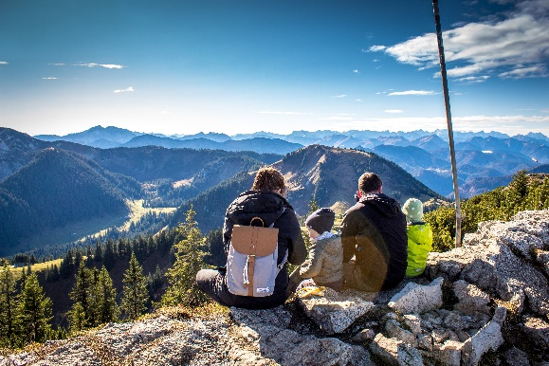
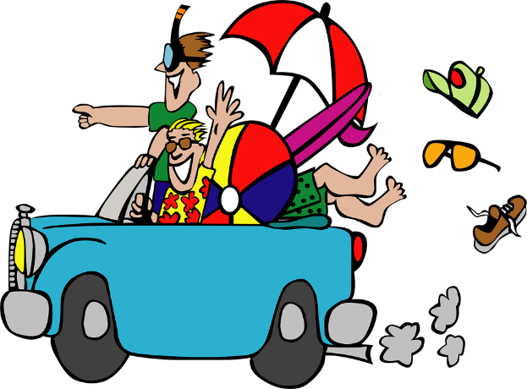
Think about it …
When has the destination been worth the journey?
When we begin a “journey” we hope it will be worth the effort.
  Some journeys are worth it, some might be a disappointment
  We can be assured that what we hope for in Christ will, indeed, be fully attained.

Slide 3
Listen for Peter’s instruction.
1 Peter 5:5b-7 (NIV) All of you, clothe yourselves with humility toward one another, because, "God opposes the proud but gives grace to the humble." 6 Humble yourselves, therefore, under God's mighty hand, that he may lift you up in due time. 7 Cast all your anxiety on him because he cares for you.

Slide 4
Humble Ourselves
What imperatives did Peter issued in these verses?
What do you think it means to “clothe yourselves with humility”?
So what reasons are given for living humbly?
What does it mean (and not mean) to “humble yourself”?
Humbling Yourself | Not Humbling Yourself

Slide 5
Humble Ourselves
What kinds of cares and anxieties do we have that we try to handle in our own pride?
Why can we trust God with those things that made us anxious?
What is the danger of trying to handle things on your own?
How do these attitudes and actions contribute to seeing our hope in Christ be attained?

Slide 6
Listen for warnings about Satan.
1 Peter 5:8-9 (NIV) Be self-controlled and alert. Your enemy the devil prowls around like a roaring lion looking for someone to devour. 9 Resist him, standing firm in the faith, because you know that your brothers throughout the world are undergoing the same kind of sufferings.

Slide 7
Remain Firm, Resist Satan
What is the responsibility of the believer in the face of opposition and suffering?
How would you describe the way the devil works in our culture?
By what means can believers resist the devil?

Slide 8
Remain Firm, Resist Satan
How can believers stay sober-minded and alert to the devil’s attacks?
What benefit comes from knowing other believers also are suffering for Christ?

Slide 9
Listen for God’s power at work.
1 Peter 5:10-11 (NIV) And the God of all grace, who called you to his eternal glory in Christ, after you have suffered a little while, will himself restore you and make you strong, firm and steadfast. 11 To him be the power for ever and ever. Amen.

Slide 10
God Restores
What quality of God does Peter identify that moved God to act?
From what perspective can it be said that suffering is only for a while?
What words or phrases describe how God would help His people during the season of affliction?

Slide 11
God Restores
Think of a difficulty or situation in which you suffered for Christ’s sake that as you now look back on it you clearly see the mighty hand of God was at work to make you stronger?
In addition to being a doxology, what declaration in verse 11 teaches us believers to have nothing to fear?

Slide 12
Application
Write.
  Review what this session—or the whole six-session study—has taught you about hope.
  Write down your understanding of hope and its impact on you.

Slide 13
Application
Pray.
  Write out 1 Peter 5:5b-11 and use it as a guide for praying.
  As you pray, surrender to the Lord and His eternal purposes for your life.

Slide 14
Application
Pray together.
  Gather with a few other believers and Pray together for the persecuted church.
  Helpful prayer lists can be found online.

Slide 15
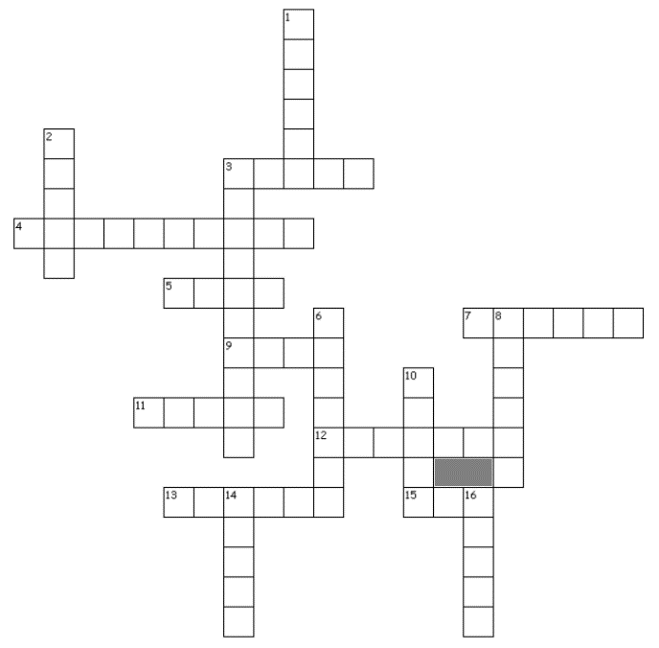
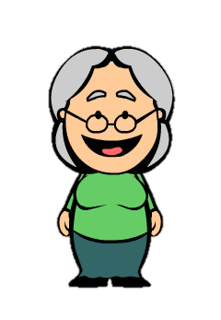
Family Activities
My HOPE to see the Crossword Puzzle has finally been CULMINATED after all these weeks. Find it at https://tinyurl.com/ybeboosg along with some other wonderful Family Activities

Slide 16
The Culmination of Our Hope
July 12

