Slide 1
The Benefits of Worship
February 9

Slide 2
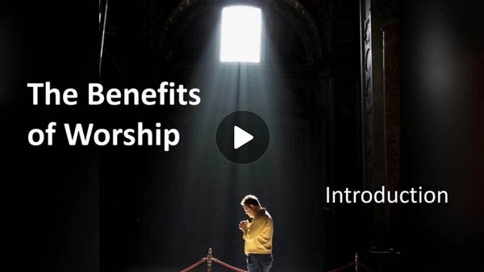
Video Introduction
View Video

Slide 3
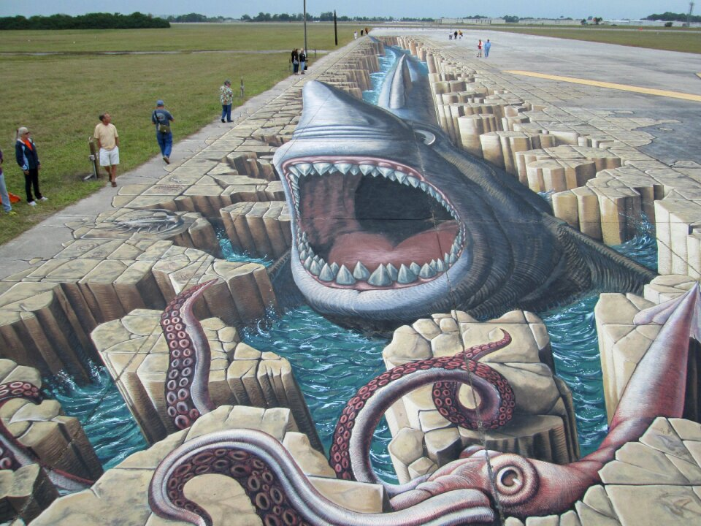
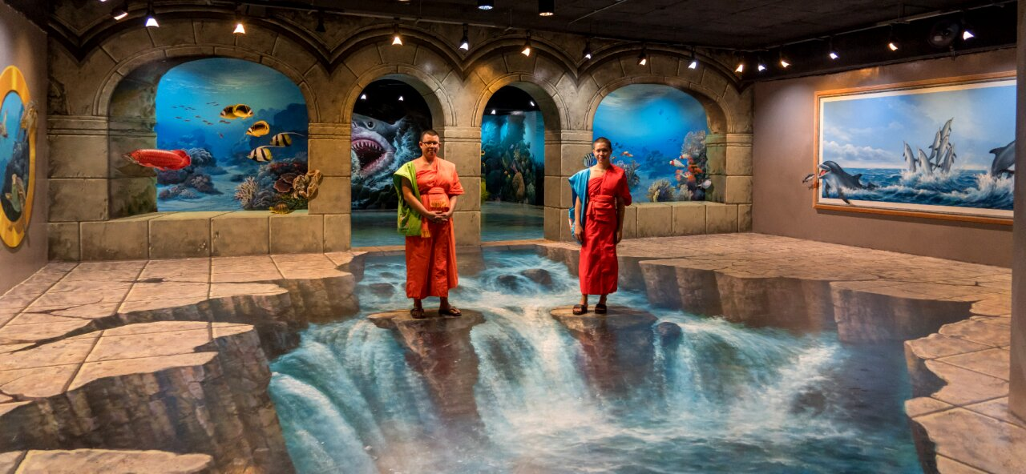
It’s Tricky
How can an optical illusion, such as 3d chalk art, been hard for you to see?
Consider your perspective when it comes to worship.
It depends on what … and more importantly … WHO you see.
We find all we need when we come to God in worship.

Slide 4
Listen for a satisfaction comparison.
Psalm 63:1-5 (NIV) O God, you are my God, earnestly I seek you; my soul thirsts for you, my body longs for you, in a dry and weary land where there is no water. 2 I have seen you in the sanctuary and beheld your power and your glory. 3 Because

Slide 5
Listen for a satisfaction comparison.
your love is better than life, my lips will glorify you. 4 I will praise you as long as I live, and in your name I will lift up my hands. 5 My soul will be satisfied as with the richest of foods; with singing lips my mouth will praise you.

Slide 6
Worship is Satisfying
David says, “Oh God, you are my God.” What do you think the phrase “you are my God” implies? Do you think the emphasis is on “you” or “my”?
What was he eagerly and earnestly desiring to do, and why was it important for him?

Slide 7
Worship is Satisfying
Upon what did he reflect that encouraged him to seek the Lord during his current predicament?
What commitment did he make?
David writes that he "earnestly seeks" God. What are some practical ways you can earnestly seek God? How is this different from a casual approach to faith?

Slide 8
Worship is Satisfying
Consider these resources for personal worship and praise.

Slide 9
Worship is Satisfying
When has God brought you out of a dry and desolate place?

Slide 10
Worship is Satisfying
David mentions experiencing God's power and glory in the sanctuary. How does corporate worship differ from private devotion in your experience? What unique value does each provide?
Private Devotion/Worship | Corporate or Group Worship

Slide 11
Listen for a reason to sing.
Psalm 63:6-8 (NIV) On my bed I remember you; I think of you through the watches of the night. 7 Because you are my help, I sing in the shadow of your wings. 8 My soul clings to you; your right hand upholds me.

Slide 12
Worship is Reassuring
In what situations might you find yourself praying in the middle of the night wondering what God will do?
What words and phrases describe the assurance that came over him during the time of personal worship?

Slide 13
Worship is Reassuring
David describes meditating on God during the night watches. What role does quiet reflection play in one’s spiritual life?
The image of being "in the shadow of your wings" appears in verse 7. What does this metaphor tell us about our relationship with God? How have you experienced God's protection?

Slide 14
Listen for a contrast in types of people.
Psalm 63:9-11 (NIV) They who seek my life will be destroyed; they will go down to the depths of the earth. 10 They will be given over to the sword and become food for jackals. 11 But the king will rejoice in God; all who swear by God's name will praise him, while the mouths of liars will be silenced.

Slide 15
Worship Instills Confidence
What is the contrasted fate of those who stand as enemies of God and those who are faithful to Him?
Those Faithful to God | Enemies of God

Slide 16
Worship Instills Confidence
David expresses confidence that his enemies will be defeated while he will rejoice. How do we balance praying for justice with Jesus' command to love our enemies?
The psalm ends with a focus on truth-telling and silencing lies. Why do you think truthfulness is connected to worship and relationship with God?

Slide 17
Worship Instills Confidence
The final verses show both judgment and rejoicing. How does this passage help us understand God's character as both just and merciful?

Slide 18
Application
The Starting Place.
Write your own “psalm” based on the outline of Psalm 63.
Begin with a statement about who God is to you and how much you need Him in your life.
Continue with a list of ways you want to praise Him.
Add a testimony of what God is doing in your life. Make your own statement of commitment to follow Him.
Finish it by declaring confidently how you expect God to move in your circumstances.

Slide 19
Application
The Growing Place.
Start a “psalm” prayer journal.
As you read through the psalms, look for ones whose structure would lend themselves to first-person application.

Slide 20
Application
The Sowing Place.
Share your observations about Psalm 63 with a friend or family member.
Give this person the context of what it means in your life right now.

Slide 21
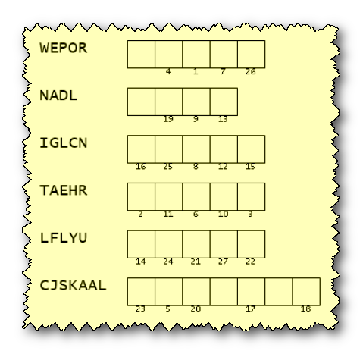
Family Activities
This is an important message from Christians on the island of Puqazam. You need to unscramble these words from Psalm 63 and use the numbers to decrypt the coded message. They hope you will experience meaningful worship today. They have smuggled out help, now posted at https://tinyurl.com/3s9cpsj7

Slide 22
The Benefits of Worship
February 9

