Slide 1
The Benefits of
Spiritual Disciplines
January 24

Slide 2


Video Introduction
View Video

Slide 3
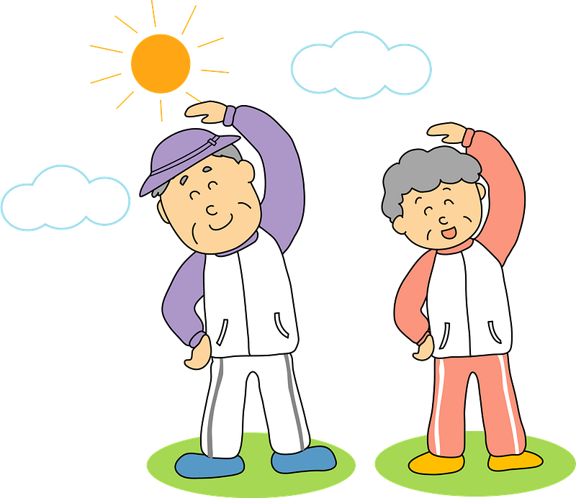
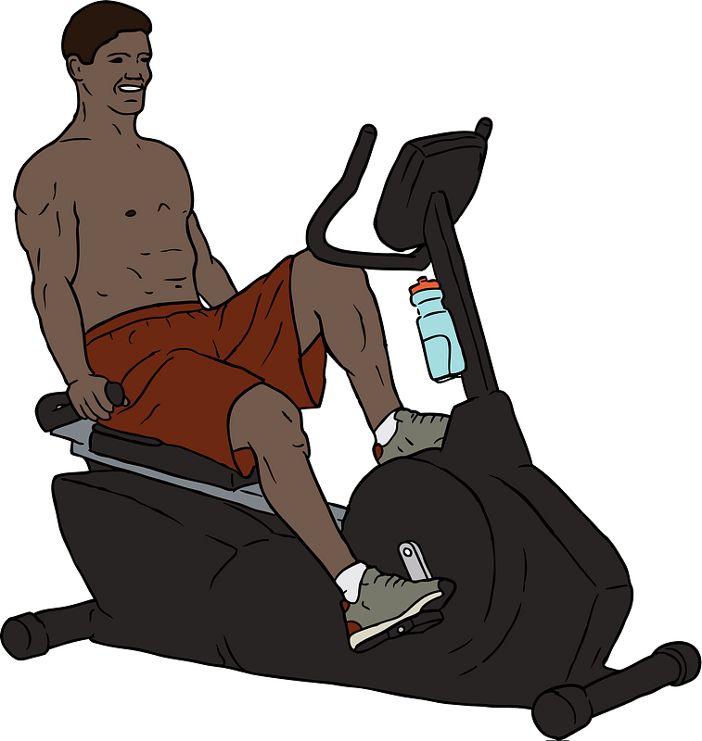
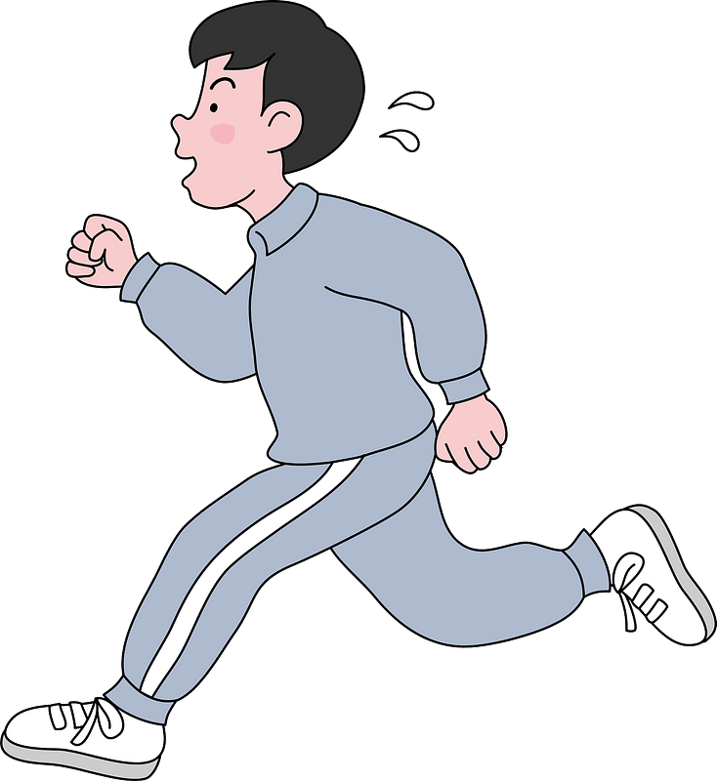

What do you think?
Why do you think there is such emphasis on physical fitness in our society?
Many of us do things to better our physical fitness.
  Growth in Christ occurs when we practice spiritual disciplines.

Slide 4
Listen for a prophecy we’ve seen fulfilled.
1 Timothy 4:1-3 (NIV) The Spirit clearly says that in later times some will abandon the faith and follow deceiving spirits and things taught by demons. 2 Such teachings come through hypocritical liars, whose consciences have been seared as with a hot iron.

Slide 5
Listen for a prophecy we’ve seen fulfilled.
They forbid people to marry and order them to abstain from certain foods, which God created to be received with thanksgiving by those who believe and who know the truth.

Slide 6
Good Things of God Distorted
What concern did Paul have about the latter times?
What are some reasons why people walk away from the church in today’s world?
What are some examples of good things that have been distorted or perverted by our culture?

Slide 7
Listen for spiritual nourishment.
1 Timothy 4:4-7a (NIV) For everything God created is good, and nothing is to be rejected if it is received with thanksgiving, 5 because it is consecrated by the word of God and prayer. 6 If you point these things out to the

Slide 8
Listen for spiritual nourishment.
brothers, you will be a good minister of Christ Jesus, brought up in the truths of the faith and of the good teaching that you have followed. 7 Have nothing to do with godless myths and old wives' tales;

Slide 9
Focus on, Lift up God’s Truth
What was Timothy supposed to do for spiritual nourishment?
How do you think God’s Word nourishes one’s spiritual life?
In deciding what to watch, read, and listen to, how do you determine what will nourish your soul and what might be spiritual junk food?

Slide 10
Focus on, Lift up God’s Truth
What effect might the irreverent and silly myths have on those who embraced them?
What passing fads have churches embraced, only to discover later that these were empty and even destructive?

Slide 11
Focus on, Lift up God’s Truth
Consider significant social and religious issues in our day to which the church often speaks.
  Abortion,
  Teen sexual abstinence,
  War,
  Prayer in schools,
  The Ten Commandments in public places

Slide 12



Focus on, Lift up God’s Truth
These issues are not irreverent and silly myths. Still, as important as these issues are, what might God place as a higher priority?

Slide 13
Listen for Paul’s priorities.
1 Timothy 4:7b-10 (NIV) rather, train yourself to be godly. 8 For physical training is of some value, but godliness has value for all things, holding promise for both the present life and the life to come. 9 This is a trustworthy saying that

Slide 14
Listen for Paul’s priorities.
deserves full acceptance 10 (and for this we labor and strive), that we have put our hope in the living God, who is the Savior of all men, and especially of those who believe.

Slide 15
Discipline and Train in Godliness
What appears to be Paul’s view about the value of physical exercise?
How does that analogy teach us about the value of spiritual exercise? What is the purpose of training ourselves in godliness?
In what positive action did Paul urge Timothy to engage?

Slide 16
Discipline and Train in Godliness
What would be some spiritual disciplines that believers might practice regularly?

Slide 17
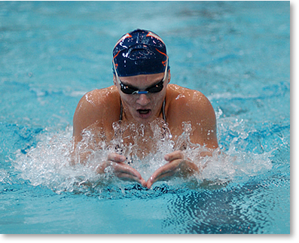
Discipline and Train in Godliness
Consider the practice schedule of a young lady (Mirjana Bosevska) preparing for Olympic swimming,
  5 1/2 hours a day in the pool,
  With extra time for weight training and
  Other strength-building exercises.
  Her training regime takes up much of her time,
⇨ Although we are not training for the Spiritual Olympics, we are engaged in spiritual warfare …
⇨ 5 minutes of Bible reading and a “Now I lay me down to sleep …” prayer don’t accomplish very much to empower us for spiritual battle

Slide 18

Discipline and Train in Godliness
So, what will be the benefits of spiritual training?

Slide 19
Application
Commit.
  Commit to prepare for and attend every session of this study on spiritual disciplines.

Slide 20
Application
Invest time.
  Add an additional thirty minutes each day to your quiet time for the next six weeks.
  Practice the spiritual disciplines covered in this study.

Slide 21
Application
Disciple.
  Develop a relationship with a new or young believer (of your same gender).
  Encourage his or her growth in Christ.

Slide 22


Family Activities
Don’t worry, there are clues for this crossword. Both the clues and the words come from today’s Bible passages. You can find other invigorating activities for the whole family at https://tinyurl.com/y3vel2zb . There’s even help for the crossword if you get out of breath ☺

Slide 23
The Benefits of
Spiritual Disciplines
January 24

