Slide 1
The Basis of Our Hope
June 7

Slide 2

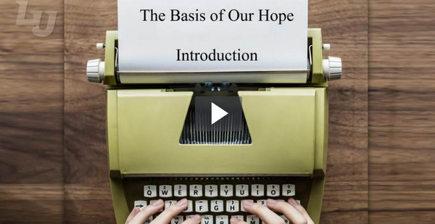
Introduction Video
View Video

Slide 3
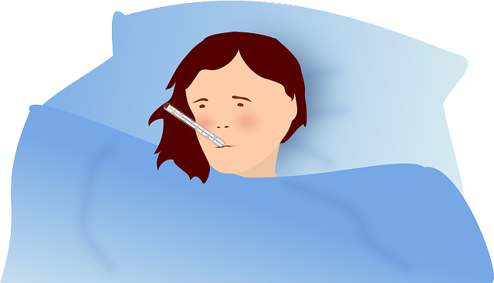
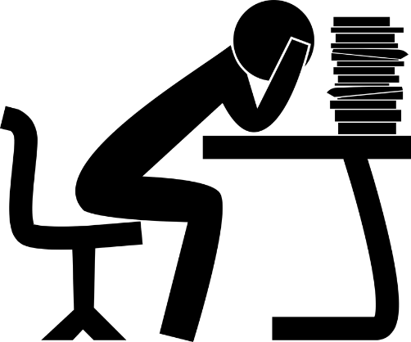

Remember the time?
When have you been glad you didn’t give up?
We hope we can finish …
  Hoping for good health, sufficient funds, the right connections.
  But only hope in Christ is sure and certain.

Slide 4
Listen for reasons to praise God.
1 Peter 1:1-3 (NIV) Peter, an apostle of Jesus Christ, To God's elect, strangers in the world, scattered throughout Pontus, Galatia, Cappadocia, Asia and Bithynia, 2 who have been chosen according to the foreknowledge of God the Father, through the sanctifying work of the Spirit,

Slide 5
Listen for reasons to praise God.
for obedience to Jesus Christ and sprinkling by his blood: Grace and peace be yours in abundance. 3 Praise be to the God and Father of our Lord Jesus Christ! In his great mercy he has given us new birth into a living hope through the resurrection of Jesus Christ from the dead,

Slide 6
Hope Based on Jesus’ Redemptive Work
To whom did Peter address his letter?
How had Peter’s readers been chosen?
According to Peter, what moved God to act on our behalf?
What became available to the believers through the Lord Jesus Christ?
What are some things people in our culture hope for?

Slide 7
Hope Based on Jesus’ Redemptive Work
On what do we base these kinds of hopefulness?
How does basing your hope on these kinds of things often disappoint?
Peter talks about a “living hope.” What do you think he meant by this phrase? How is it “living?”
How do we demonstrate this living hope on a day to day basis?

Slide 8
Listen for a promised inheritance.
1 Peter 1:4-5 (NIV) and into an inheritance that can never perish, spoil or fade--kept in heaven for you, 5 who through faith are shielded by God's power until the coming of the salvation that is ready to be revealed in the last time.

Slide 9
Hope Secure for Eternity
What are words and phrases that Peter uses to describe our spiritual inheritance?
On what basis can believers know they are secure?
What is the place of faith in our spiritual security?

Slide 10
Hope Secure for Eternity
Peter said that his readers would be protected or shielded by God’s power. If so why did they end up experiencing persecution?
You or someone you know have probably experienced suffering of one sort or another within the last year. What are practical ways believers can manage suffering?

Slide 11
Listen for hope, even though you suffer.
1 Peter 1:6-9 (NIV) In this you greatly rejoice, though now for a little while you may have had to suffer grief in all kinds of trials. 7 These have come so that your faith--of greater worth than gold, which perishes even though refined by fire--may be proved genuine and may result in praise,

Slide 12
Listen for hope, even though you suffer.
glory and honor when Jesus Christ is revealed. 8 Though you have not seen him, you love him; and even though you do not see him now, you believe in him and are filled with an inexpressible and glorious joy, 9 for you are receiving the goal of your faith, the salvation of your souls.

Slide 13
Hope Displayed through Faith
Peter talks of suffering grief in all kinds of trials . What kinds of trials do you imagine these folks had?
In what wrong ways can we react to these kinds and other troubles in our lives?
What reasons does Peter give that we have these experiences?

Slide 14
Hope Displayed through Faith
Notice the comments of verses 8 and 9 … list the contrasts
How would clinging to this promise and perspective influence your outlook on daily living and your hope?
Even though … | Still …

Slide 15
Application
Recognize.
  Admit to God the areas where you’re losing hope.
  Confess any sin and ask Him to open your eyes to the reality of living hope in Christ.

Slide 16
Application
Remember.
  Read through 1 Peter 1:1‑9 again and make a list of how Peter described those who follow and trust in Christ.
  Place this list in a prominent place to remind you of who you are in Christ.

Slide 17
Application
Restore.
  Is there someone the Lord has brought to your mind who is losing hope?
  Take time to meet or call them this week and share the truths the Lord has shown you in this study.

Slide 18

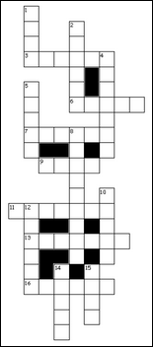
Family Activities
Well, pshaw! There is HOPE … you are not clueless on this crossword puzzle. However, you can give up hope about ignoring that book report my sister demands. Pshaw, just put it off while you check out the family activities at https://tinyurl.com/y8ws97ue

Slide 19
The Basis of Our Hope
June 7

