Slide 1
Sure of the Truth
September 19

Slide 2
Video Introduction
View Video

Slide 3
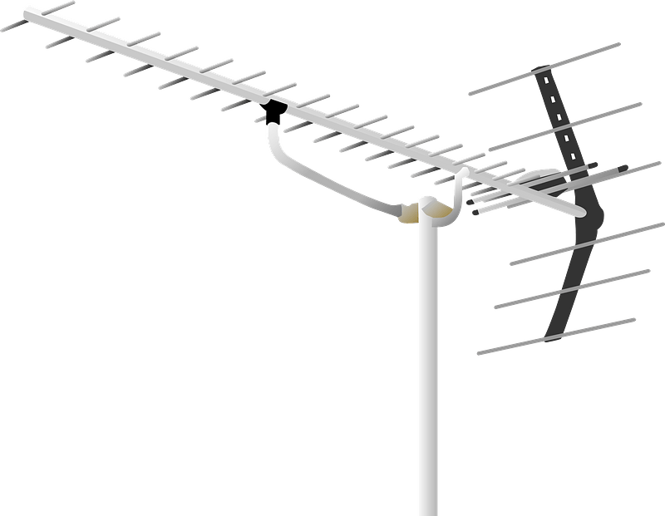
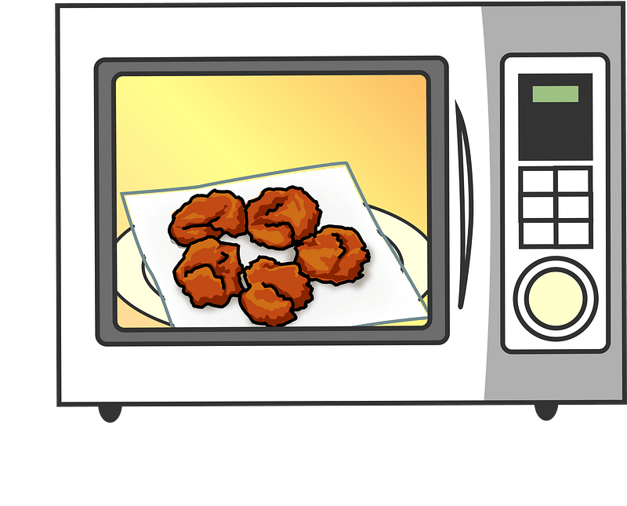
Remember that claim?
What is something you read on the internet that turned out not to be true?
Now days there is much confusion about what is true.
Today we will study John’s comments on Truth
We will conclude that Truth is found in Jesus alone.
Free TV with this Antenna $19.99
Alive and on life support in Hawaii
Microwave Ovens Are Killing Us

Slide 4
Listen for a warning.
1 John 2:18-21 (NIV) Dear children, this is the last hour; and as you have heard that the antichrist is coming, even now many antichrists have come. This is how we know it is the last hour. 19 They went out from us, but they did not really belong to us. For if they had belonged to us, they would have remained with us;

Slide 5
Listen for a warning.
but their going showed that none of them belonged to us. 20 But you have an anointing from the Holy One, and all of you know the truth. 21 I do not write to you because you do not know the truth, but because you do know it and because no lie comes from the truth.

Slide 6
Anchored in the Faith
What might John mean by the phrase “It is the last time” or “last hour”?
What makes you think that we are living in the last hour today?
By what term did he identify those who opposed Christ and His church?
What antichrists are among us today?

Slide 7
Anchored in the Faith
What conclusion did John draw about those who voluntarily withdrew from the fellowship of believers?
What did John’s readers have that made them different from those who left.

Slide 8
Anchored in the Faith
View Video

Slide 9
Anchored in the Faith
Let’s review the ways …
Add to scripture with other books, writings, so called “new truth”
Subtract from deity of Christ … only a man, just a good teacher, just a prophet
Multiply requirement of good works to earn salvation
Divide factions amongst believers

Slide 10
Listen for where Truth is grounded.
1 John 2:22-26 (NIV) Who is the liar? It is the man who denies that Jesus is the Christ. Such a man is the antichrist--he denies the Father and the Son. 23 No one who denies the Son has the Father; whoever acknowledges the Son has the Father also. 24 See that what you have heard

Slide 11
Listen for where Truth is grounded.
from the beginning remains in you. If it does, you also will remain in the Son and in the Father. 25 And this is what he promised us--even eternal life. 26 I am writing these things to you about those who are trying to lead you astray.

Slide 12
Grounded in Who Jesus Is
Who did John say was a liar? What made one antichrist?
What made one an antichrist? What are the attributes of such a person.
Why are some truths about Jesus that for some folks are difficult to grasp or believe?

Slide 13
Grounded in Who Jesus Is
What truths do we, as believers, know about Christ?
How would you define “eternal life”?
So “eternal death” would be separation from God throughout eternity.

Slide 14
Listen for where Truth leads.
1 John 2:27-29 (NIV) As for you, the anointing you received from him remains in you, and you do not need anyone to teach you. But as his anointing teaches you about all things and as that anointing is real, not counterfeit--just as it has taught you, remain in him.

Slide 15
Listen for where Truth leads.
And now, dear children, continue in him, so that when he appears we may be confident and unashamed before him at his coming. 29 If you know that he is righteous, you know that everyone who does what is right has been born of him.

Slide 16
Truth Leads to Righteous Living
On what can believers rely when facing those who would deceive them and lead them away from the truth concerning Jesus?
How can believers anticipate Christ’s return with a sense of confidence?
What proof can true believers produce to affirm that they have been born of God?

Slide 17
Truth Leads to Righteous Living
How does the Holy Spirit help us discern truth?
How can we remain in or have fellowship with Jesus Christ?

Slide 18
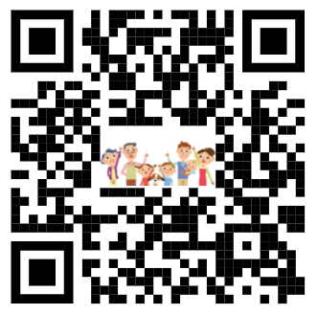
Family Discussion Time Video

Slide 19
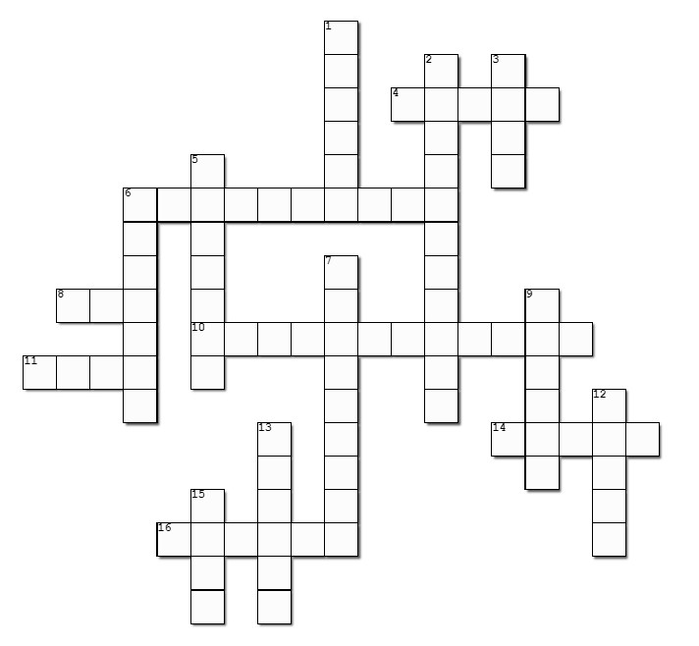
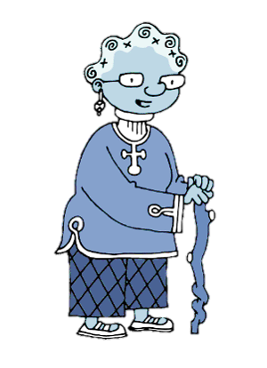
Family Activities
Well, it’s about time to see that lovely crossword puzzle again! But, if you want the cryptogram, you can go to https://tinyurl.com/z4r5r3zv There’s some other really great activities, also.

Slide 20
Sure of the Truth
September 19

