Slide 1
Sure of a Relationship
Sept. 12

Slide 2
Video Introduction
View Video

Slide 3
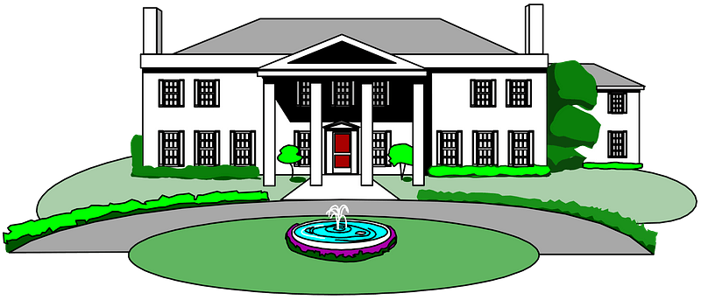
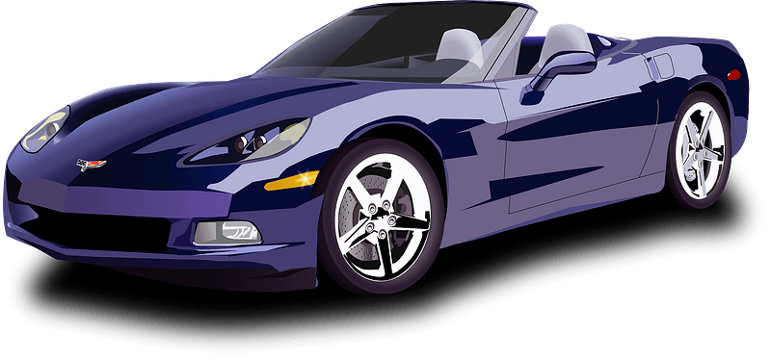
Wonder why …
Why do you think the drive to acquire more “stuff” motivates so many people in our culture?
Today we will study what John says about loving God.
We will see that how we live reflects the reality about our relationship with God.

Slide 4
Listen for the word “know” in this passage.
1 John 2:3-6 (NIV) We know that we have come to know him if we obey his commands. 4 The man who says, "I know him," but does not do what he commands is a liar, and the truth is not in him.

Slide 5
Listen for the word “know” in this passage.
But if anyone obeys his word, God's love is truly made complete in him. This is how we know we are in him: 6 Whoever claims to live in him must walk as Jesus did.

Slide 6
Walk in Obedience
What does this passage say about someone who truly knows God?
What do you think John meant by the phrase, "the truth is not in him"?
How do we get the Truth "in us"?

Slide 7
Walk in Obedience
What does it mean to say that the love of God is perfected in the one who obeys Him?
What do you find challenging about walking in Jesus’ footsteps?”
What should “walking like Jesus” look like?

Slide 8
Listen for something both old and new.
1 John 2:7-11 (NIV) Dear friends, I am not writing you a new command but an old one, which you have had since the beginning. This old command is the message you have heard. 8 Yet I am writing you a new command; its truth is seen in him and you, because the darkness is passing and the true light is already shining. 9 Anyone who claims to be

Slide 9
Listen for something both old and new.
to be in the light but hates his brother is still in the darkness. 10 Whoever loves his brother lives in the light, and there is nothing in him to make him stumble. 11 But whoever hates his brother is in the darkness and walks around in the darkness; he does not know where he is going, because the darkness has blinded him.

Slide 10
Walk in the Light
How did John contrast love and hate?
What is the old/new commandment John writes about? How can it be both?
How does our culture get “love” wrong?
Love | Hate

Slide 11
Walk in the Light
What imagery did John use to describe those who are able to obey the commandment to love?
Why is no occasion of stumbling present in the person who loves his brother or sister?

Slide 12
Listen for how to walk in the will of God.
1 John 2:15-17 (NIV) Do not love the world or anything in the world. If anyone loves the world, the love of the Father is not in him. 16 For everything in the world--the cravings of sinful man, the lust of his eyes and the boasting of what

Slide 13
Listen for how to walk in the will of God.
he has and does--comes not from the Father but from the world. 17 The world and its desires pass away, but the man who does the will of God lives forever.

Slide 14
Walk According to God’s Will
What prohibition does John give to his readers?
What does love for the world indicate about a person’s love for God?
What were three means of temptation that John cautioned his readers to avoid?

Slide 15
Walk According to God’s Will
How do we demonstrate that we love the world and the things in it?
What can we expect if we choose the way of the world?
What do we enjoy by choosing the way of God?

Slide 16
Application
Examine your life.
Consider the fruit of the Spirit listed in Galatians 5:22-23.
If, after examining your life, you feel as though you have fallen short in manifesting a true Christian’s character, then repent and trust in Christ now.

Slide 17
Application
Align your life.
Perhaps through this study, you have been assured of your relationship with God.
However, you also realize there are a few things in your life that need to be re-aligned under God’s will.
If so, begin making those changes this week. It might be something as simple as waking up earlier so you can spend quality time with God.

Slide 18
Application
Make a difference in someone else’s life.
Be intentional this week to share about your relationship with Christ.
Look for opportunities to serve someone, and when you see it, don’t hesitate.
Serving others gives a great opportunity for sharing the gospel.

Slide 19
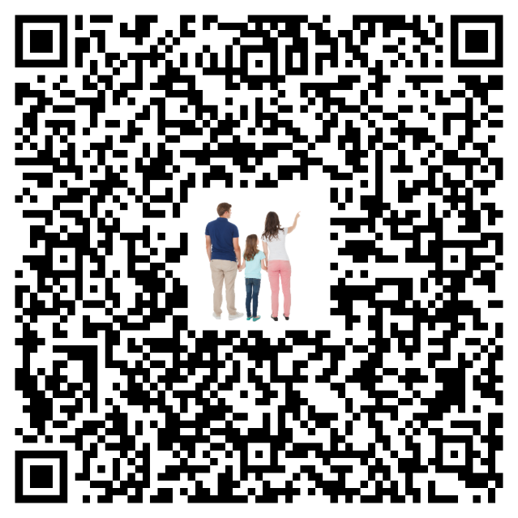
Family Discussion Time
What do you think?

Slide 20
Family Activities
They’ve jumped off the edge of my lilly pad of knowledge. You’ll have to straighten out the letters to make sense of them. That will help you solve the quote. If you hop too far, go to https://tinyurl.com/tjj9n7sw for help.

Slide 21
Sure of a Relationship
Sept. 12

