Slide 1
Sure of Victory
Sept. 26

Slide 2

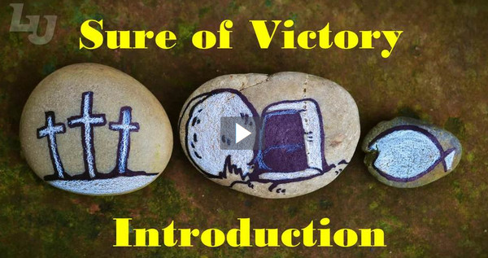
Video Introduction
View Video

Slide 3
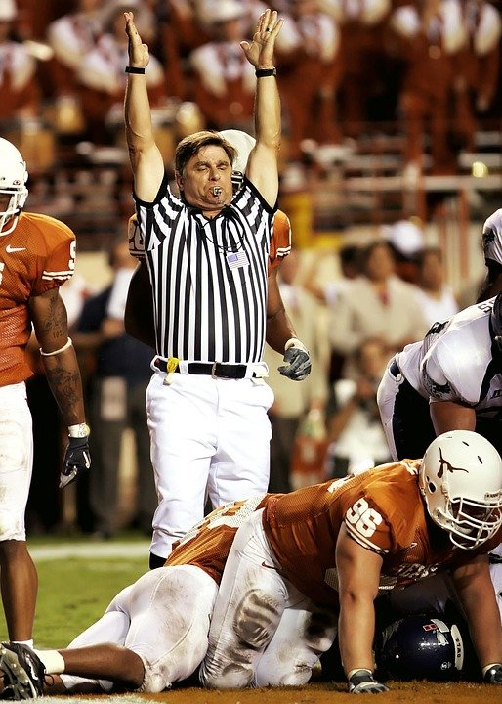
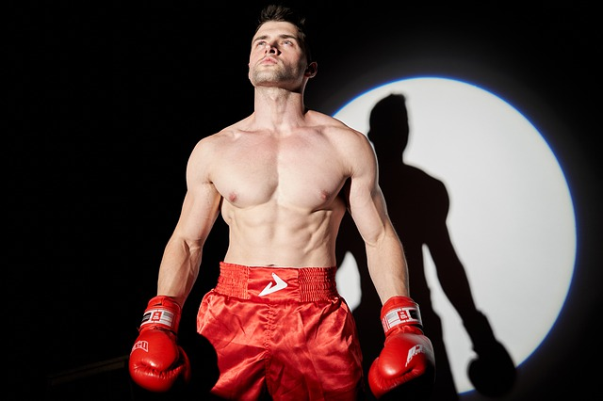
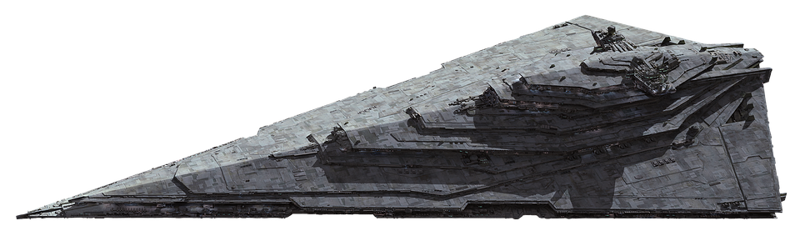
Remember that time?
What is your favorite comeback story?
Today we will look at spiritual victory
  Because Jesus has won the victory over sin, Satan, and death, His people are victorious.
ROCKY

Slide 4
Listen for assurance.
1 John 3:19-22 (NIV) This then is how we know that we belong to the truth, and how we set our hearts at rest in his presence 20 whenever our hearts condemn us. For God is greater than our hearts, and he knows everything.

Slide 5
Listen for assurance.
21 Dear friends, if our hearts do not condemn us, we have confidence before God 22 and receive from him anything we ask, because we obey his commands and do what pleases him.

Slide 6
Victory over Doubt
What does this passage say about how believers can be assured they are right with God, even if they doubt or don’t feel right?
Why is conscience not always a good gauge of one’s relationship with God?

Slide 7
Victory over Doubt
Why would our hearts need reassurance?
According to this passage, what will be the results of obedience to God and doing what pleases Him?

Slide 8
Listen for Jesus’ command.
1 John 3:23-24 (NIV) And this is his command: to believe in the name of his Son, Jesus Christ, and to love one another as he commanded us. 24 Those who obey his commands live in him, and he in them. And this is how we know that he lives in us: We know it by the Spirit he gave us.

Slide 9
Remaining in Jesus
What is the two-pronged commandment John states in verse 23?
What does it mean to “believe in the name of Jesus Christ”?
How is it possible to keep these and any other commandment of God?

Slide 10
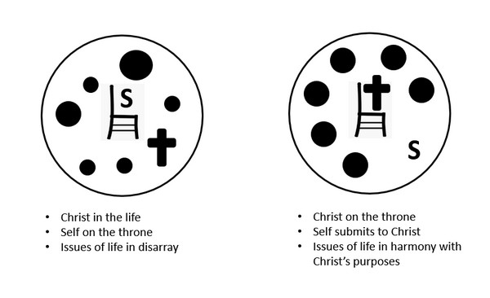
Remaining in Jesus
This diagram illustrates how God dwells in the life of the believer in the person of the Holy Spirit. How do we dwell/live in Him as it also says in verse 24?

Slide 11
Listen for who is conqueror.
1 John 4:1-4 (NIV) Dear friends, do not believe every spirit, but test the spirits to see whether they are from God, because many false prophets have gone out into the world. 2 This is how you can recognize the Spirit of God: Every spirit that acknowledges that Jesus Christ has come in the flesh is from God,

Slide 12
Listen for who is conqueror.
but every spirit that does not acknowledge Jesus is not from God. This is the spirit of the antichrist, which you have heard is coming and even now is already in the world. 4 You, dear children, are from God and have overcome them, because the one who is in you is greater than the one who is in the world.

Slide 13
Victory in Jesus
What did John instruct his readers to do?
John goes on to warn about false prophets in the world. Considering this warning along with previous studies on spirits, what do you think He means by the phrase “test the spirits”?
How can we distinguish truth from error in spiritual matters? How do we “test the spirits”?

Slide 14
Victory in Jesus
According to this passage, what is the so called “litmus test” to recognize the Spirit of God?
List some present day examples of groups who spread false teachings regarding the full humanity and full divinity of Jesus.

Slide 15

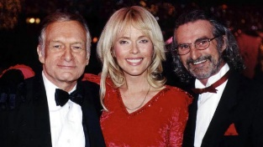
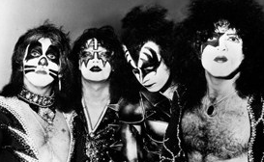

Victory in Jesus
Common characteristics of cults – false spirits … signified by math symbols:
What spirits should we be testing today? What false prophets are in the world today?

Slide 16
Application
Examine your life.
Do you struggle with doubt? If so, answer these two questions:
  Do you believe the truth of Christ as taught in the Scriptures?
  Do you love other brothers and sisters in Christ?
If you answered yes to both, then you have no reason to doubt. Christ remains in those who remain in Him.

Slide 17
Application
Align your life.
  Make sure you are practicing the spiritual disciplines regularly.
  Practice such things as prayer, Bible study, Scripture memory, fasting, journaling, and serving.
  Each of these disciplines will help you walk with Christ.

Slide 18
Application
Make a difference in someone’s life.
Do you know someone in doubt?
Take time this week to walk them through 1 John.
Ask them questions such as:
  Do you desire to have fellowship with God?
  Are you sensitive to sin in your life?
  Do you believe what the Bible teaches about Christ?
  Do you have hatred in your heart toward others?

Slide 19

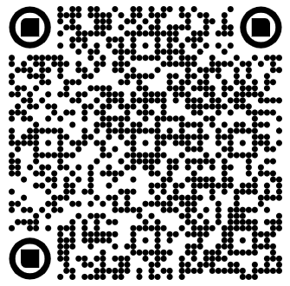
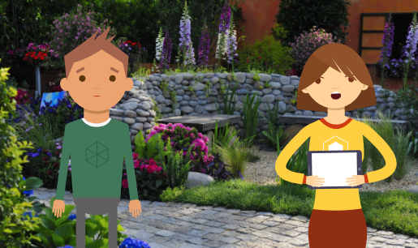
Family Discussion Time Video

Slide 20
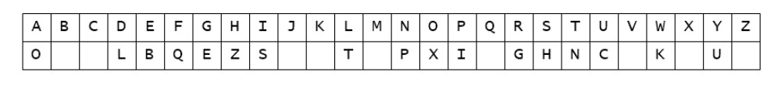
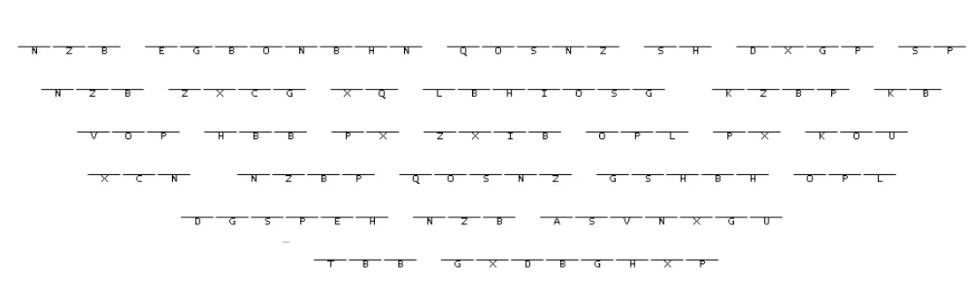

Family Activities
We can do this! How about also downloading the color page at https://tinyurl.com/u5ax65pm

Slide 21
Sure of Victory
Sept. 26

